Slide 1


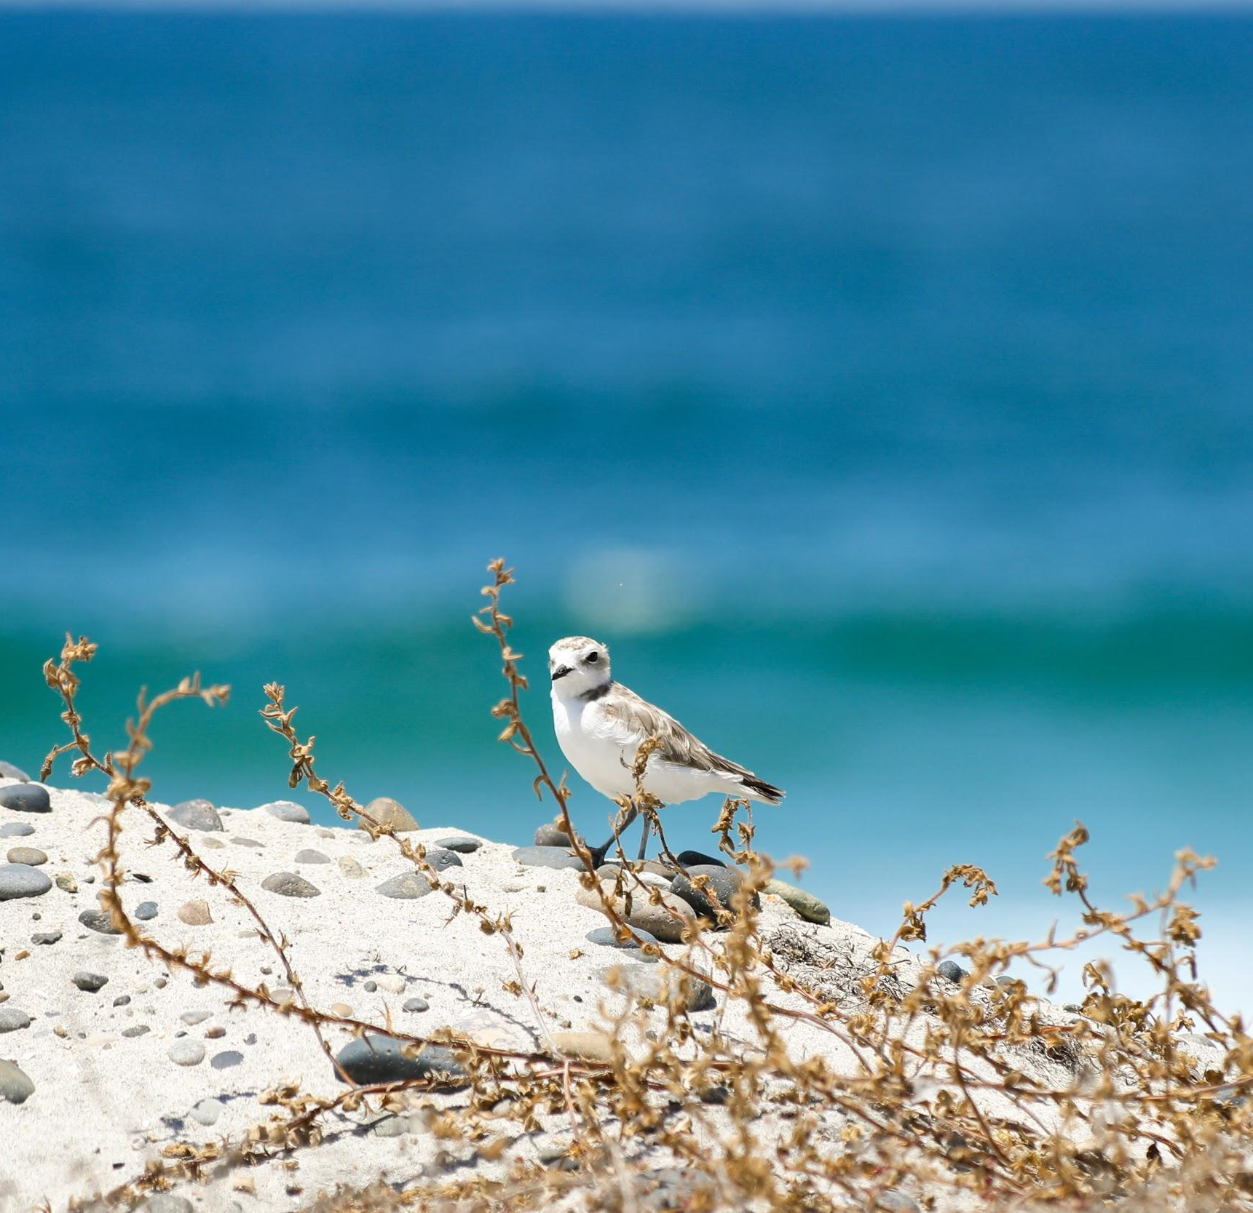
Who Digs the Dunes?
Marine Protected Areas
Special Dune Habitat
Tides
Be an Ambassador
Notes:
Photo credit: Tanner Olthoff

Slide 2
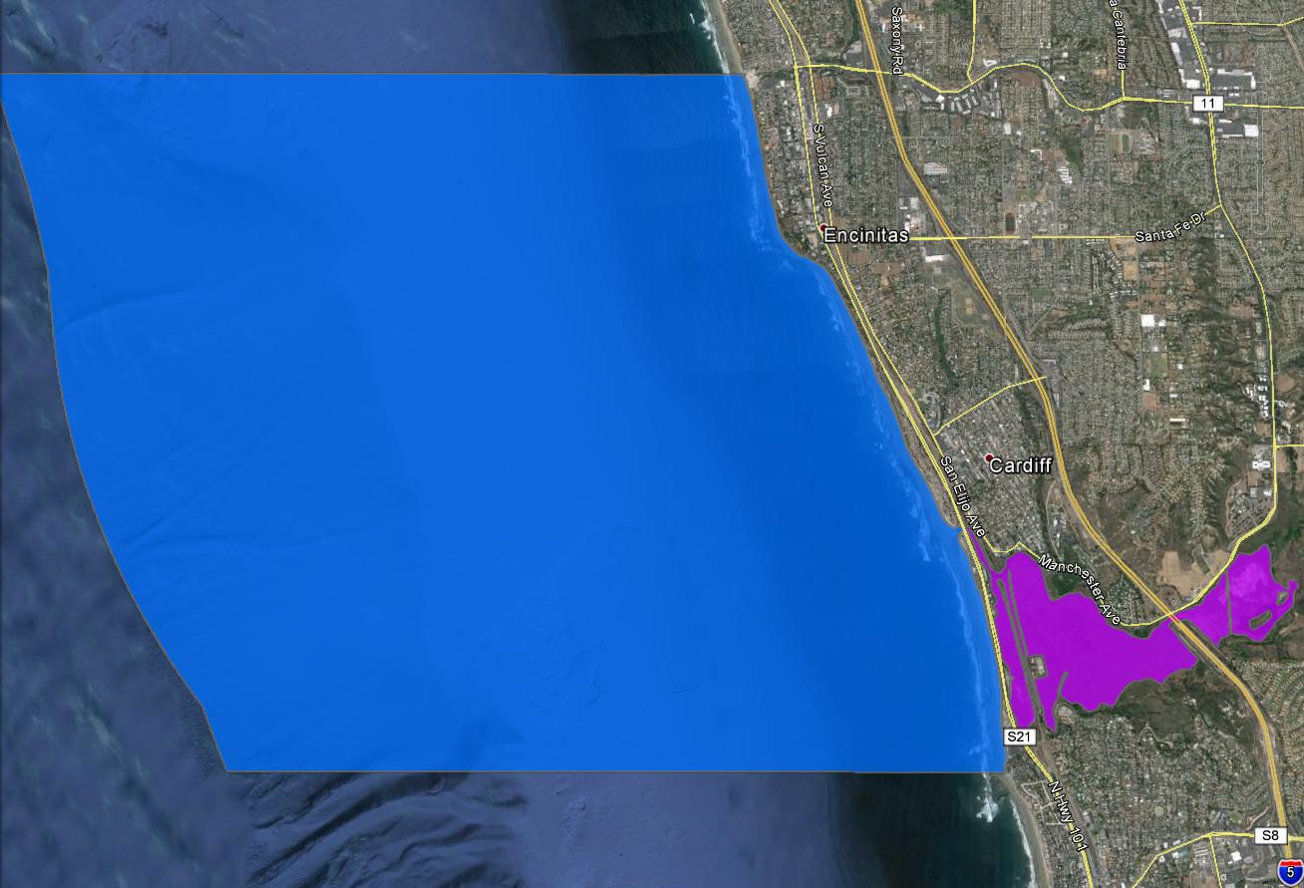
Swami’s State Marine Conservation Area (SMCA)
Notes:
Permitted/Prohibited Uses: Take of all living marine resources is prohibited except:
Recreational take by hook-and-line from shore is allowed.
no take of lobster, mention success story above and the importance of having this area protected. Calico bass, halibut ADD PHOTOS?
The recreational take by spearfishing of white seabass and pelagic finfish is allowed.
Take pursuant to the authorized activities listed below is allowed.
Pelagic finfish (CCR Title 14, Section 632(a)(3)), as defined for purposes of MPA regulations, are a subset of finfish defined as: northern anchovy (Engraulis mordax), barracudas (Sphyraena spp.), billfishes* (family Istiophoridae), dolphinfish (Coryphaena hippurus), Pacific herring (Clupea pallasii), jack mackerel (Trachurus symmetricus), Pacific mackerel (Scomber japonicus), salmon (Oncorhynchus spp.), Pacific sardine (Sardinops sagax), blue shark (Prionace glauca), salmon shark (Lamna ditropis), shortfin mako shark (Isurus oxyrinchus), thresher sharks (Alopias spp.), swordfish (Xiphias gladius), tunas (family Scombridae), including Pacific bonito (Sarda chiliensis), and yellowtail (Seriola lalandi). *Marlin is not allowed for commercial take.

Slide 3
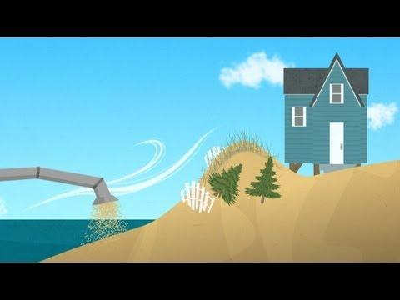

Slide 4
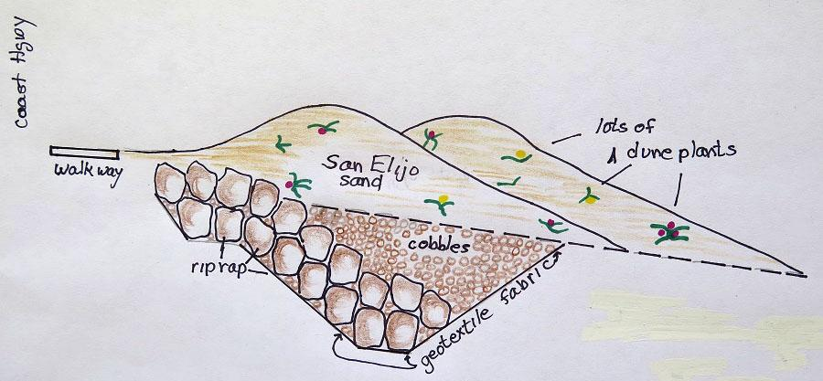
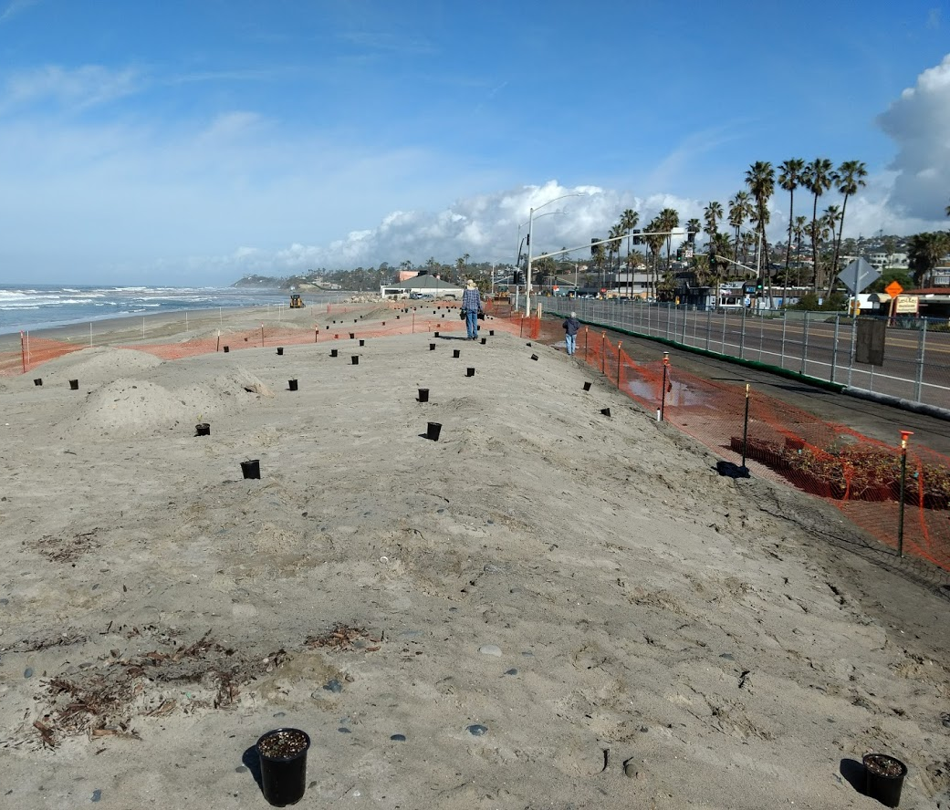
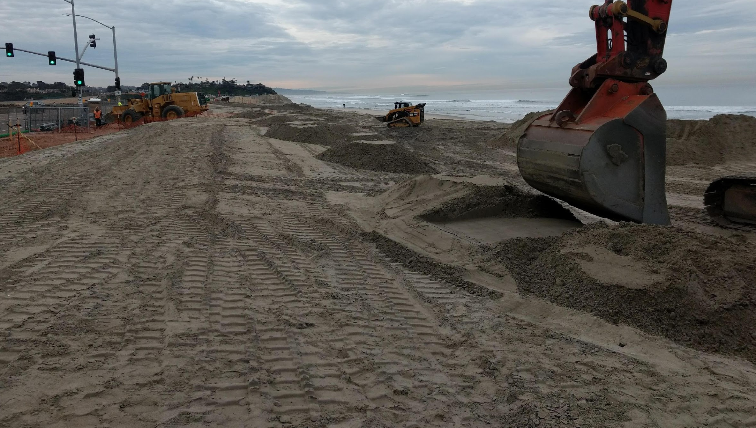
Dune Restoration
Notes:
*Mention partnership with City of Encinitas*

Slide 5
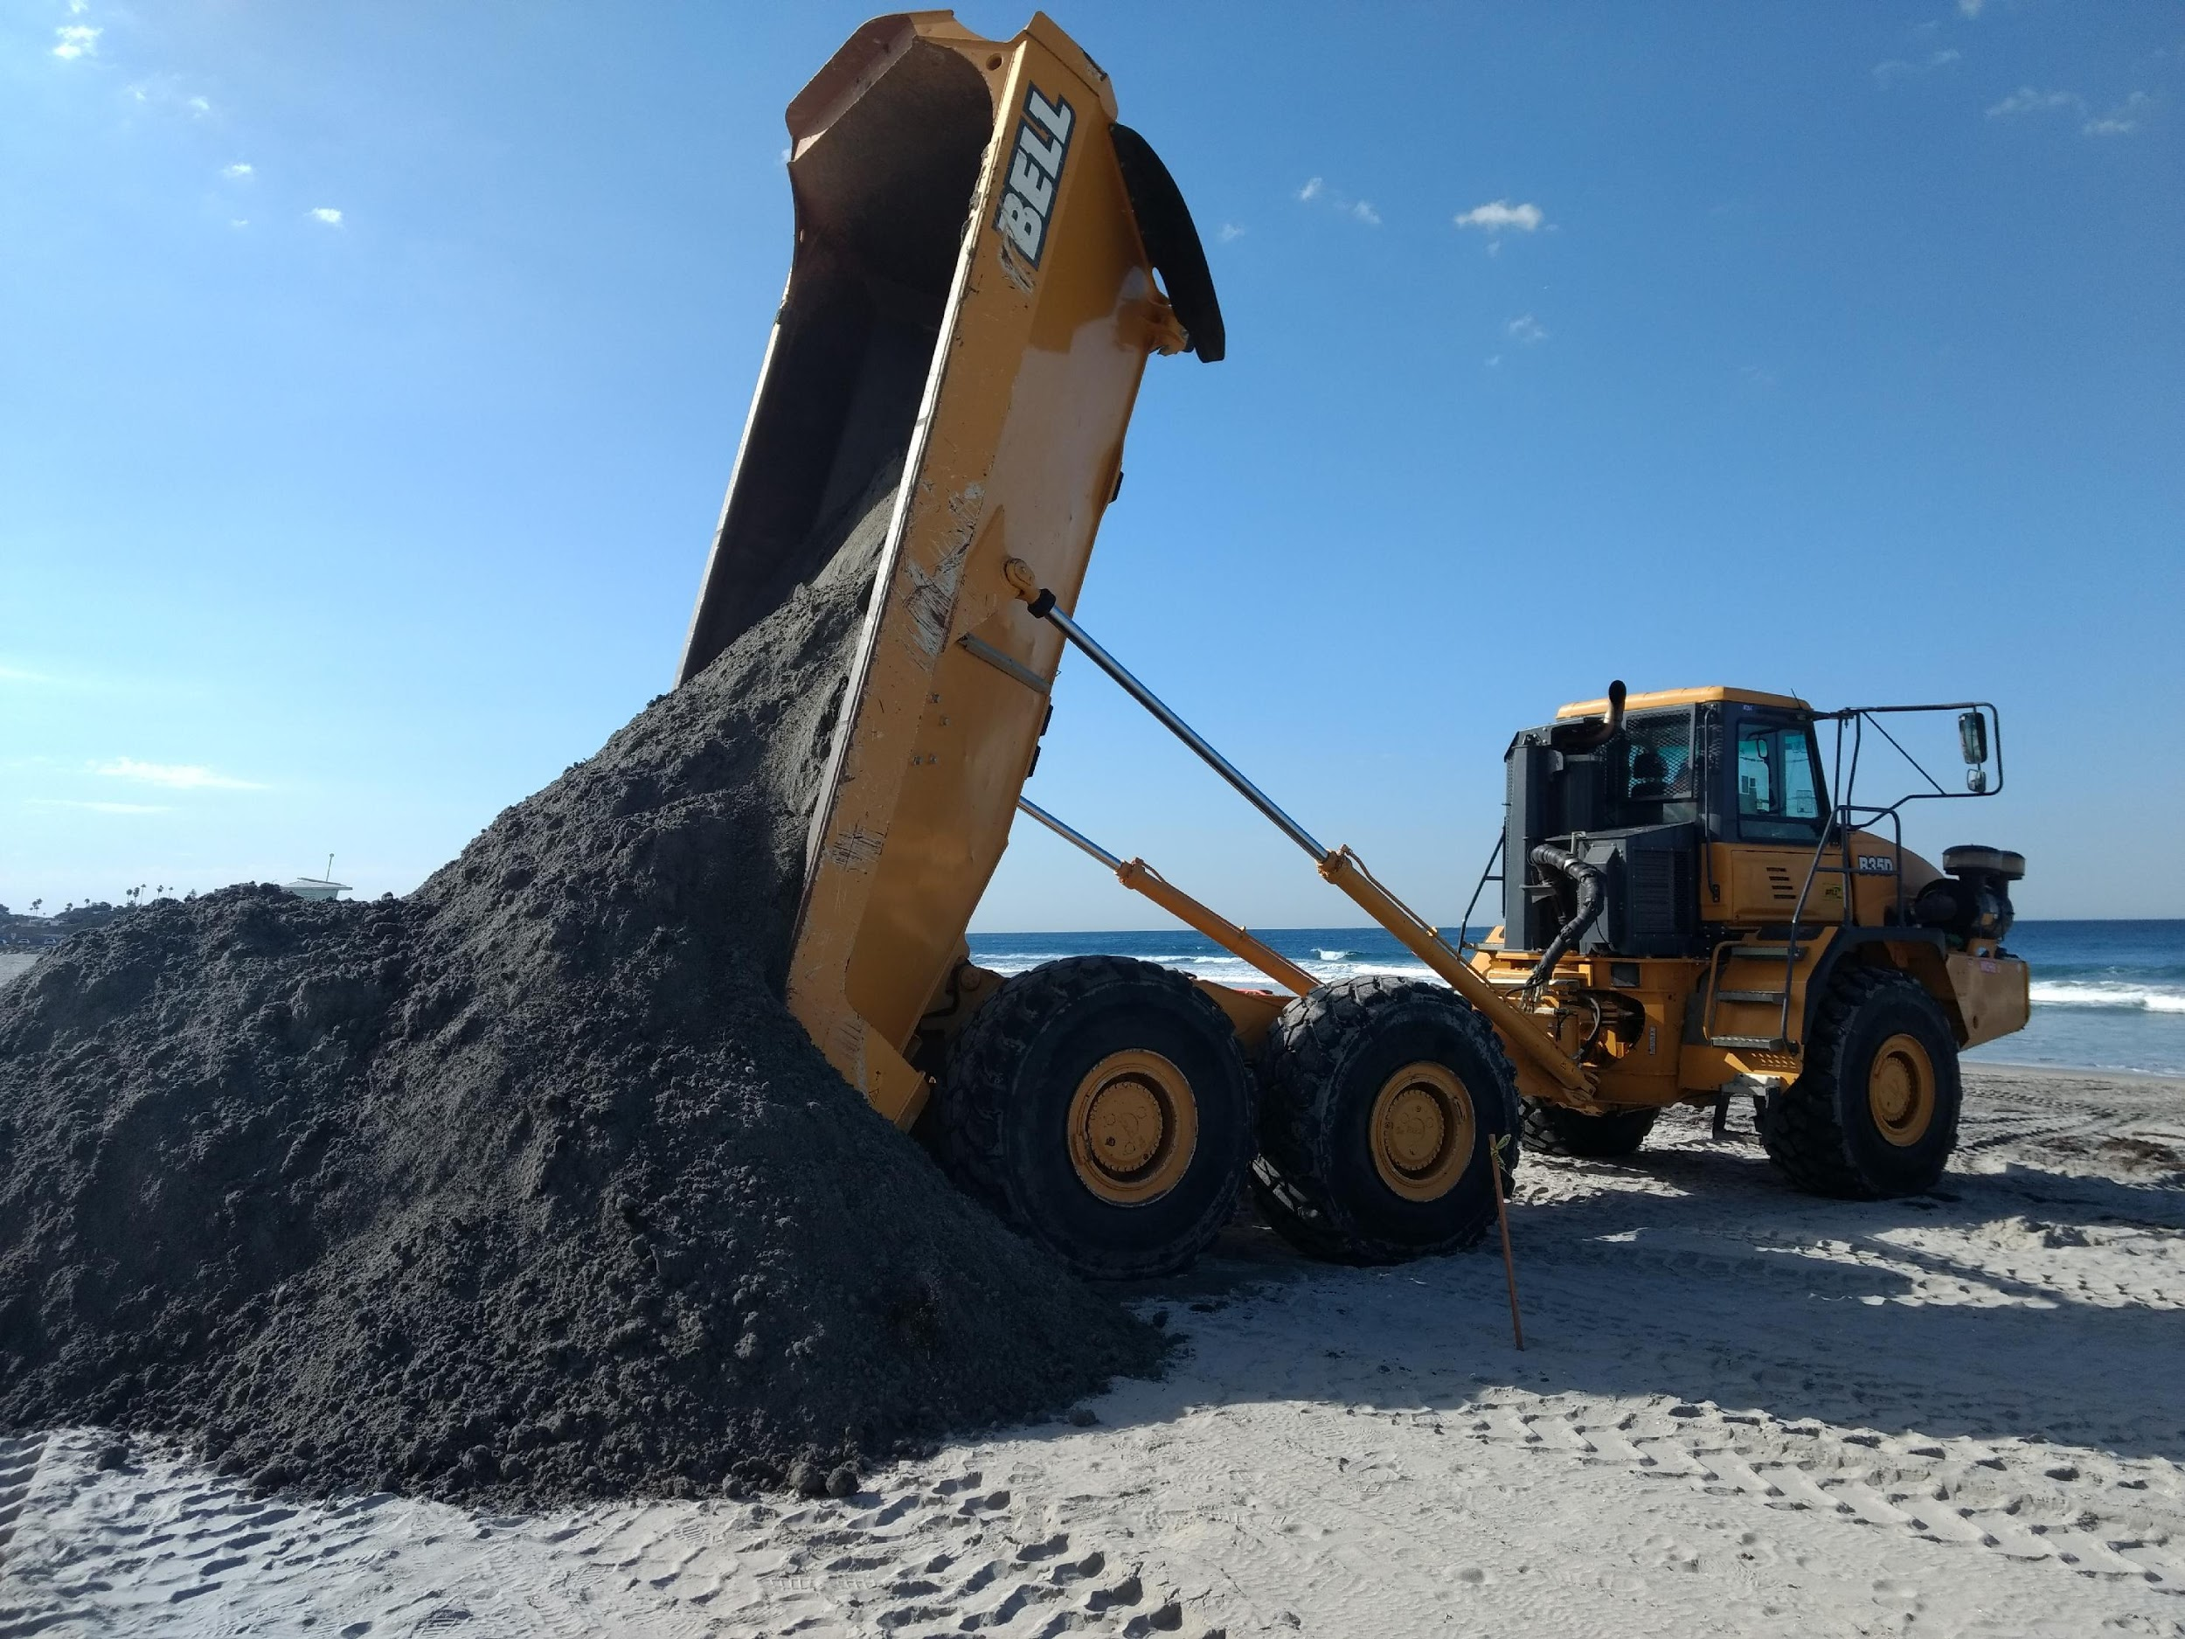
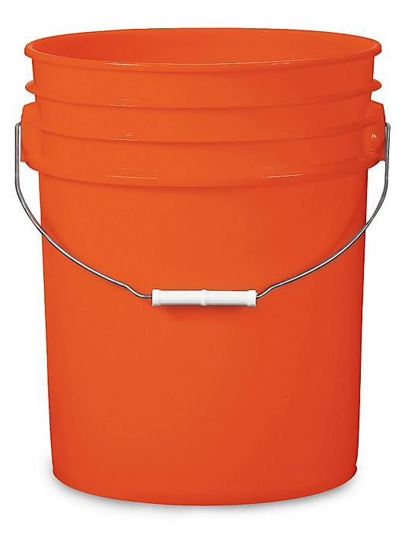
How Many Buckets Did It Take?

Slide 6
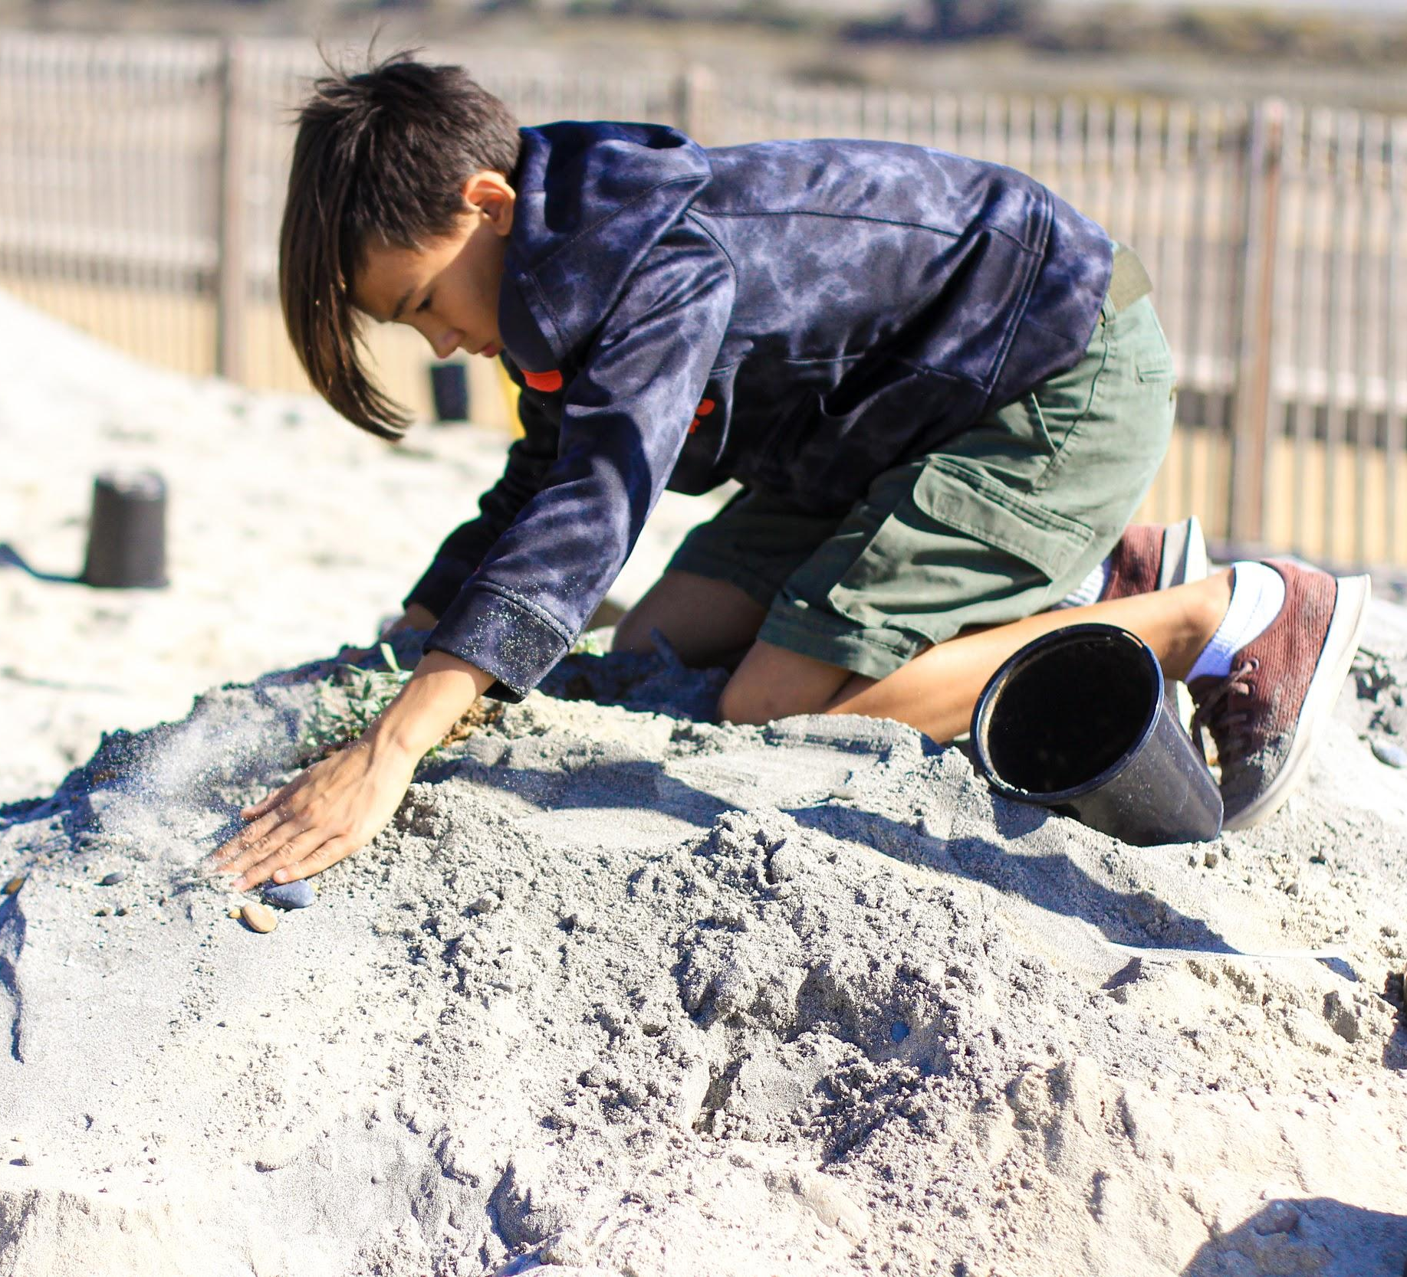
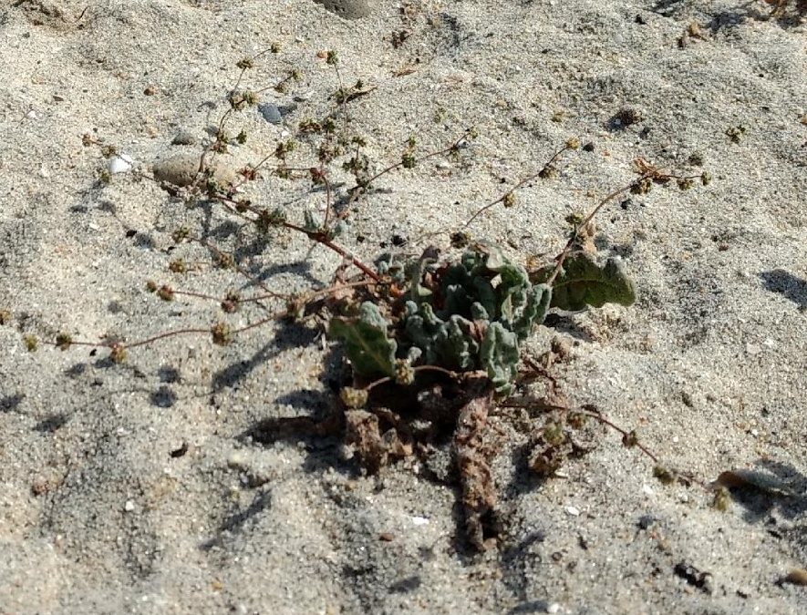
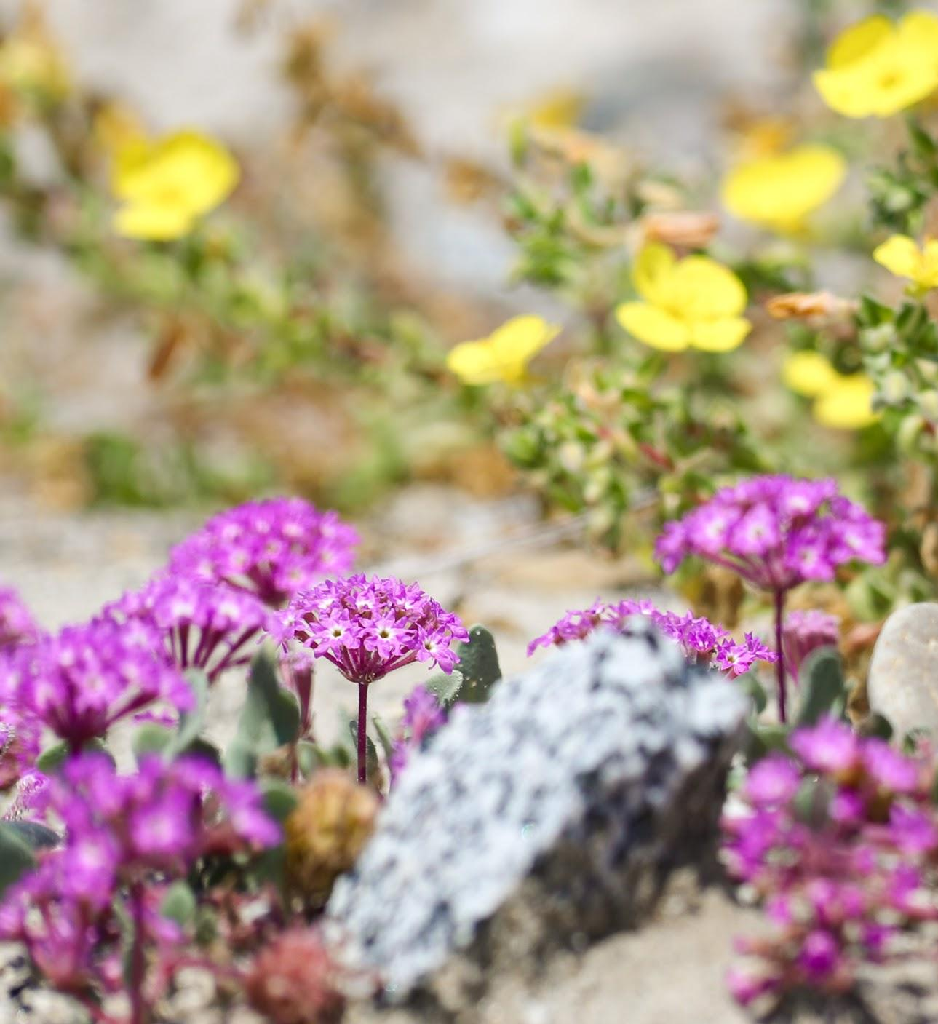
Dune Plants

Slide 7
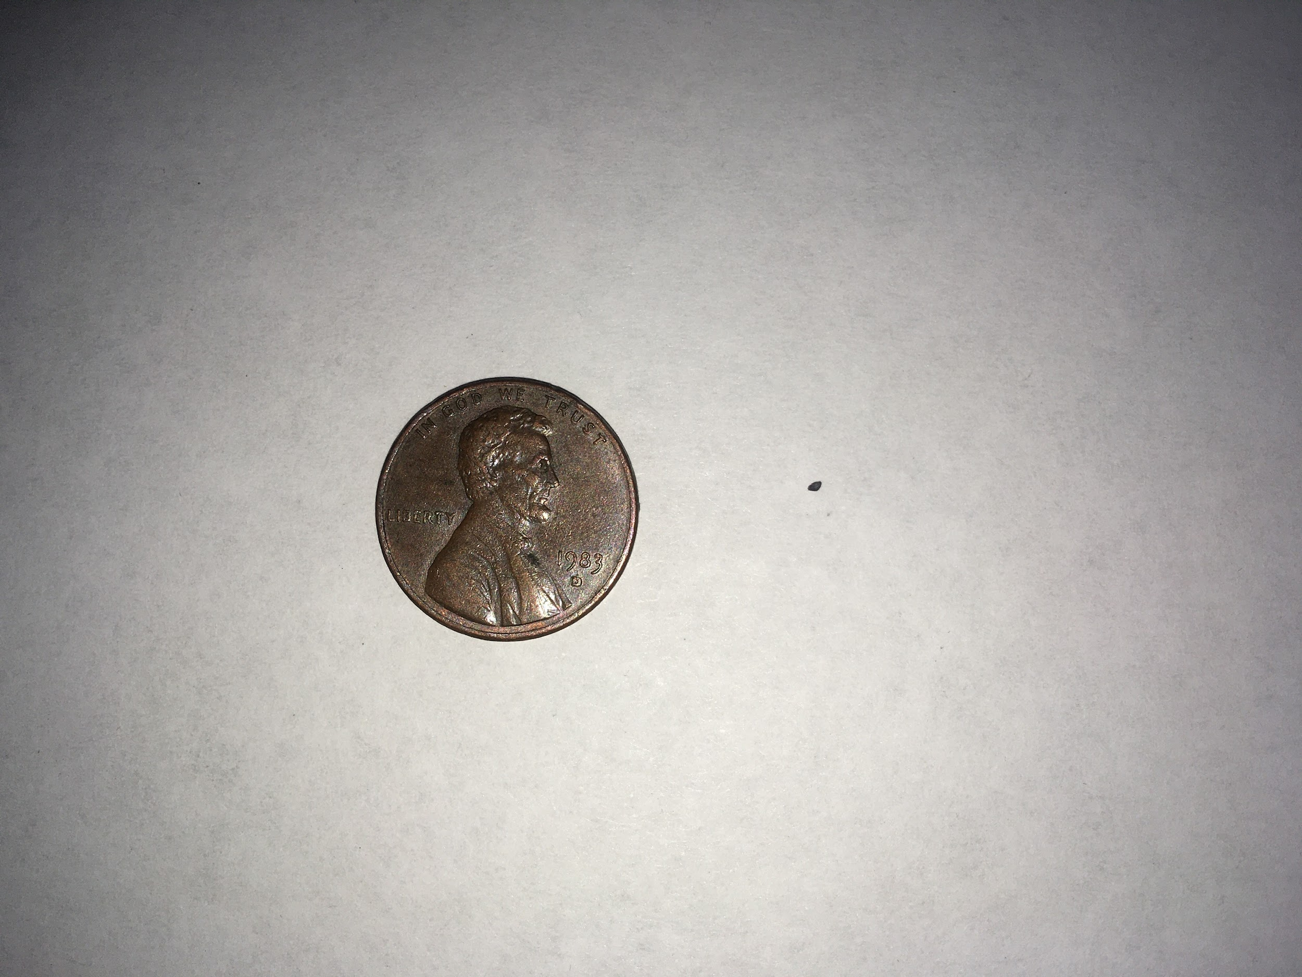

Slide 8
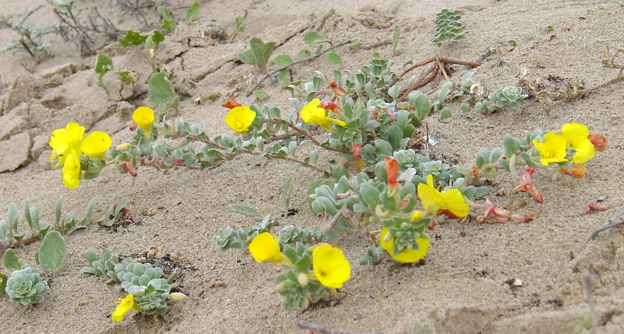
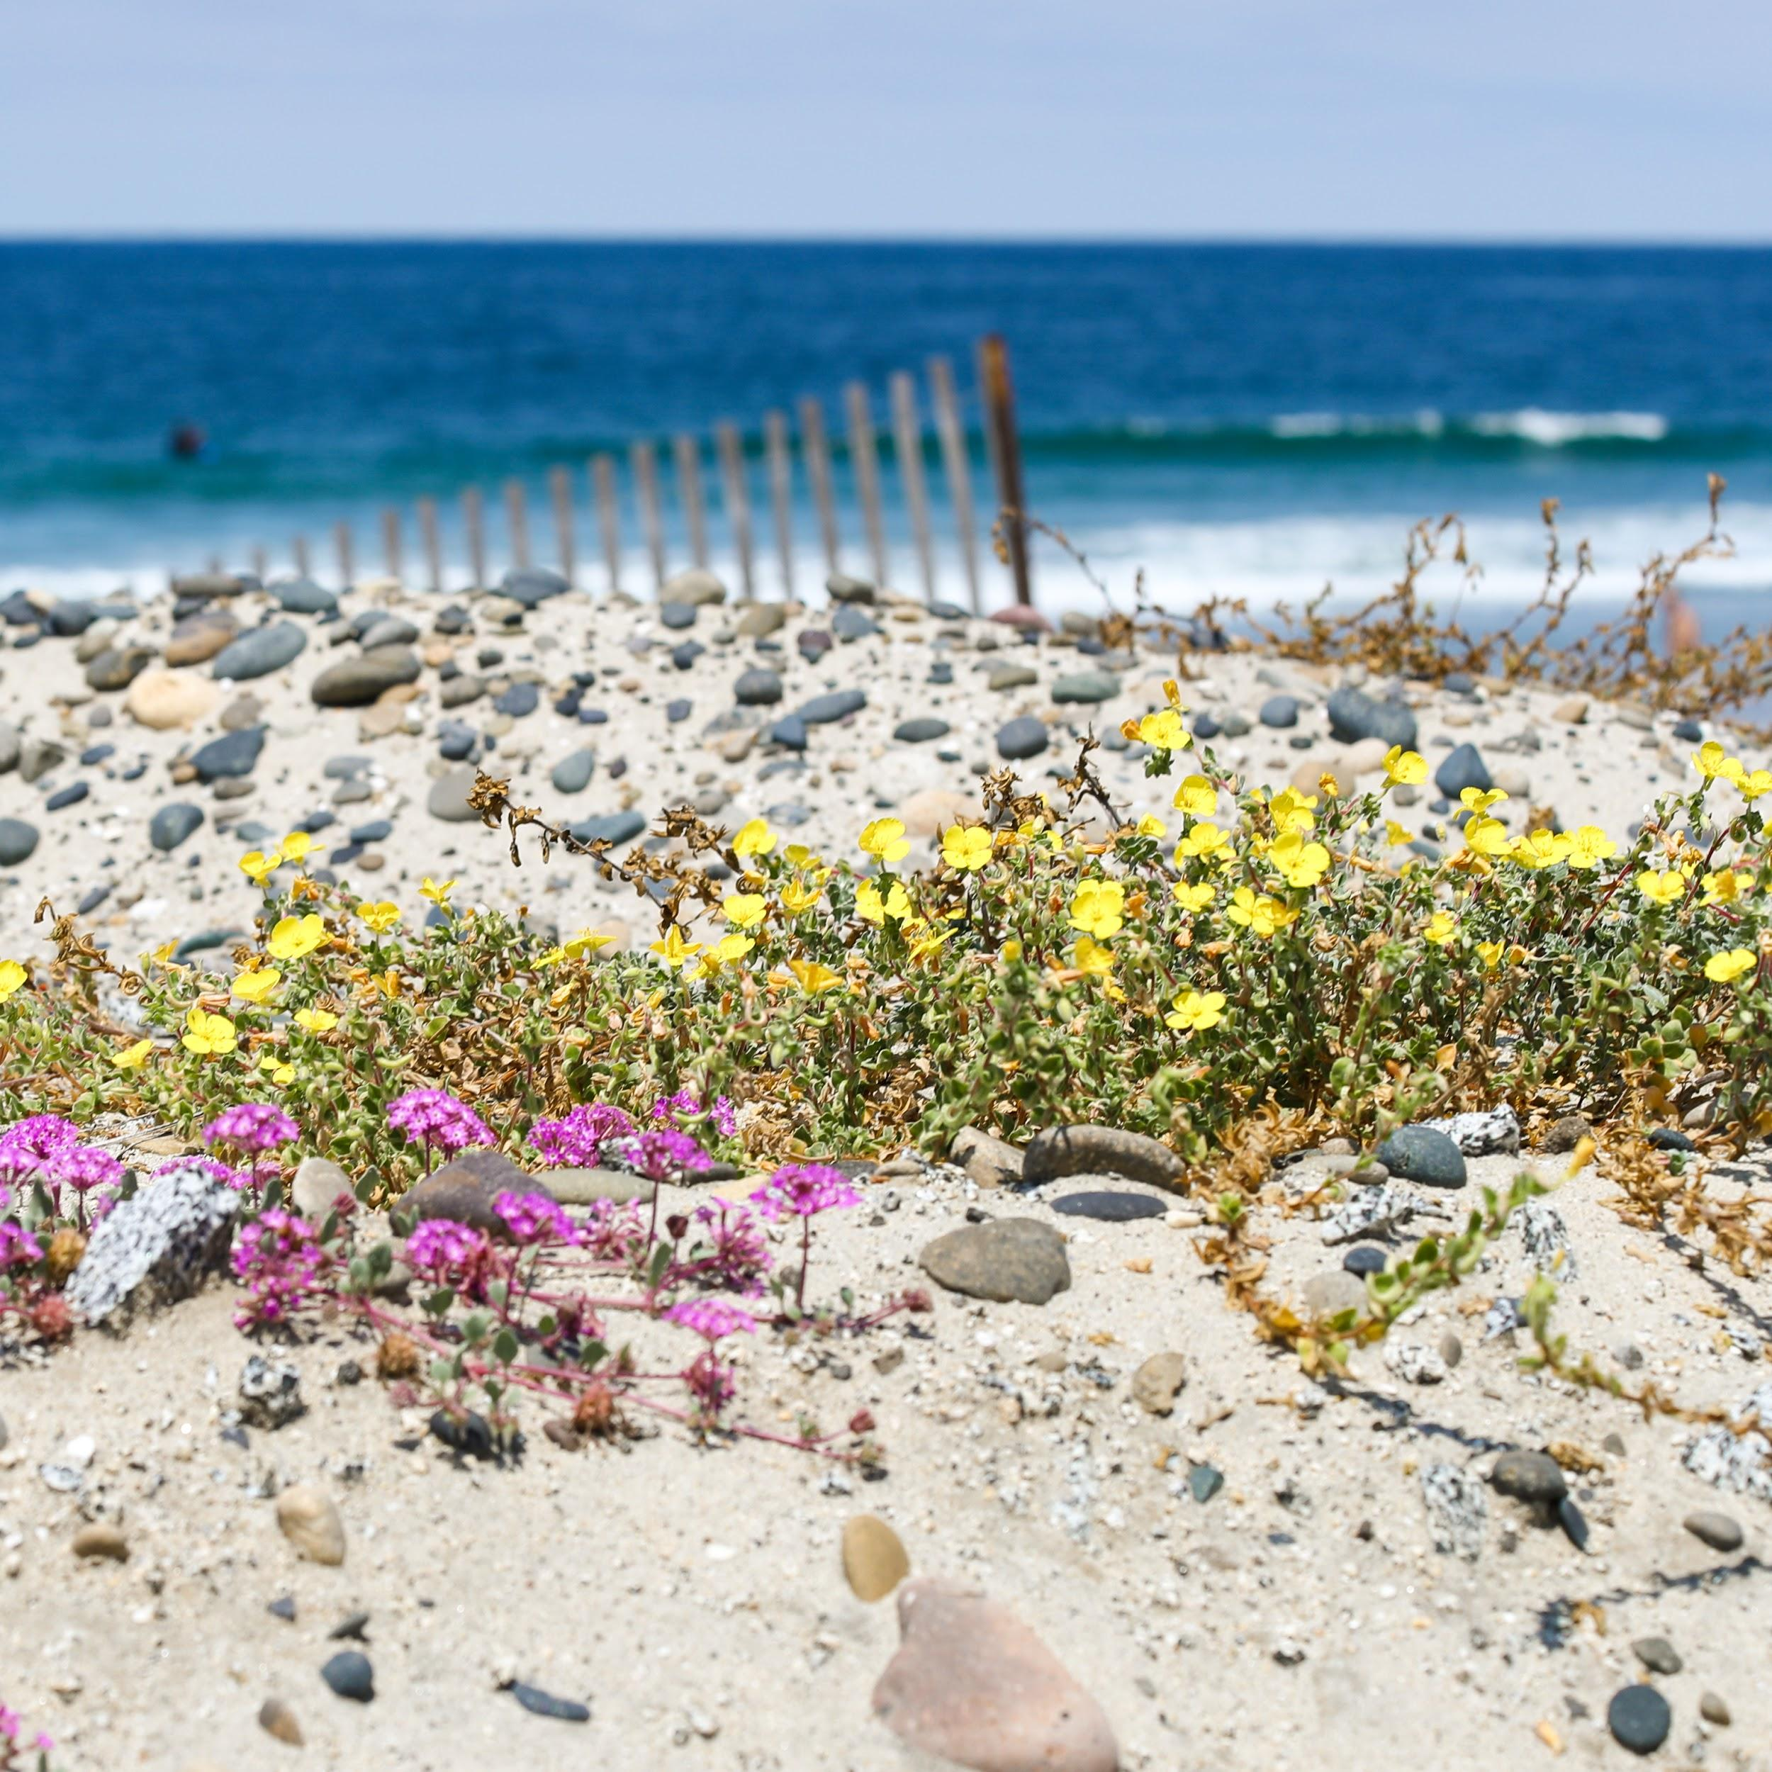
Beach Evening Primrose

Slide 9
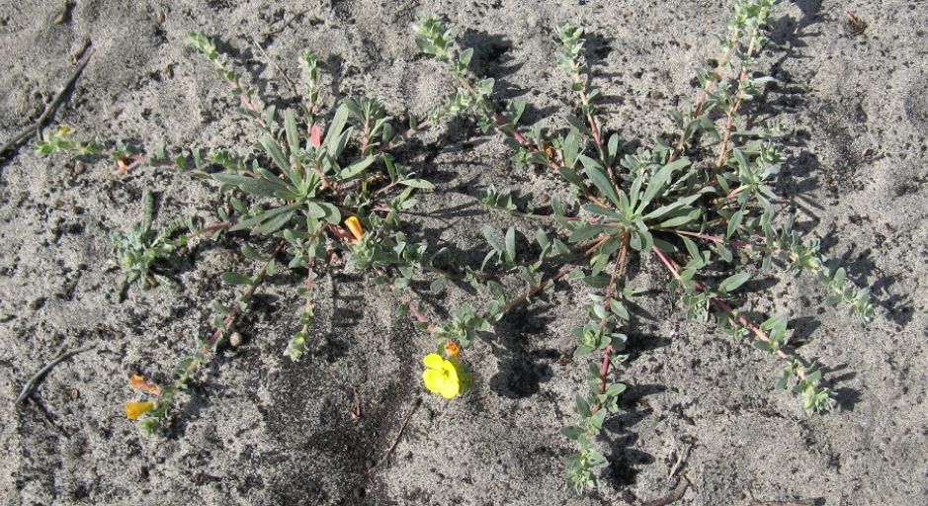
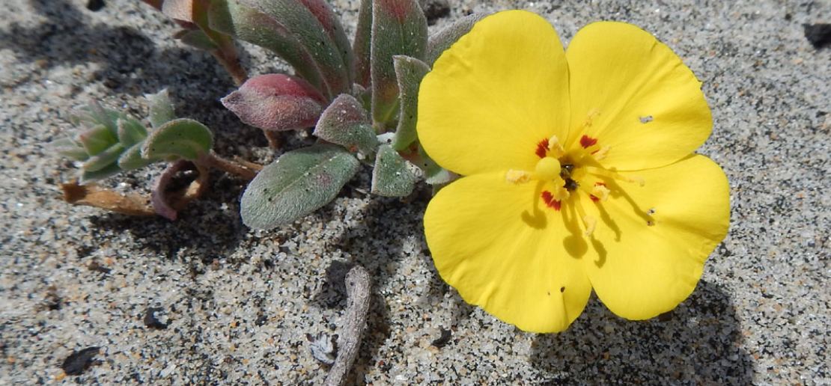
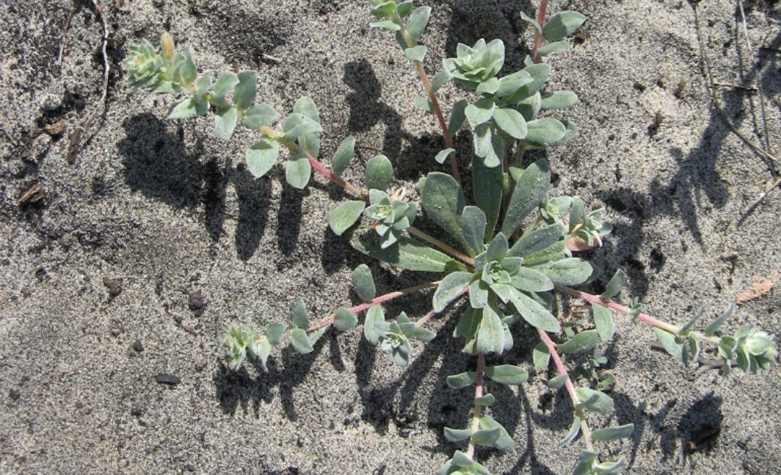

Slide 10
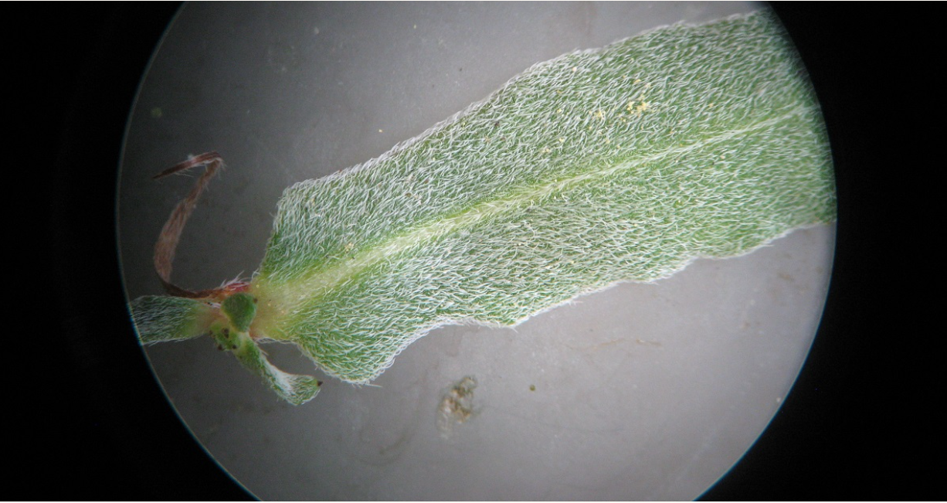

Slide 11
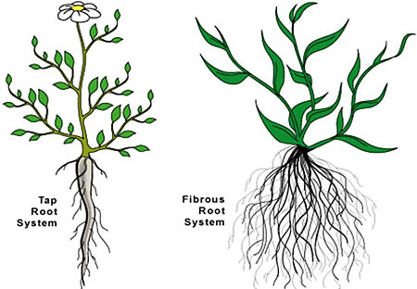

Slide 12


Slide 13
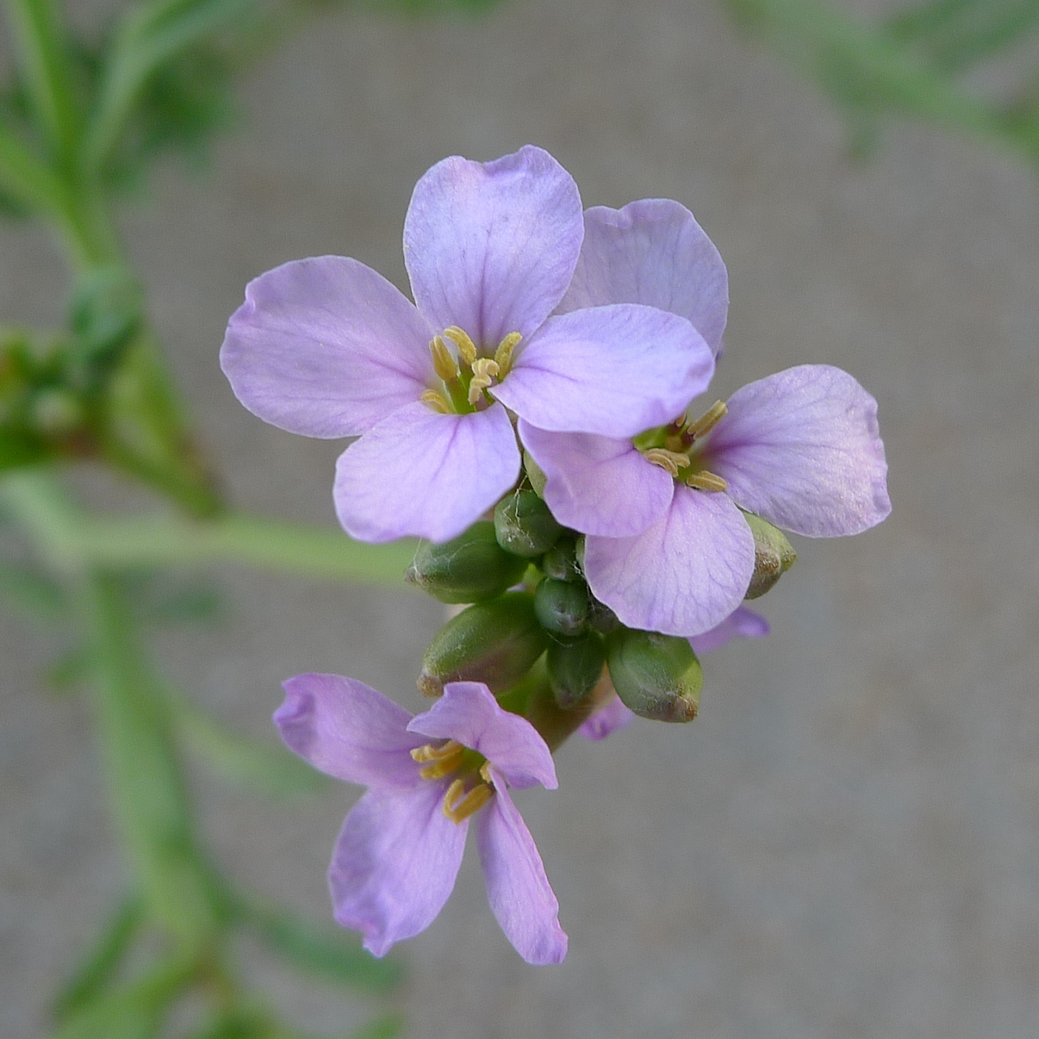
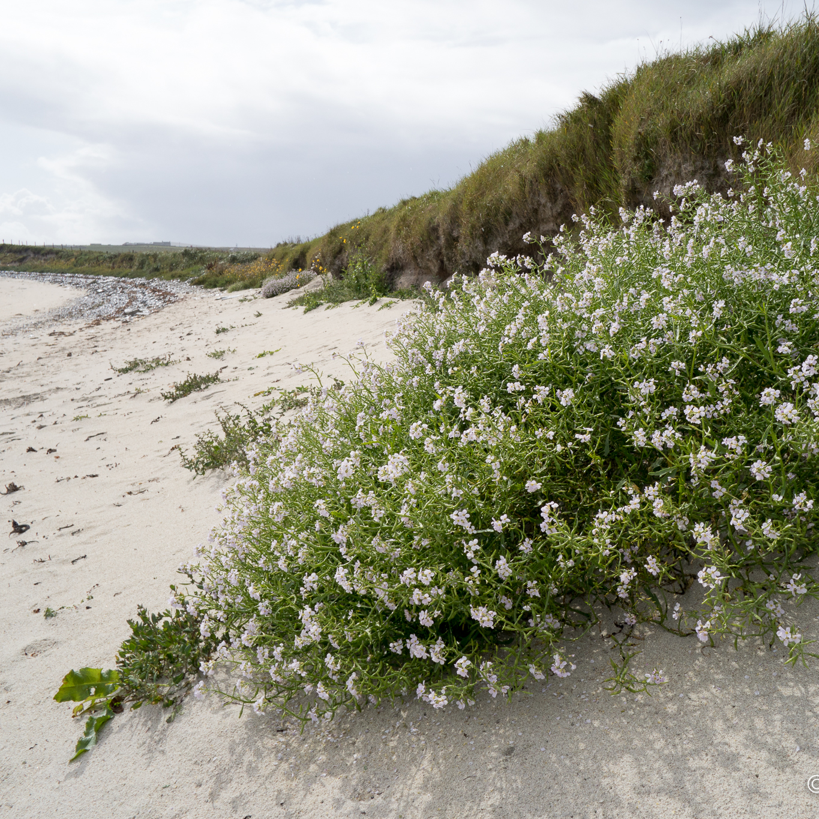
Sea Rocket

Slide 14
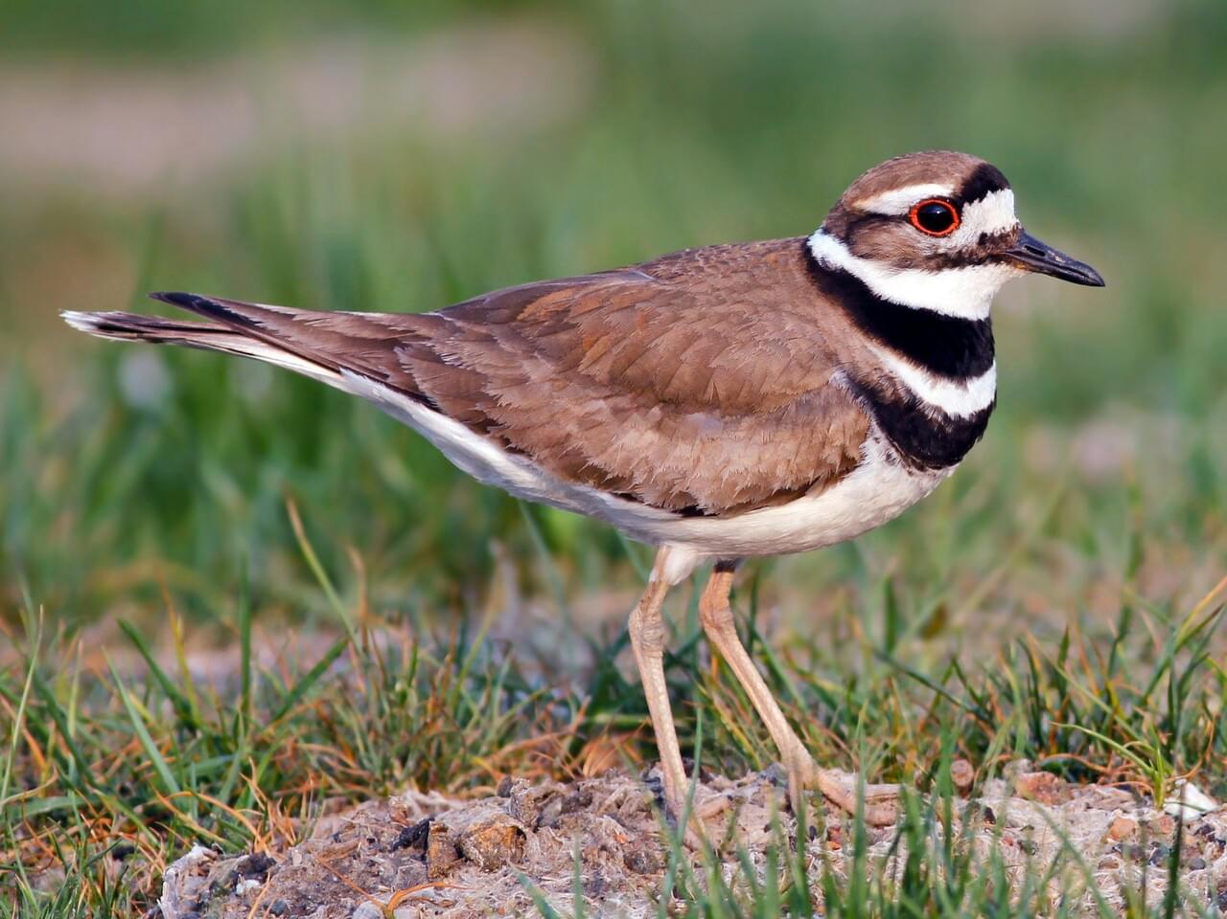

Slide 15
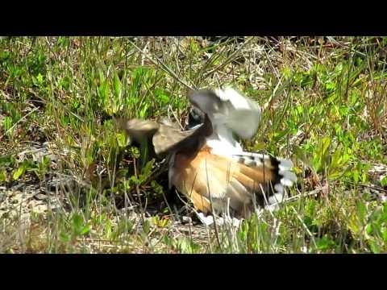

Slide 16
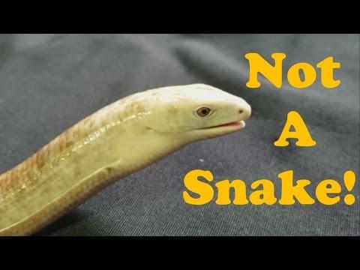
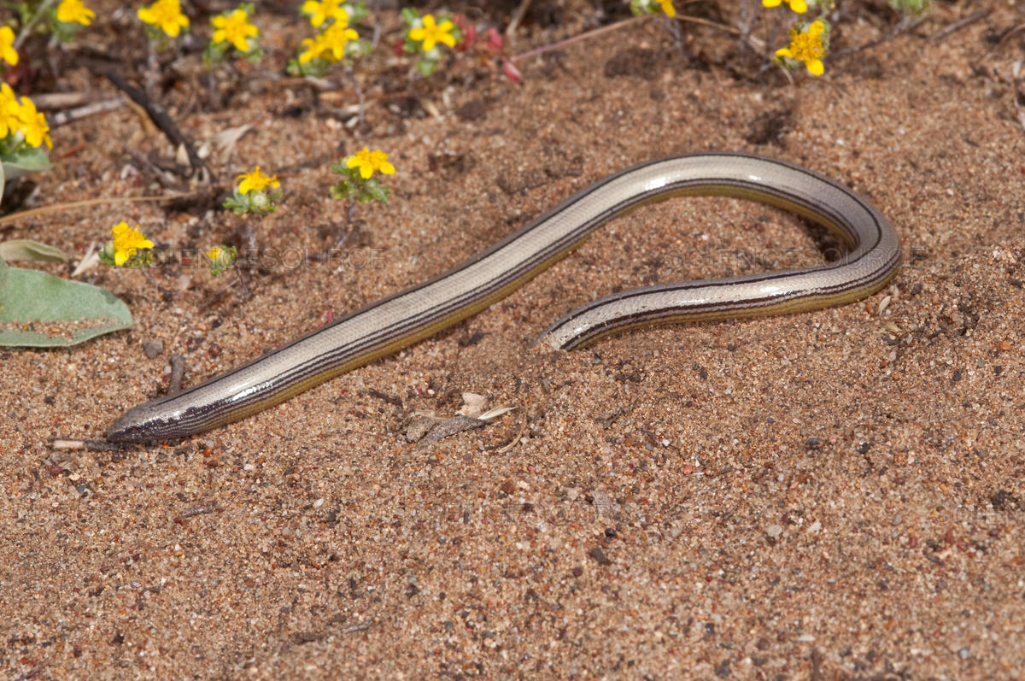
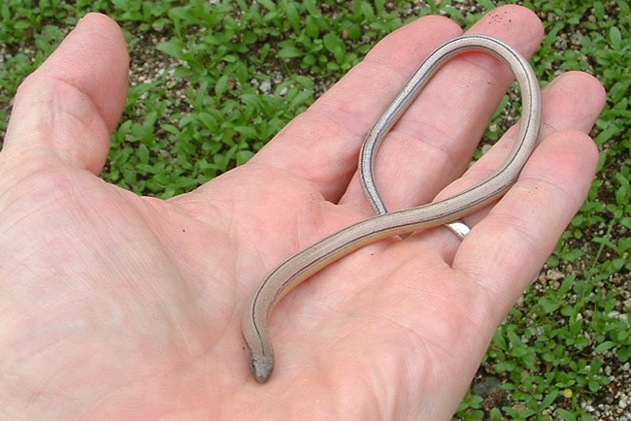

Slide 17
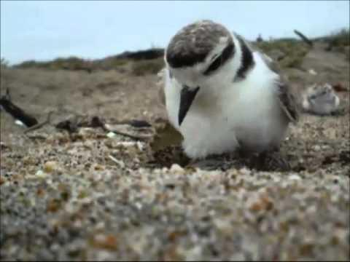

Slide 18
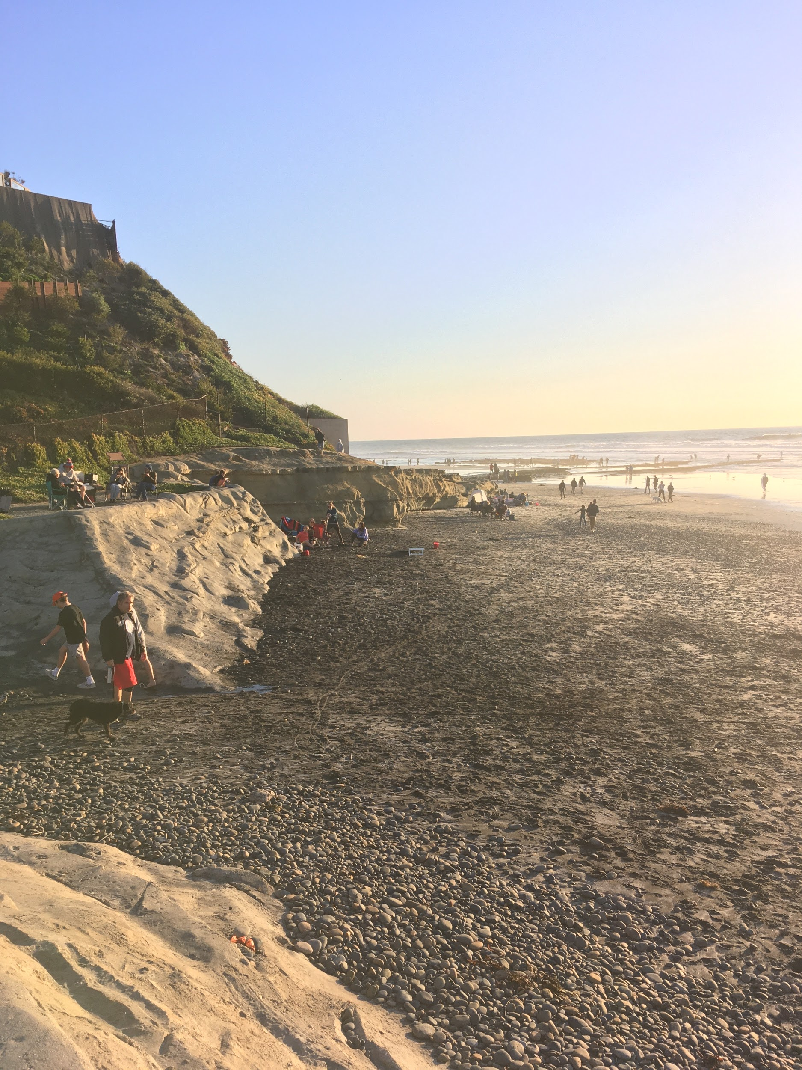
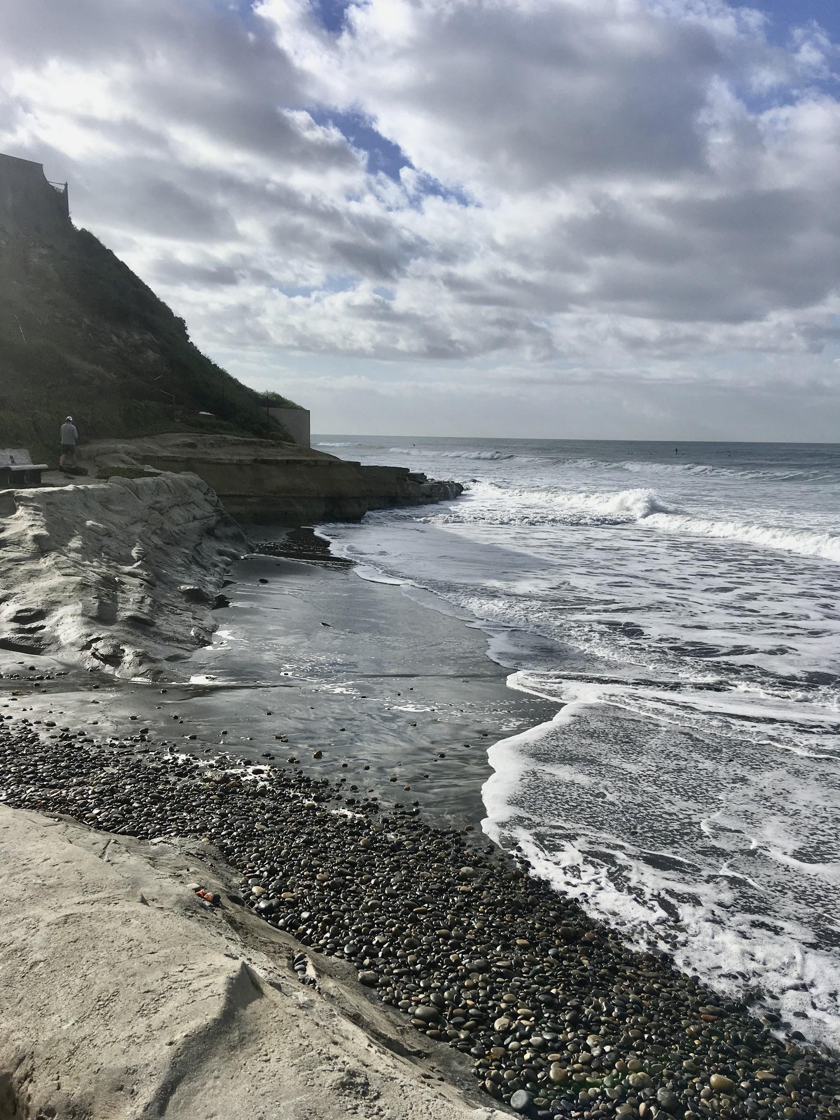
Low vs. High Tide

Slide 19
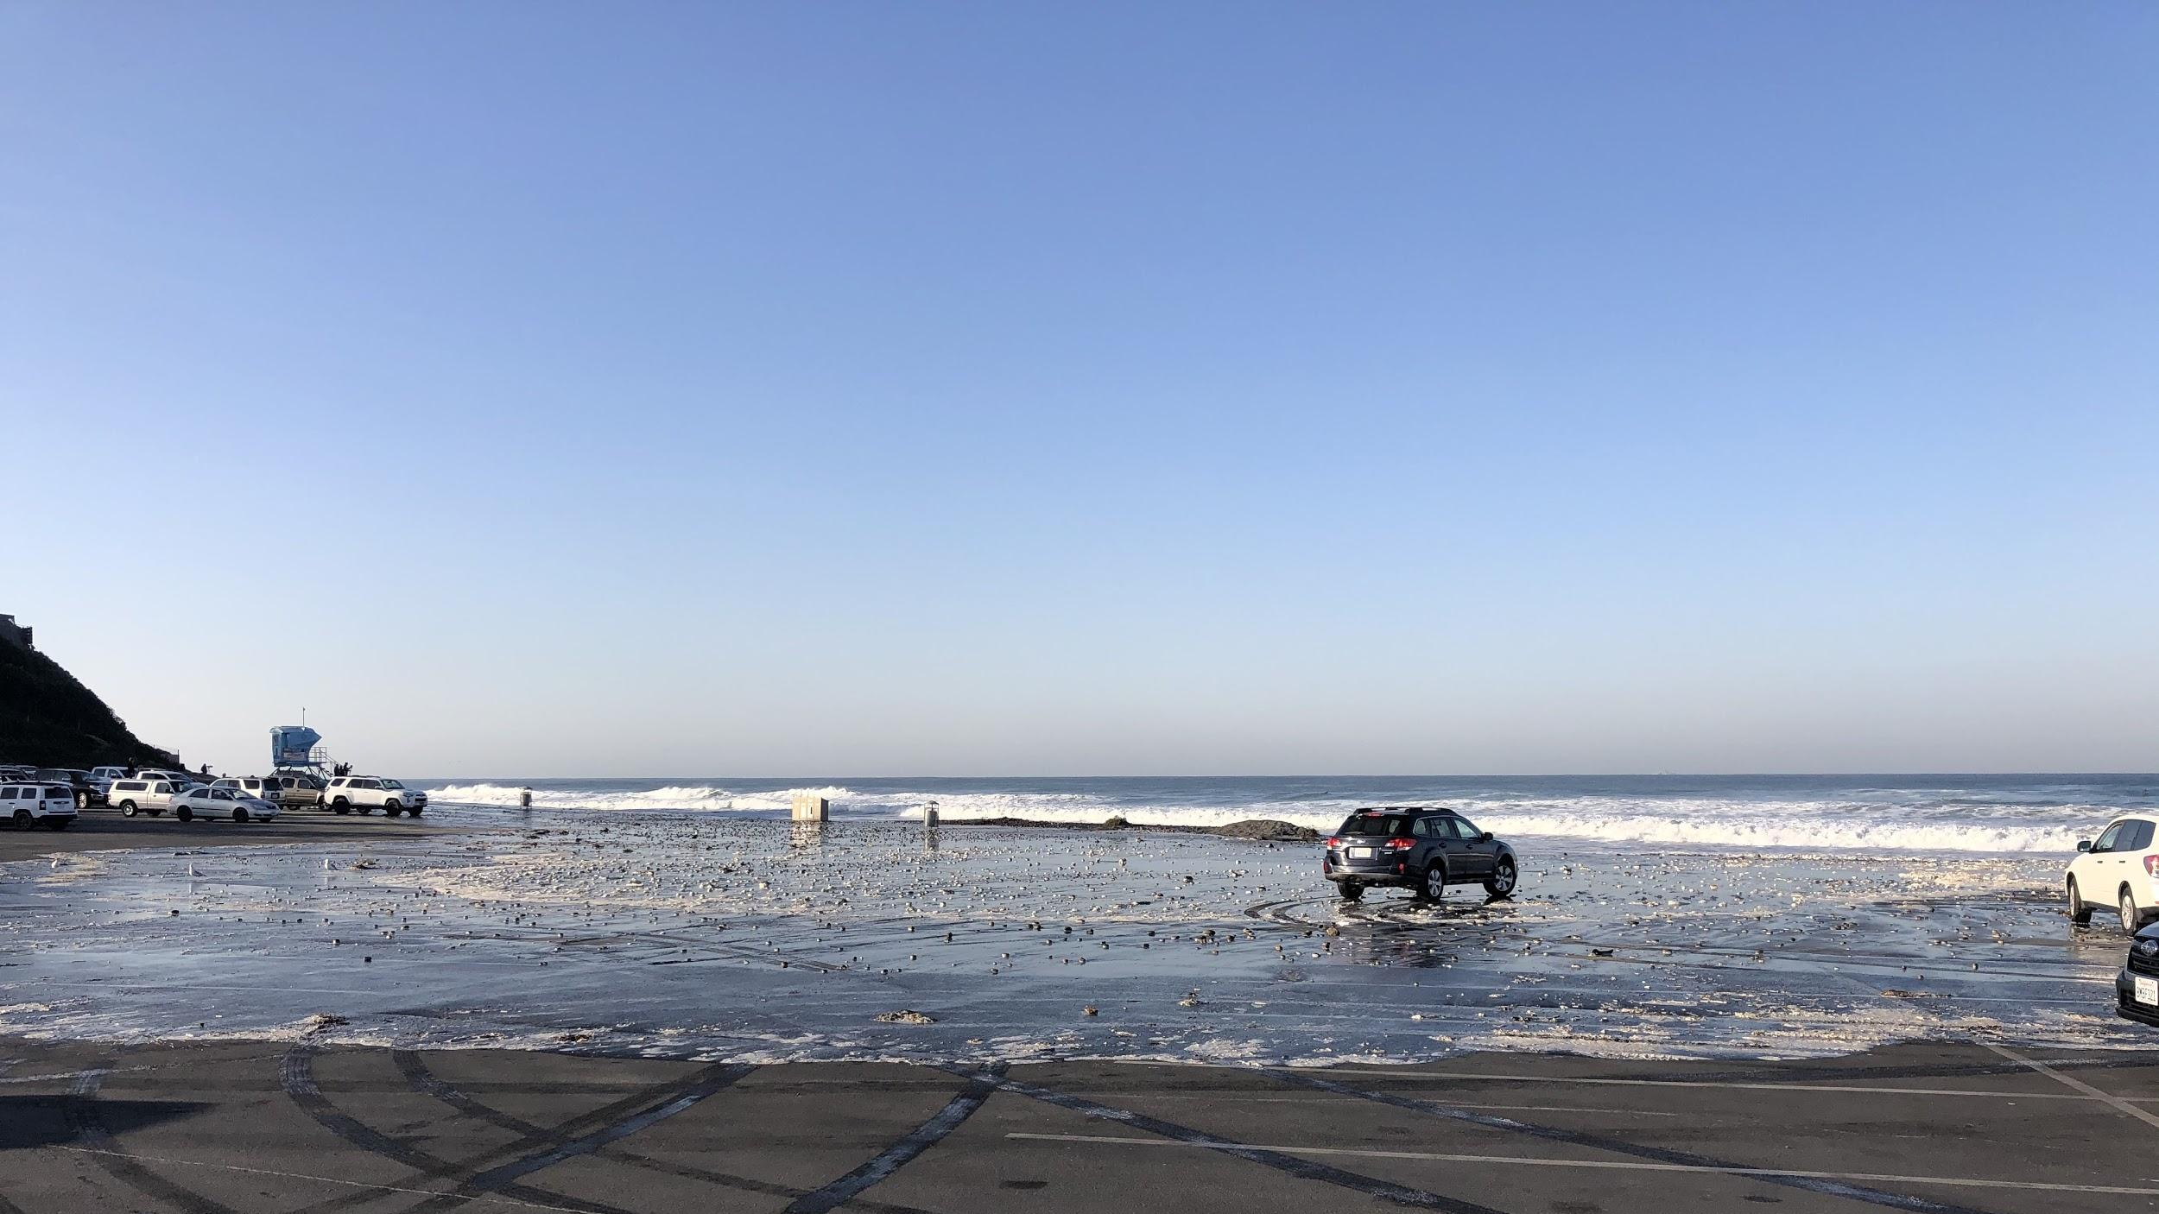
Cardiff State Beach | Nov. 2019
Notes:
Seaside State Beach Parking Lot 11/26/19 (Photo credit: Nick Sadrpour)

Slide 20

How Do Tides Work?

Slide 21
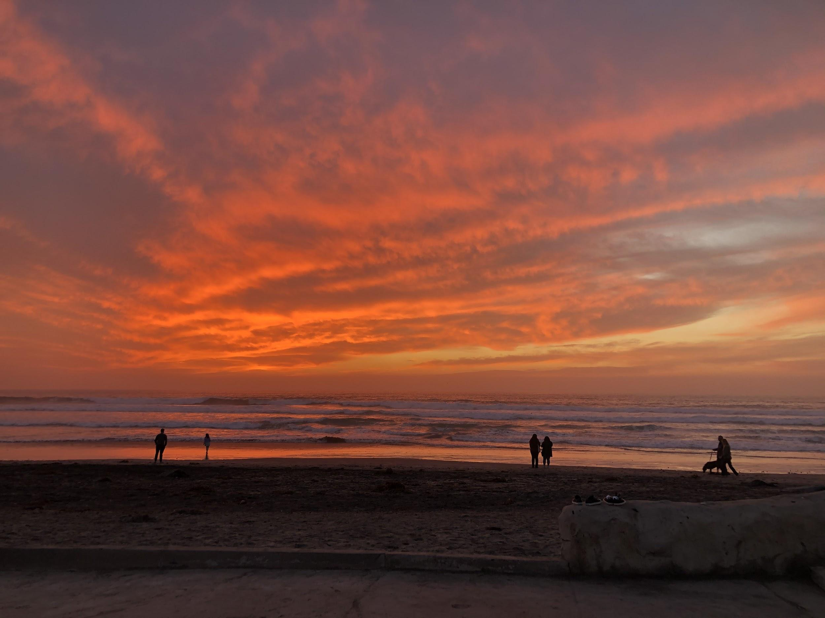
What Do You Notice?

Slide 22
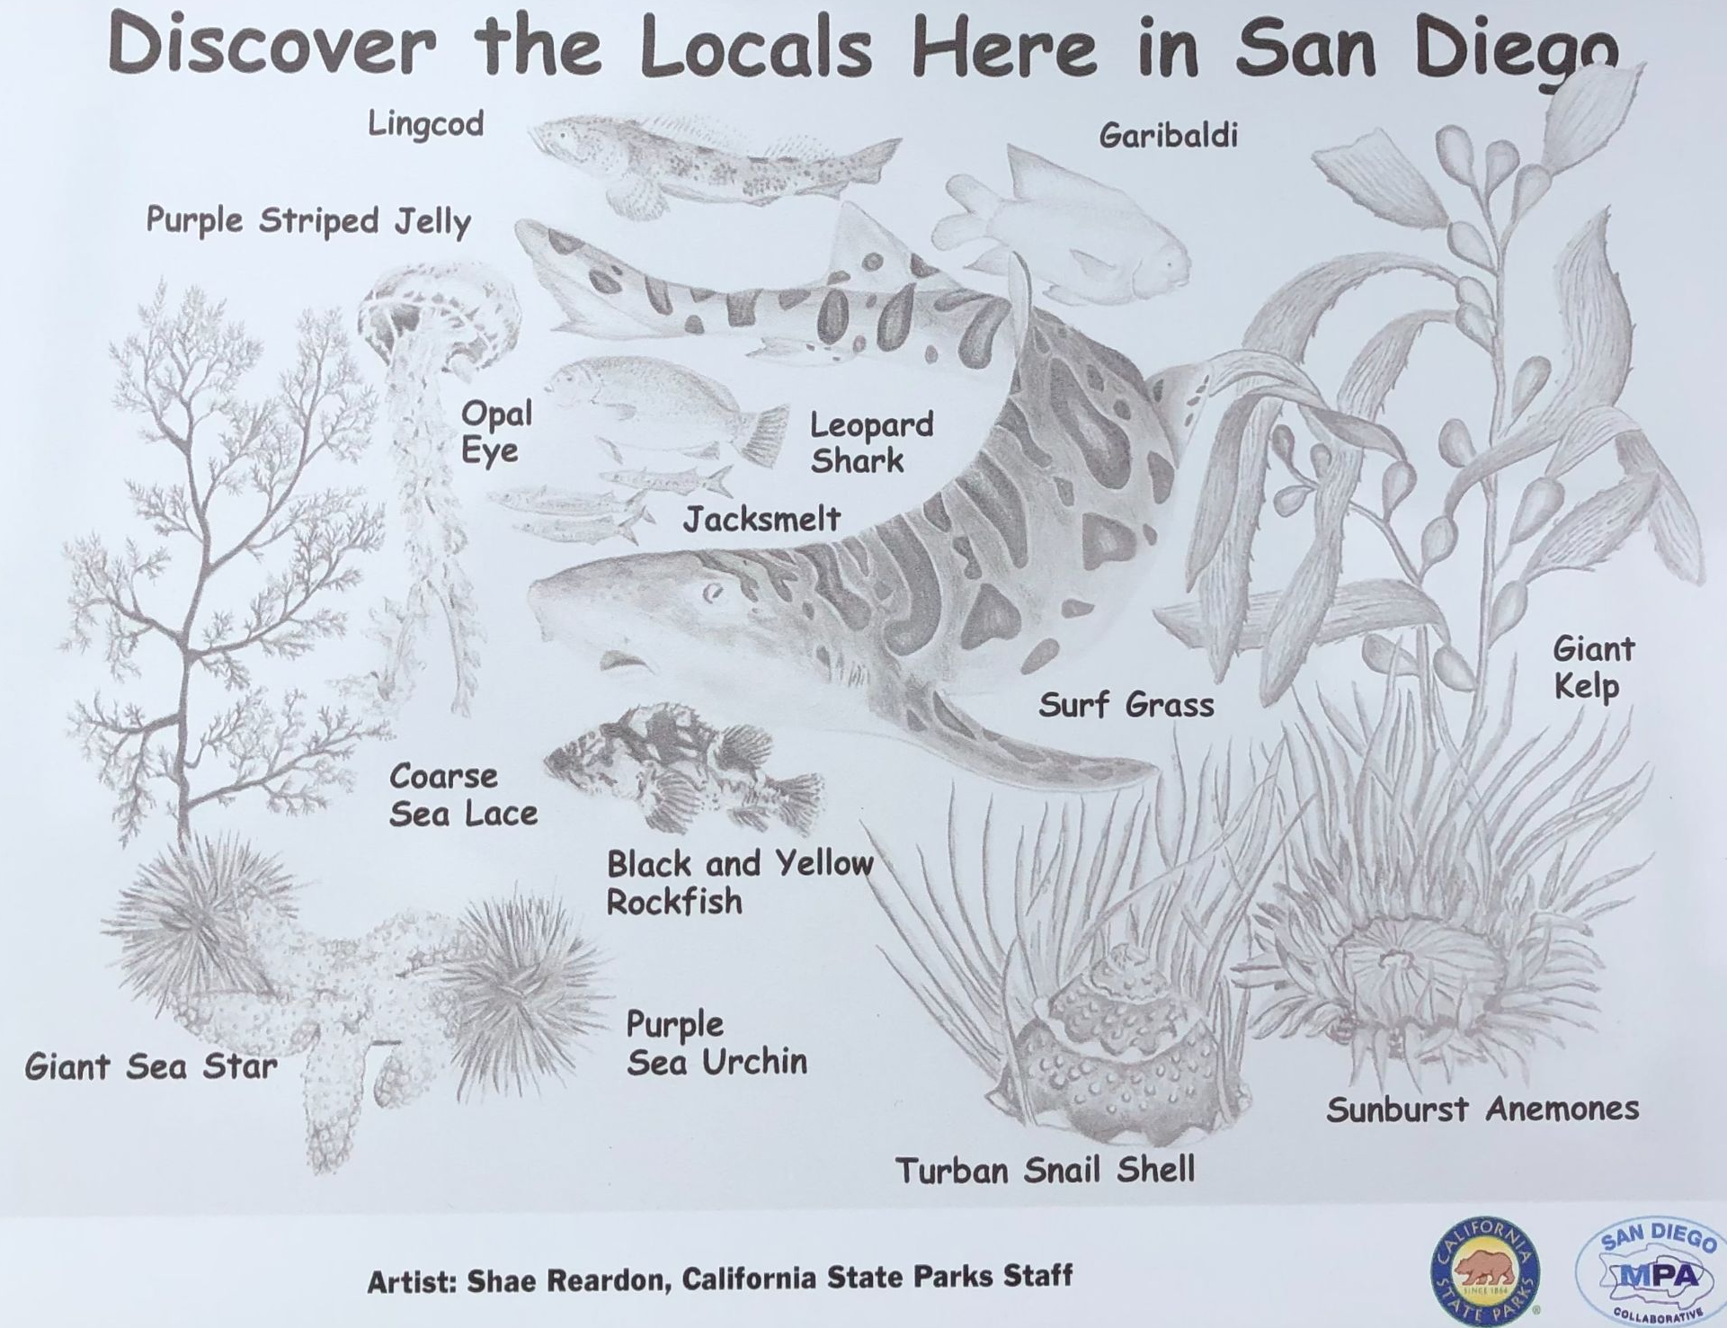

Slide 23
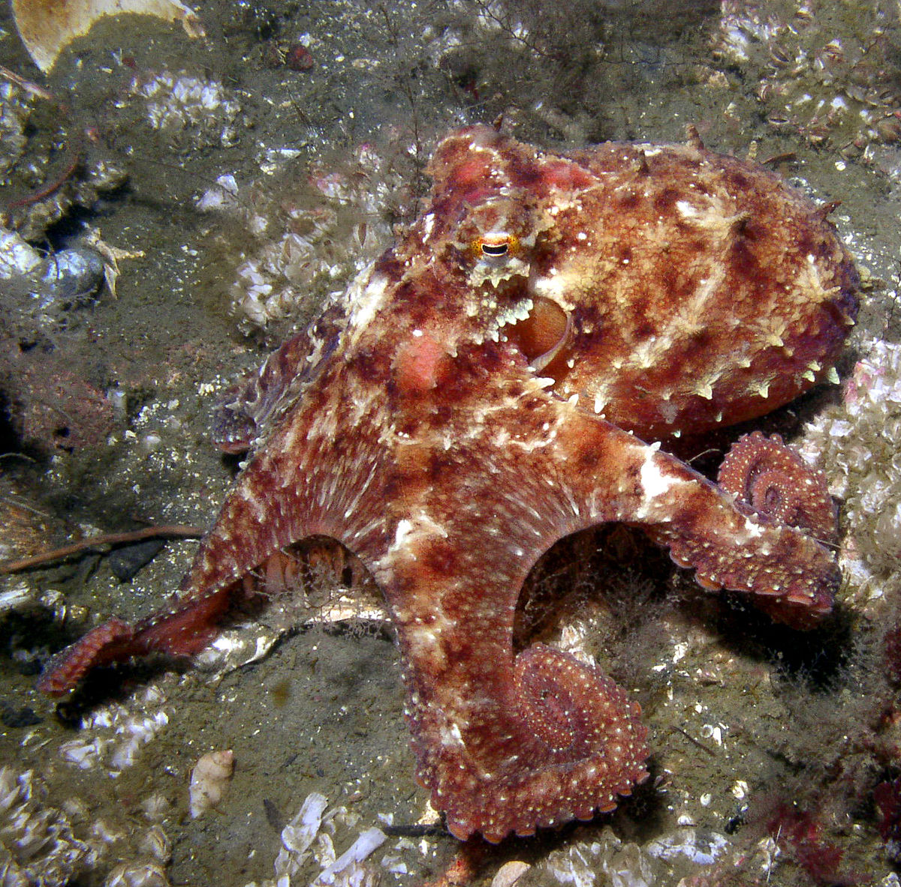
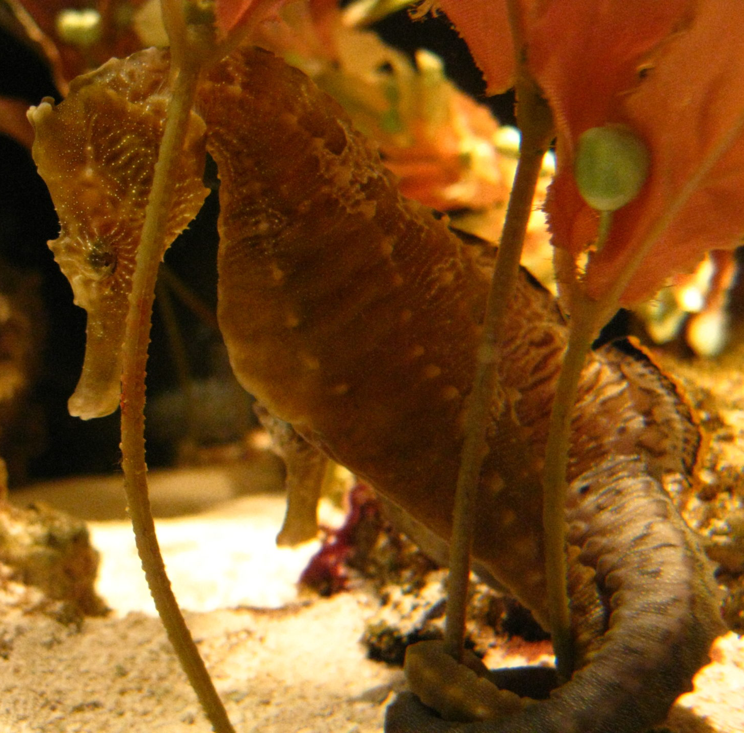
Join Us
PORTS Programs
ports-ca.us
Nature Collective
thenaturecollective.org

Slide 24
CALTIP
Dial CalTIP: 1 888 334-CALTIP | 888.334.2258
Send an anonymous tip by texting "CALTIP", followed by a space and the message, to 847411 (tip411).

Slide 25





Stay Connected
Elayna Flanders
Volunteer Director
elayna@thenaturecollective.org
858.704.4550
thenaturecollective.org
Sandy Tolzda
Interpretation Team
SanDiego.Interp@parks.ca.gov
ports-ca.us
San Elijo & South Carlsbad State Beach
Notes:
We invite you to …. Stay connected by visiting our website or our social media pagesam

