Slide 1
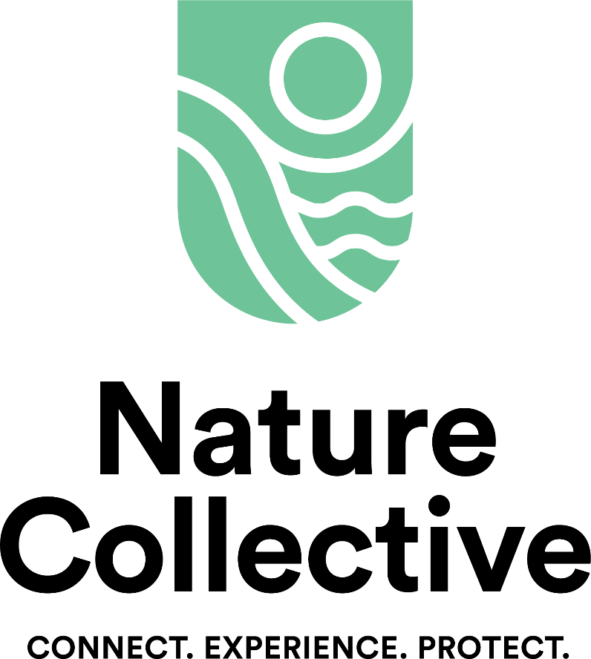

Slide 2

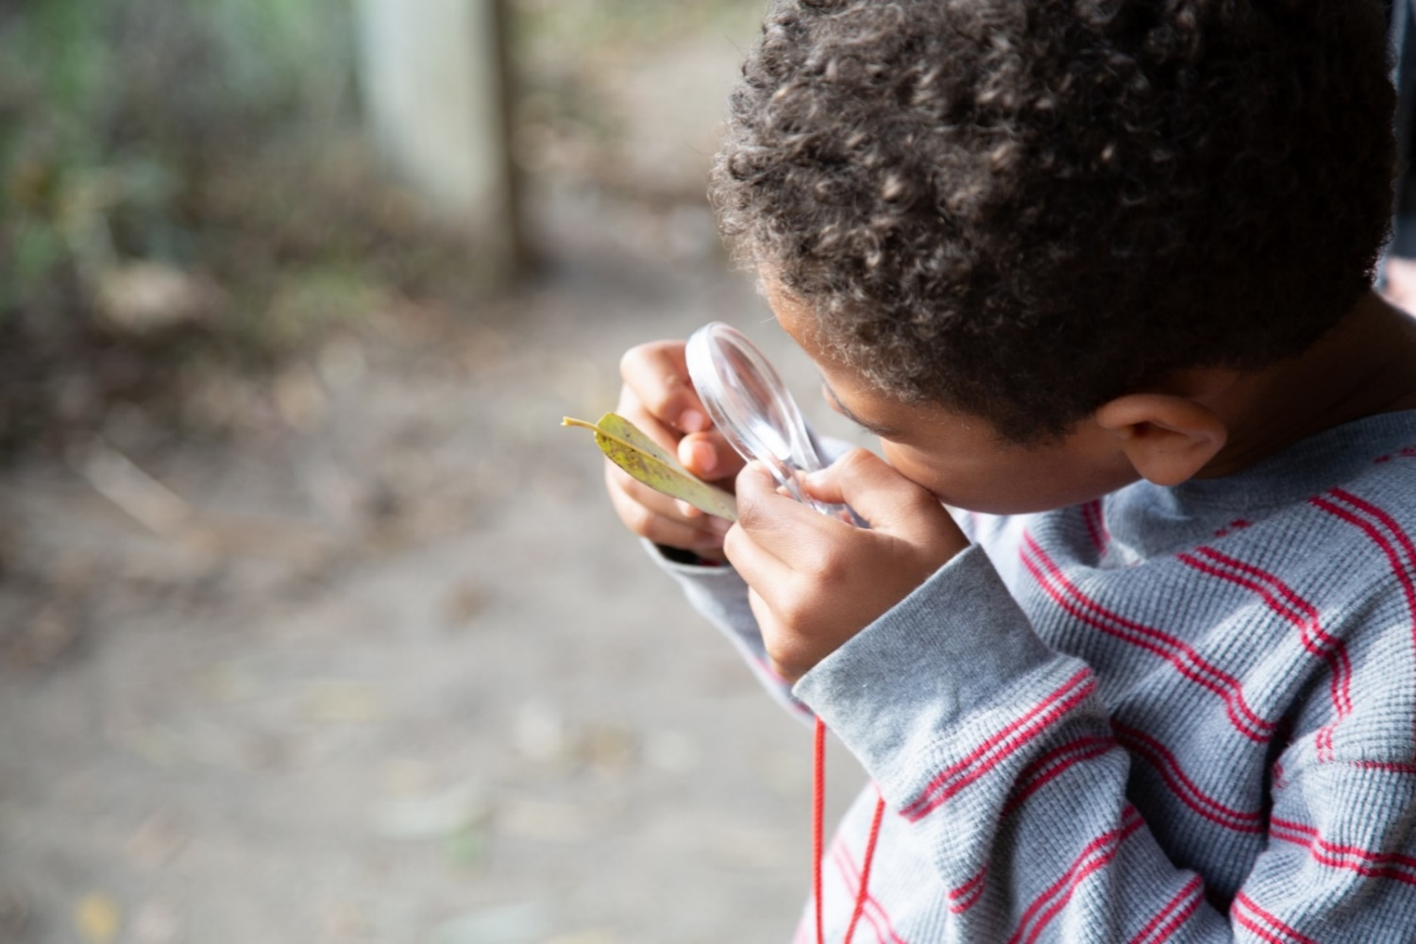
Connect. Experience. Protect.
Notes:
Our tagline: Connect. Experience. Protect. We believe that if we help people discover a passion for nature, they will want to protect it and value everything it has to offer.

Slide 3
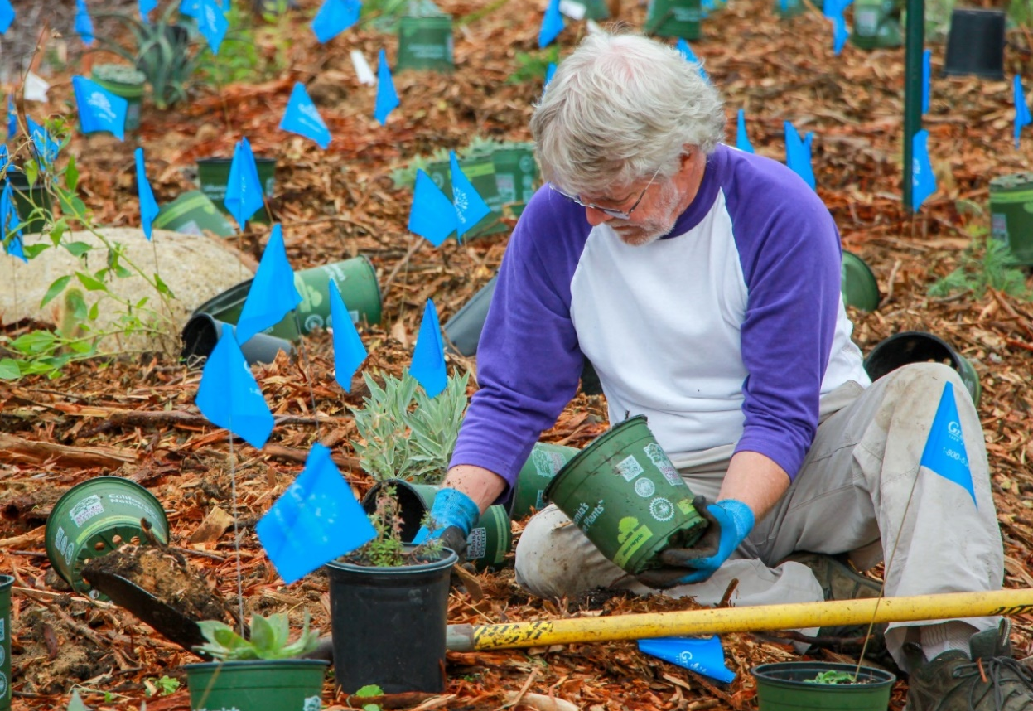
What We Do
We restore habitat to provide healthier waters + greater wildlife diversity.

Slide 4
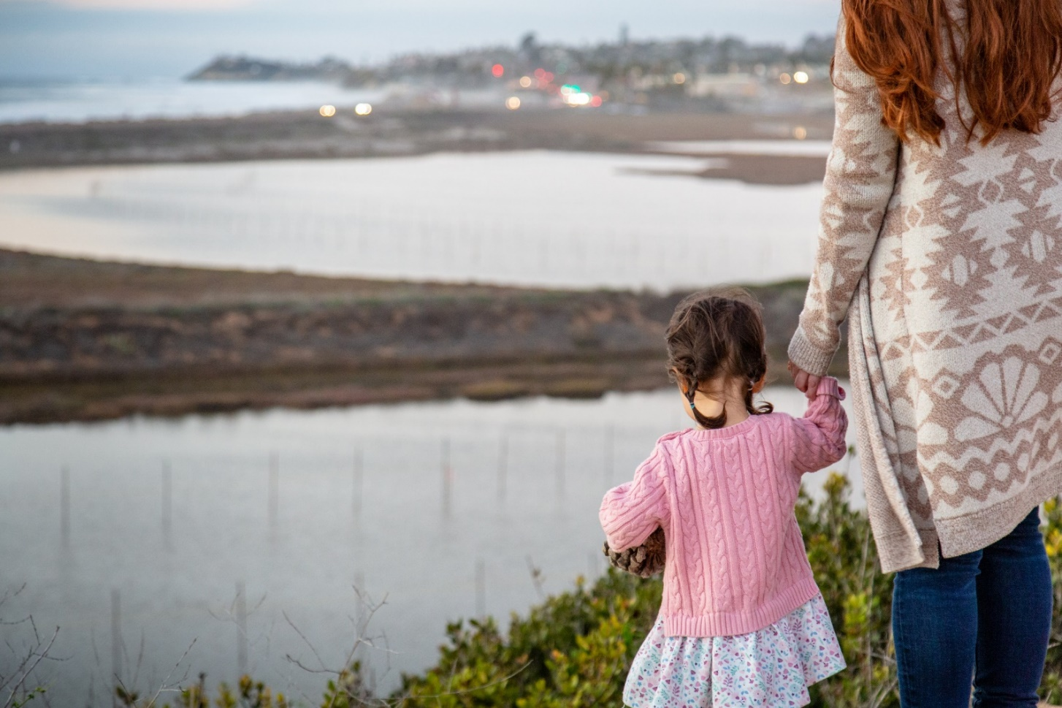
We buy land + receive conservation easements.
Notes:
…so that open space will be protected in perpetuity. Most recent land acquisitions include the 3 acres Harbaugh Seaside Trails property and the 77 acre Lake Drive property.

Slide 5
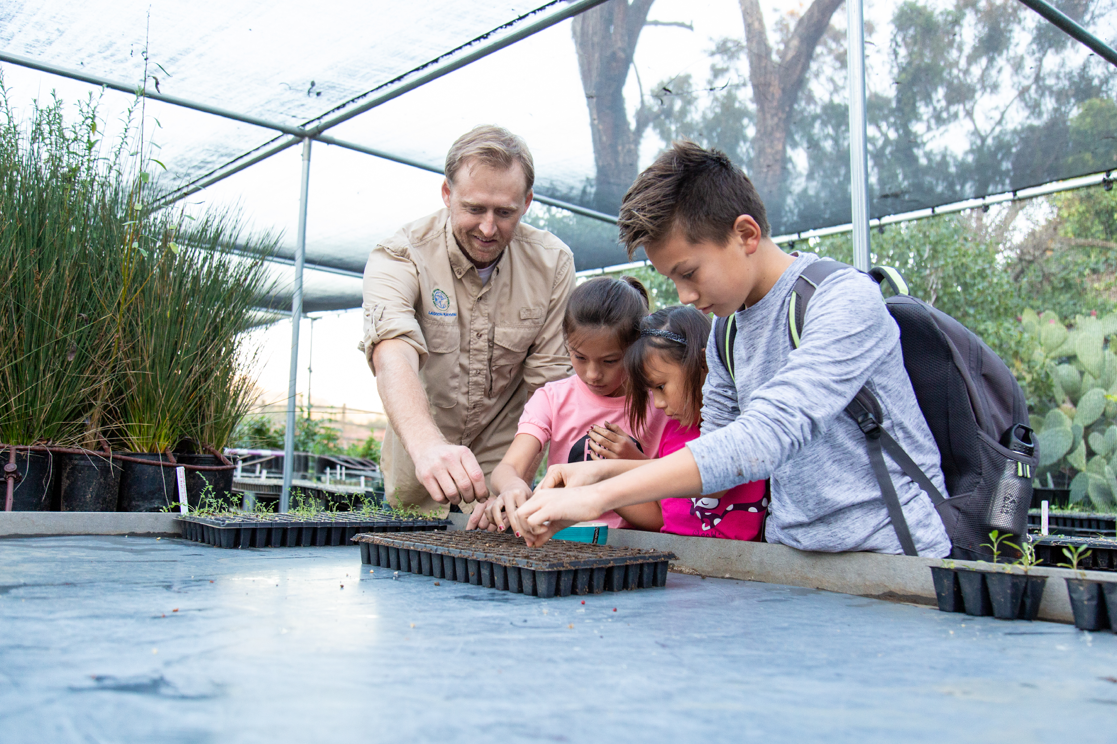
We provide experiences like
field trips, events, and tours

Slide 6
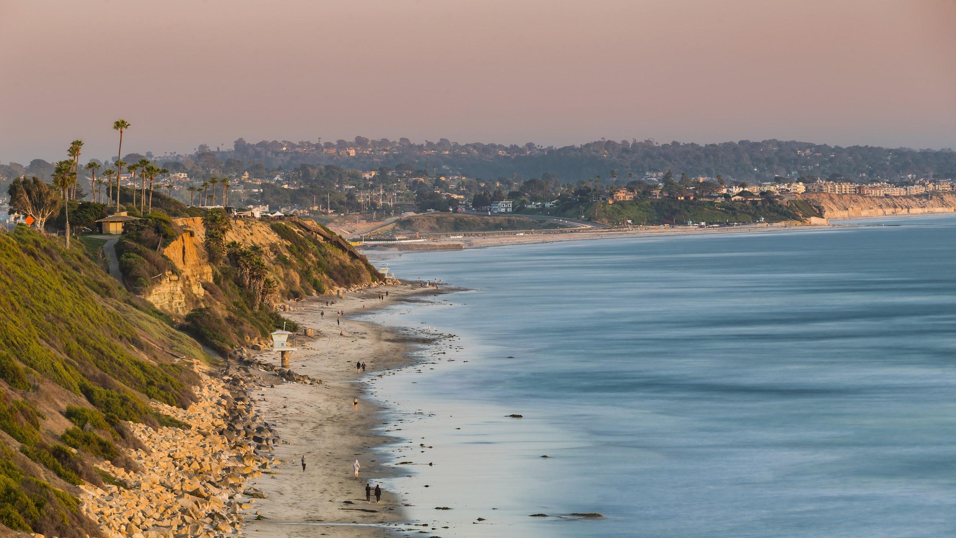


Slide 7

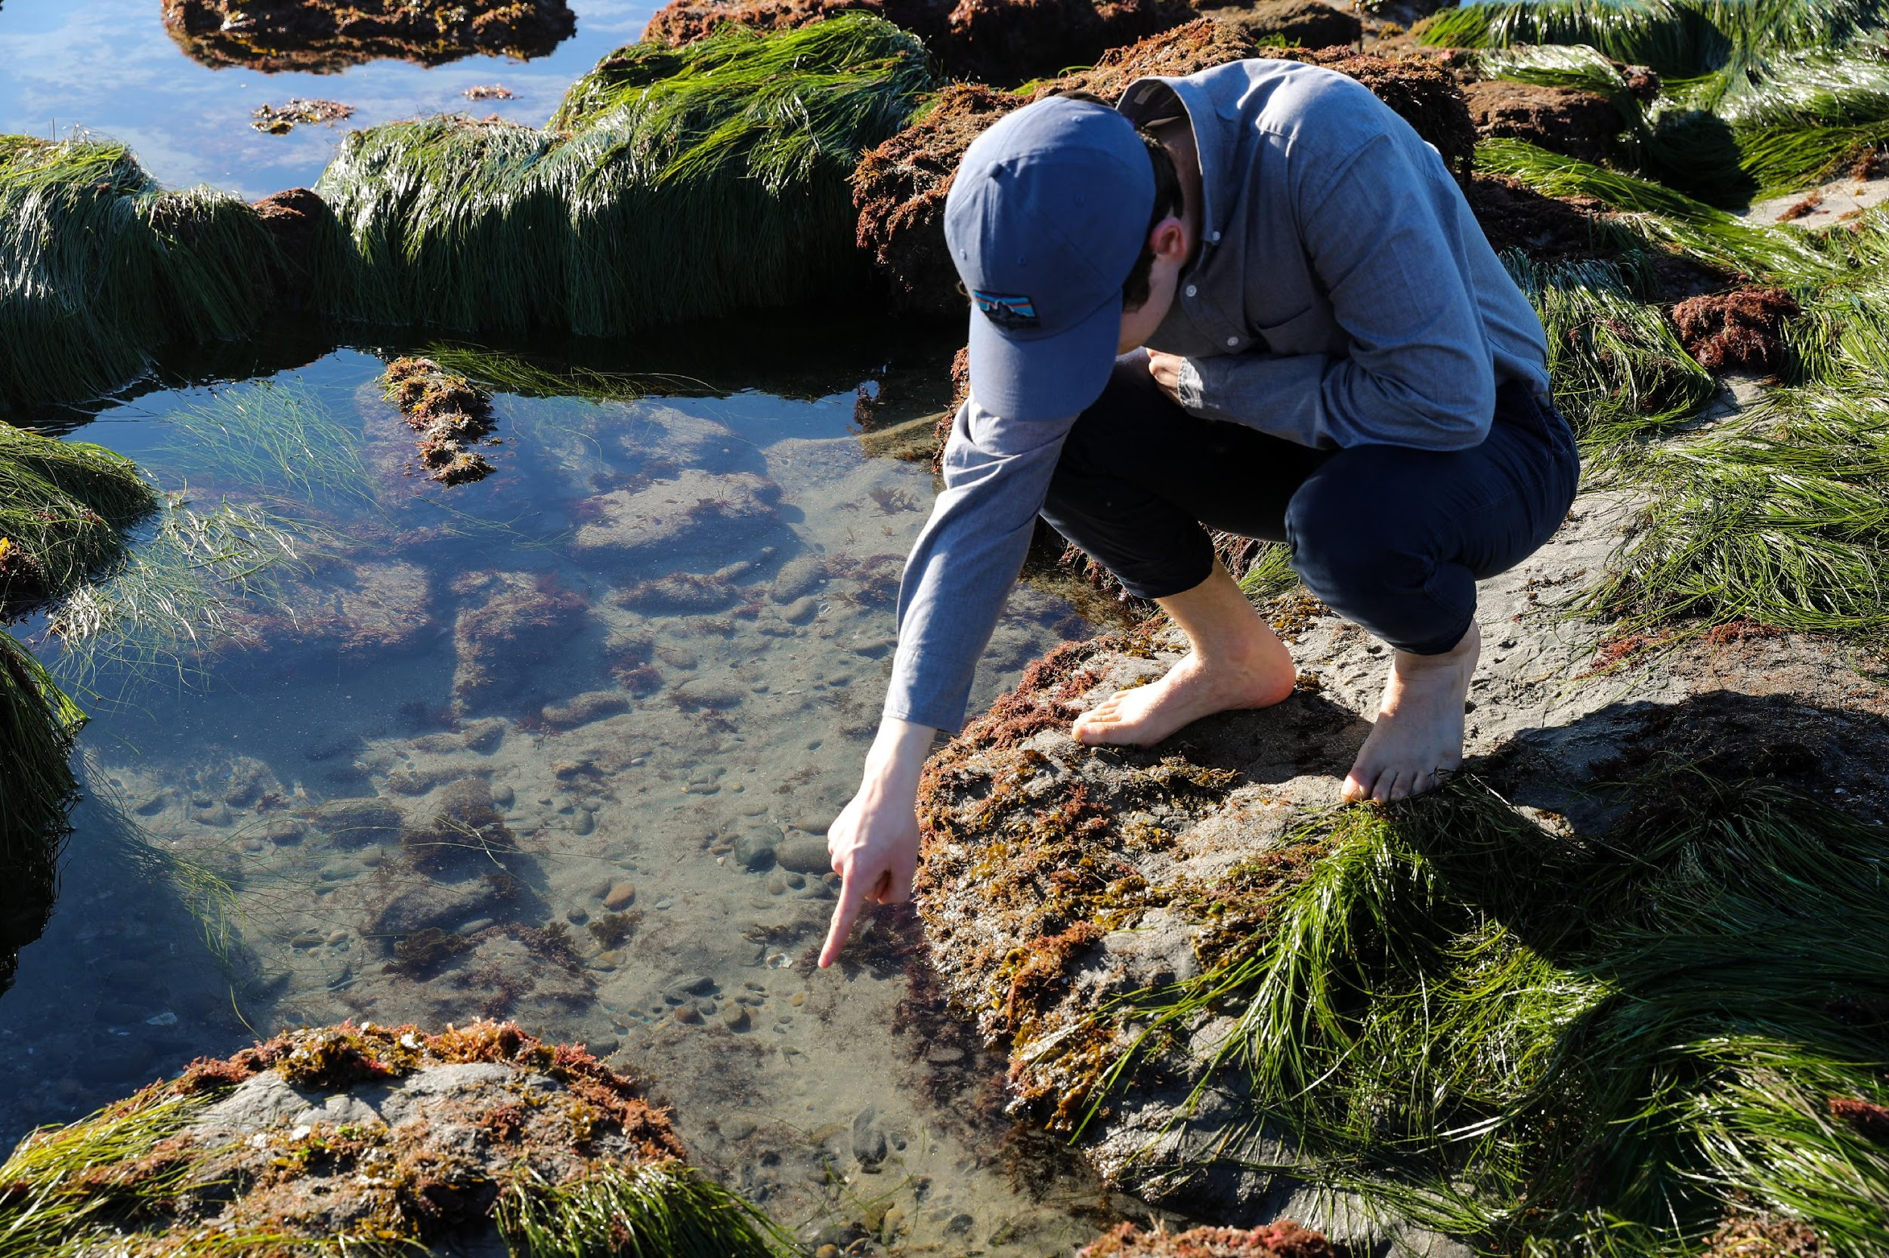
Swami’s Tidepools
History of Swami’s
Marine Protected Areas
Tidepool Exploration
Be an Ambassador
Notes:
Photo credit: Tanner Olthoff

Slide 8
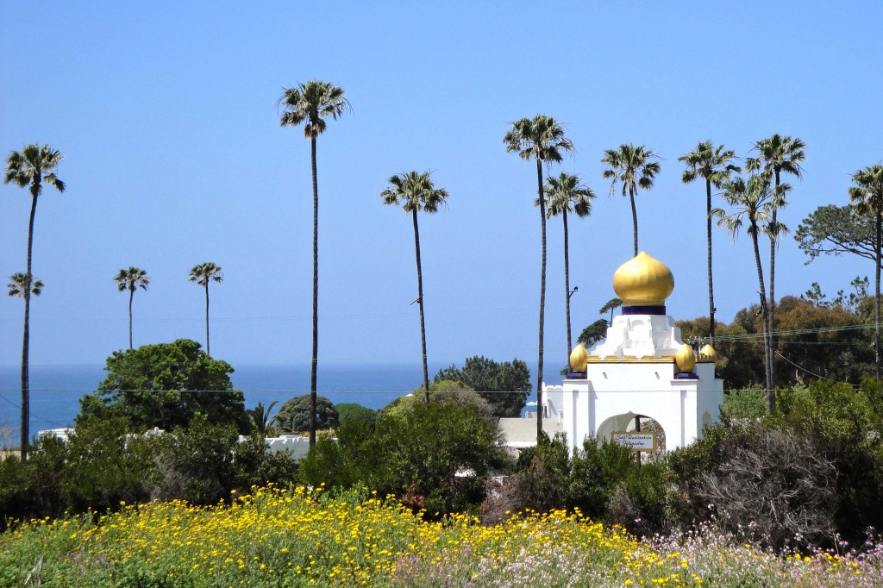

Swami’s History
Notes:
Photo credit: Tanner Olthoff

Slide 9
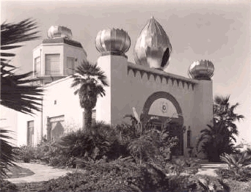
The Story of the Lotus Temple
Notes:
Photo credit: Tanner Olthoff

Slide 10
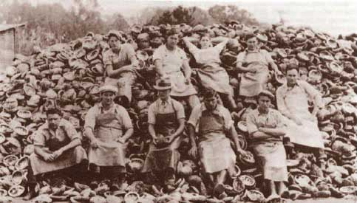
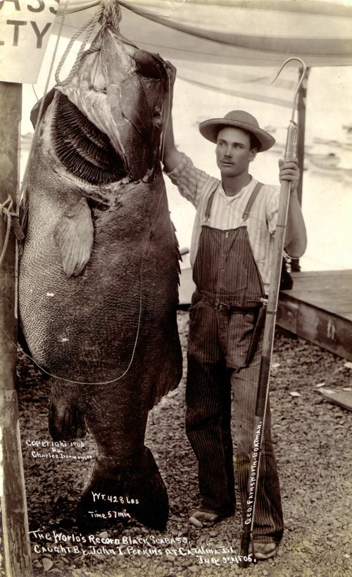
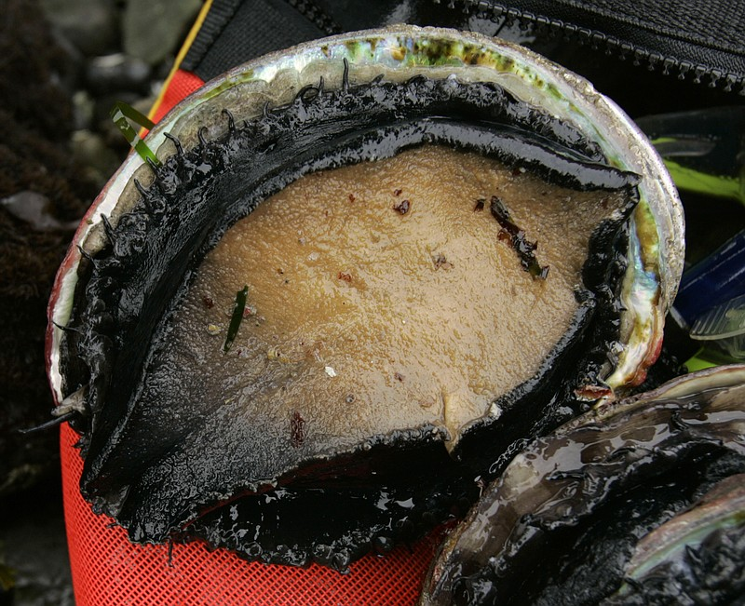
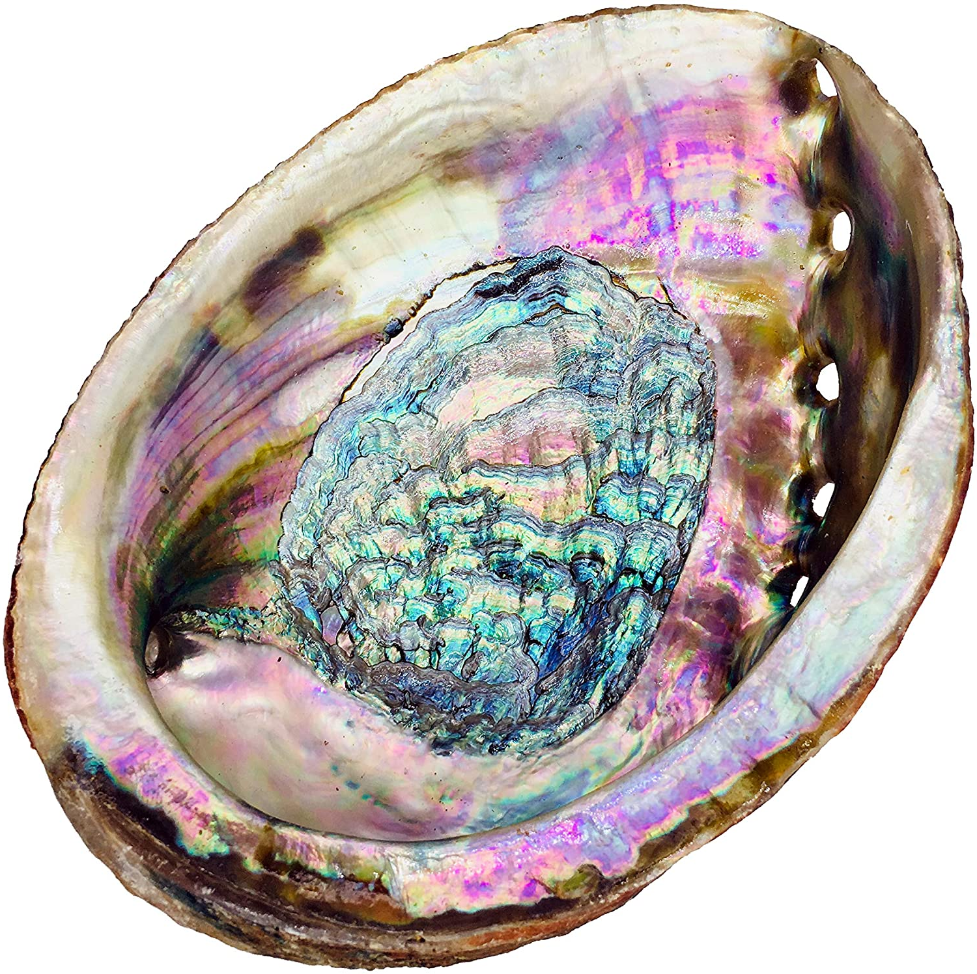
Abalone
Notes:
One the left is an image of a giant sea bass caught of Catalina Island in Southern California in 1906, weighing in at over 400 pounds. That’s about 4 times my size. Back then there was a big commercial and sport fishery sea bass, bringing in nearly a million pounds in some years. Under such intense pressure, landings decreased until finally a moratorium for sea bass was put in place in 1982. Sea bass are still protected, but they have yet to return to the size or number seen in the early 19009’s
In the image to the right shows how abundant abalone once were in California. These also were harvested zealously and neared extinction in the state. Today abalone are protected, but disease and changes in oceanographic conditions now threaten their recovery.
We should all be aware that California’s oceans are simply not the same as they were 100 years ago. While we likely wont be able to return to those days, with skies flocking with birds, and rivers pulsing with salmon, we do know now from experience that conservation CAN and does work.

Slide 11
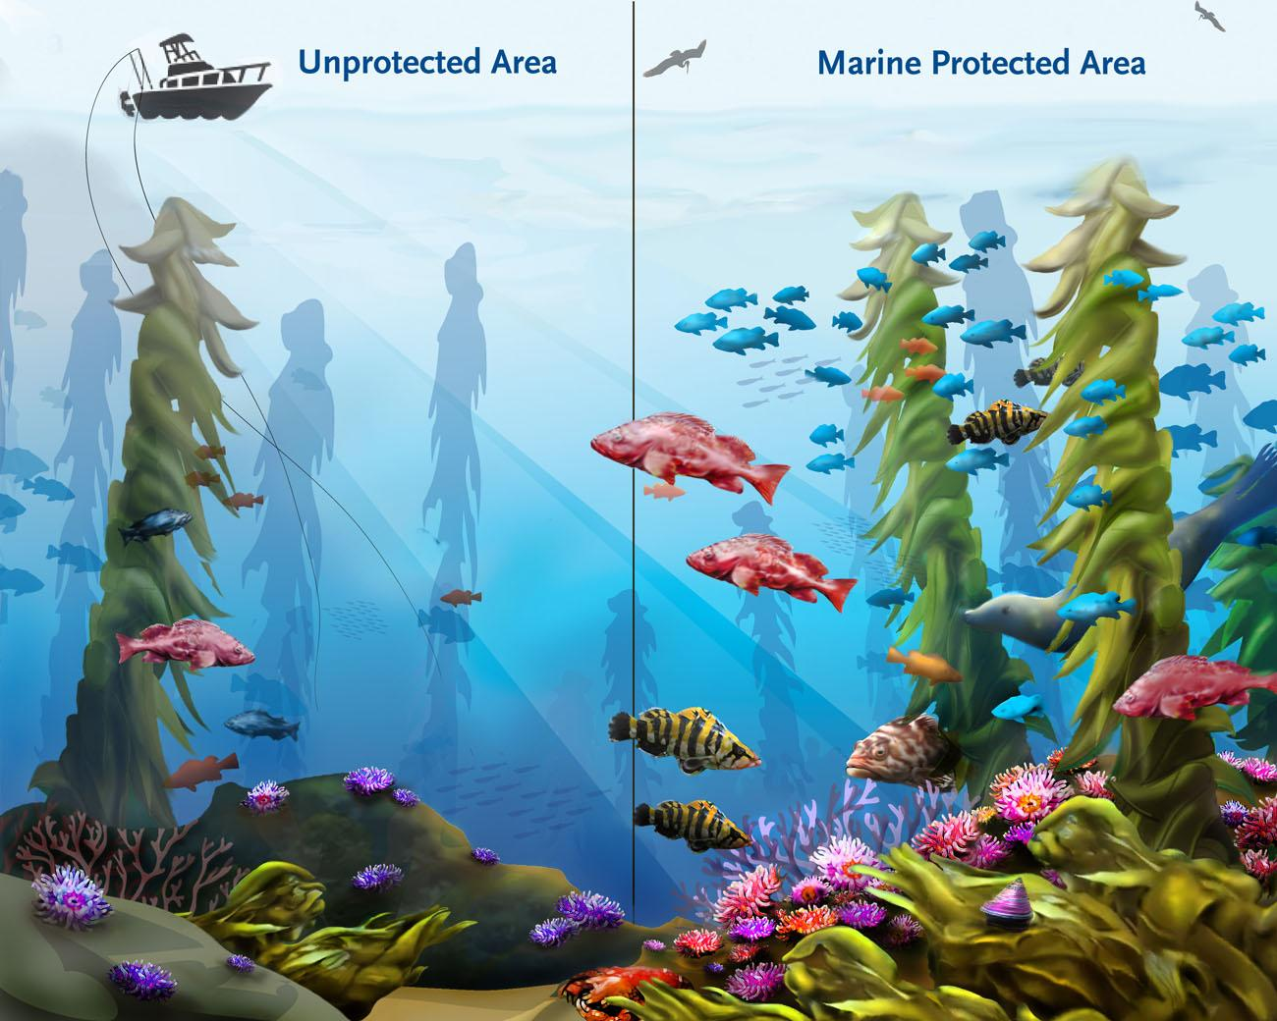
What is a Marine Protected Area?
Notes:
Photo credit: Tanner Olthoff

Slide 12
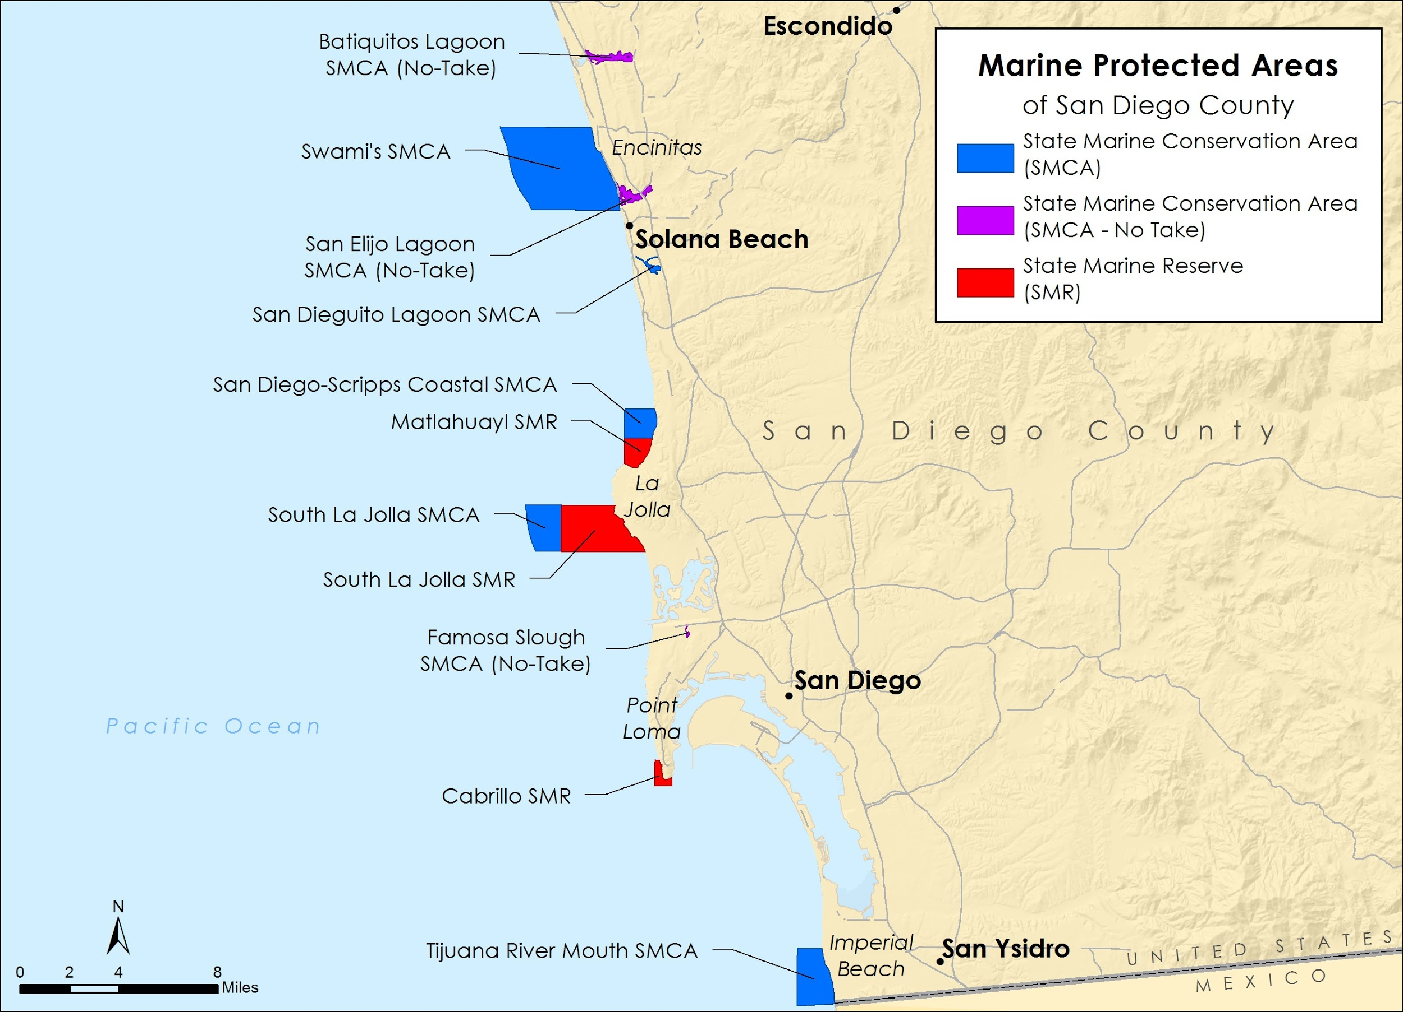
San Diego County Marine Protected Areas
Notes:
Photo credit: Tanner Olthoff

Slide 13
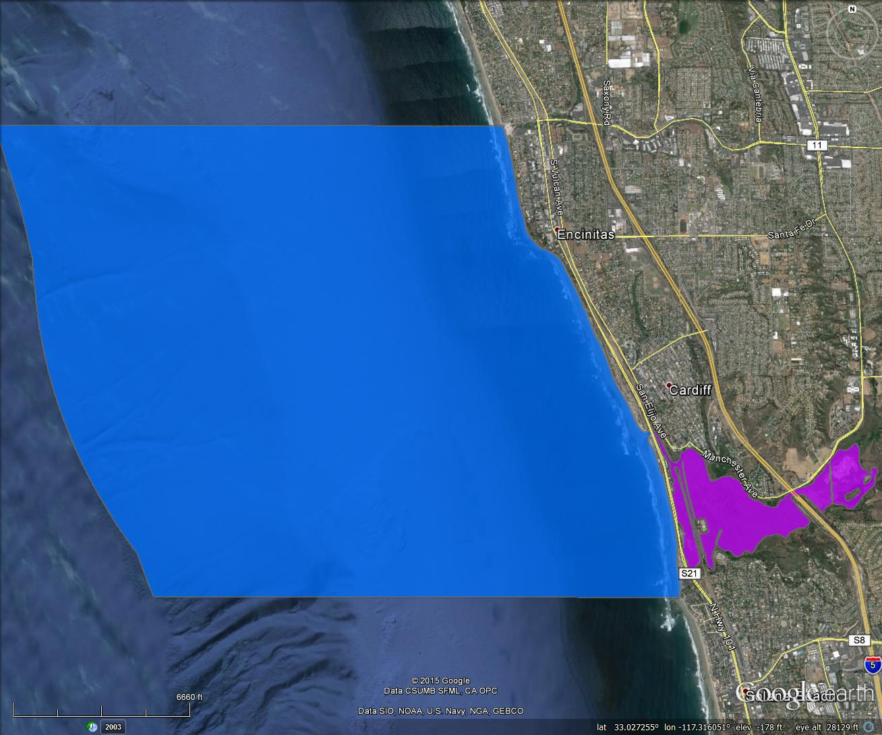
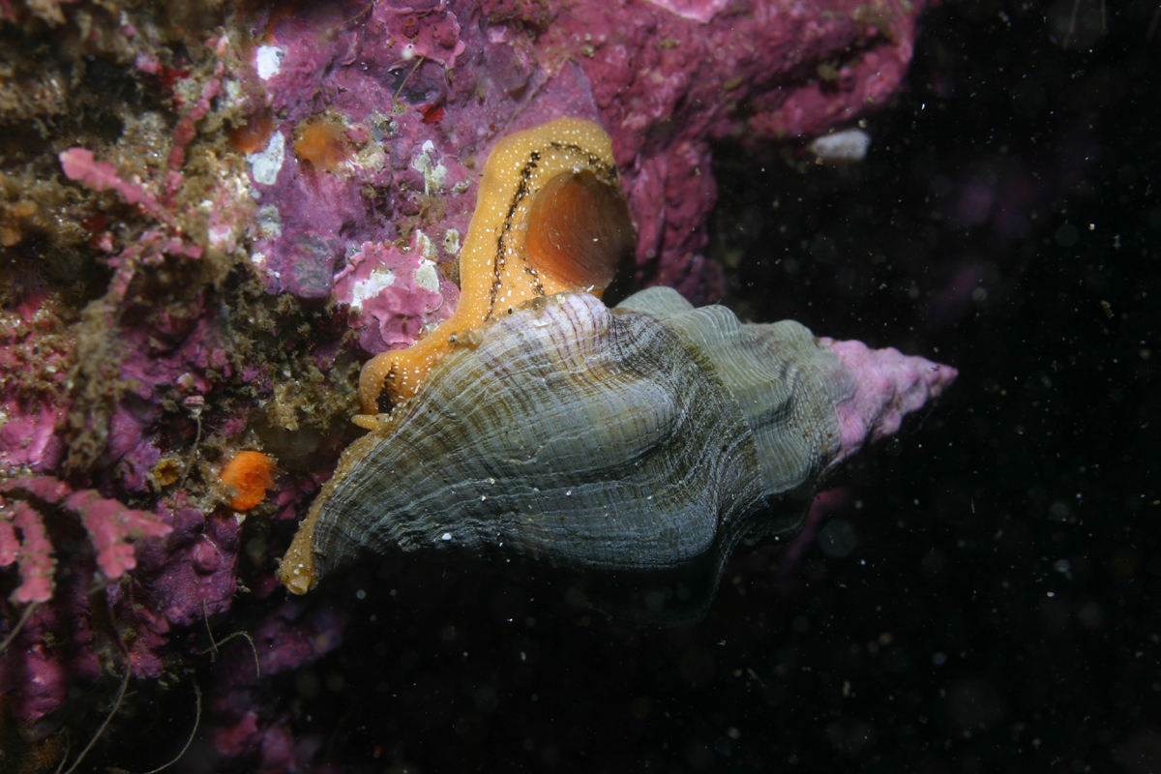
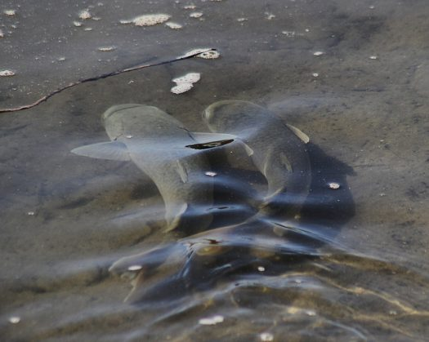
Swami’s State Marine Conservation Area (SMCA)
Notes:
Permitted/Prohibited Uses: Take of all living marine resources is prohibited except:
Recreational take by hook-and-line from shore is allowed.
no take of lobster, mention success story above and the importance of having this area protected. Calico bass, halibut ADD PHOTOS?
The recreational take by spearfishing of white seabass and pelagic finfish is allowed.
Take pursuant to the authorized activities listed below is allowed.
Pelagic finfish (CCR Title 14, Section 632(a)(3)), as defined for purposes of MPA regulations, are a subset of finfish defined as: northern anchovy (Engraulis mordax), barracudas (Sphyraena spp.), billfishes* (family Istiophoridae), dolphinfish (Coryphaena hippurus), Pacific herring (Clupea pallasii), jack mackerel (Trachurus symmetricus), Pacific mackerel (Scomber japonicus), salmon (Oncorhynchus spp.), Pacific sardine (Sardinops sagax), blue shark (Prionace glauca), salmon shark (Lamna ditropis), shortfin mako shark (Isurus oxyrinchus), thresher sharks (Alopias spp.), swordfish (Xiphias gladius), tunas (family Scombridae), including Pacific bonito (Sarda chiliensis), and yellowtail (Seriola lalandi). *Marlin is not allowed for commercial take.

Slide 14
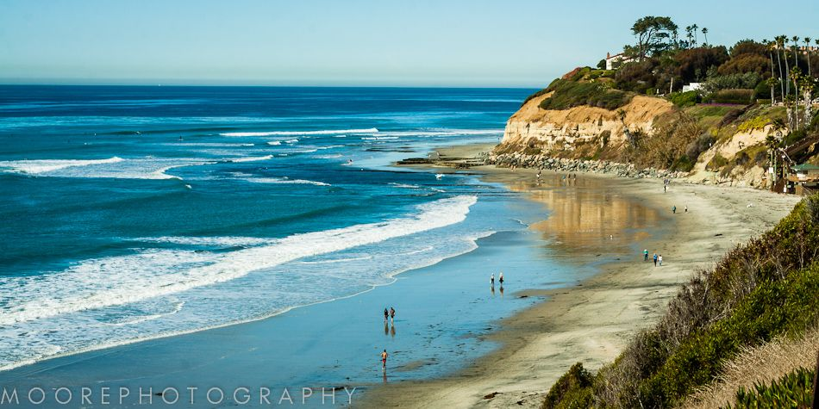
Swami’s Beach Encinitas
Notes:
Photo credit: Tanner Olthoff

Slide 15
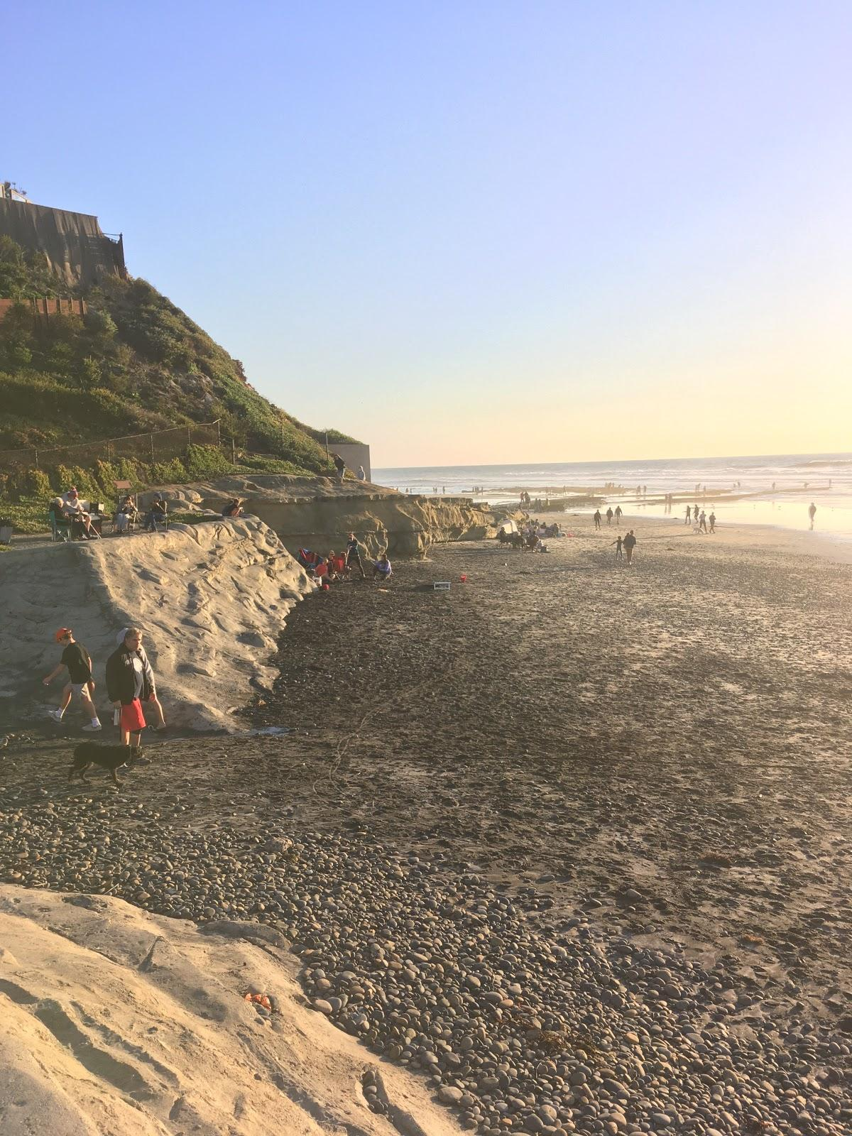
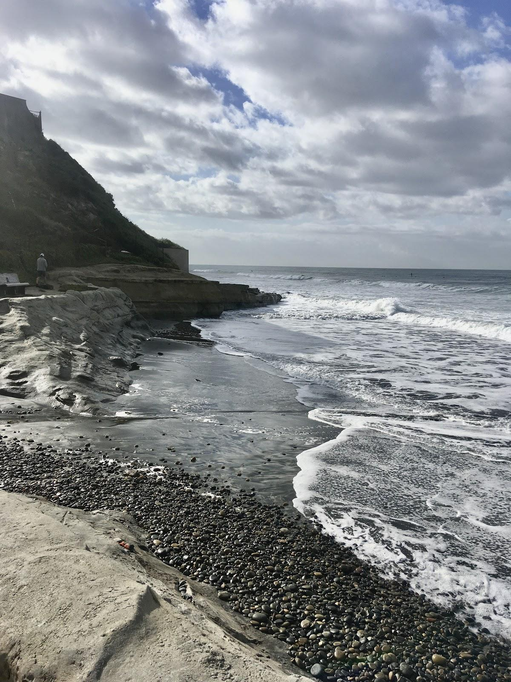
Low vs. High Tide

Slide 16
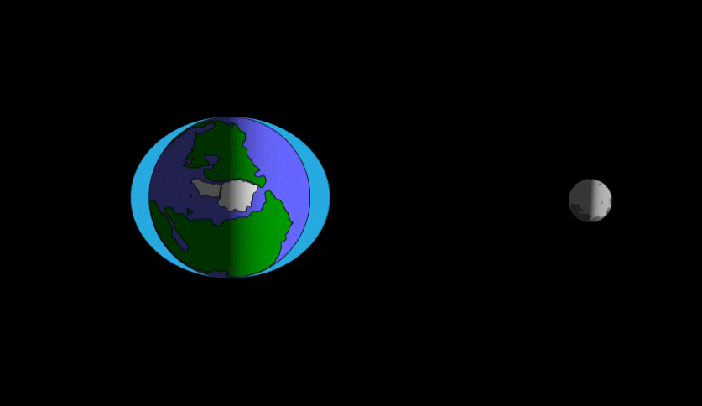
How Do Tides Work?

Slide 17
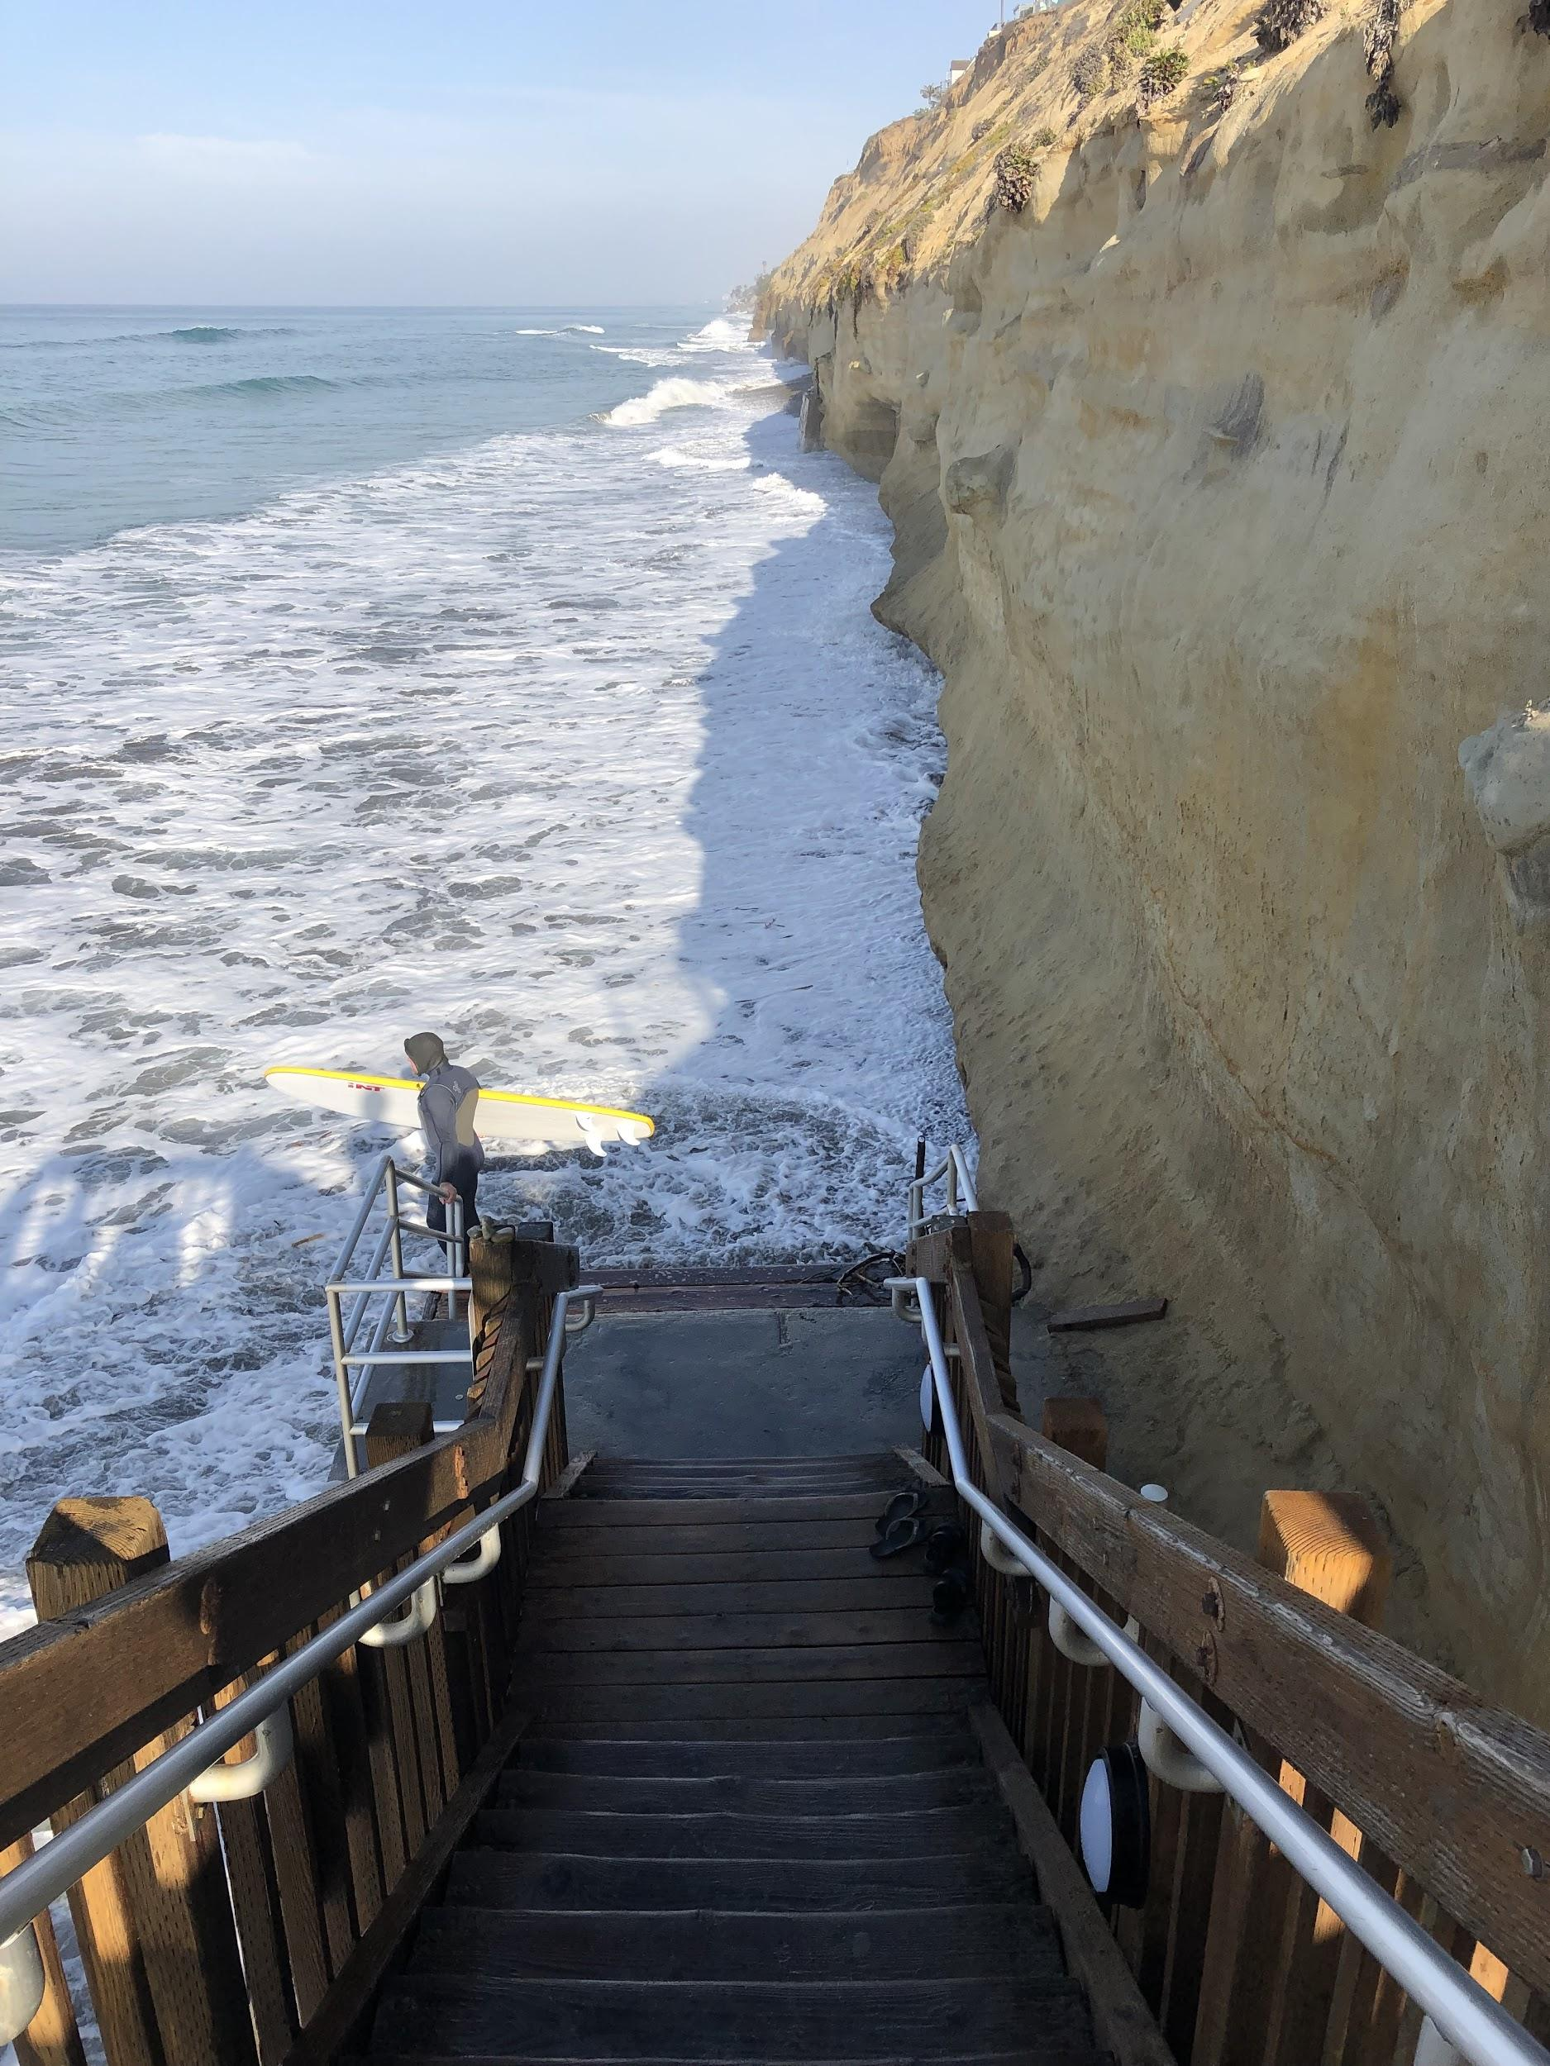
King Tides
Highest tides of the year
Glimpse of what our coast may look like as sea-level rises
Coastal access lost from high tide and swell. Encinitas 12/23/18 (Photo credit: Nick Sadrpour)
Notes:
https://caseagrant.ucsd.edu/extension-outreach/facts-and-resources/king-tides-a-cosmic-phenomenon
The term king tide is generally used to describe the highest tides of the year.
This year King Tides were November 15-16 and this coming weekend, December 13-15, 2020
King tides provide a great opportunity to get a glimpse of what our coast may look like as sea-level rises. The water level reached by an extreme high tide this weekend will be the same water level of more frequent moderate tides in the future. Seeing what areas flood during these events can help us plan for the future.

Slide 18
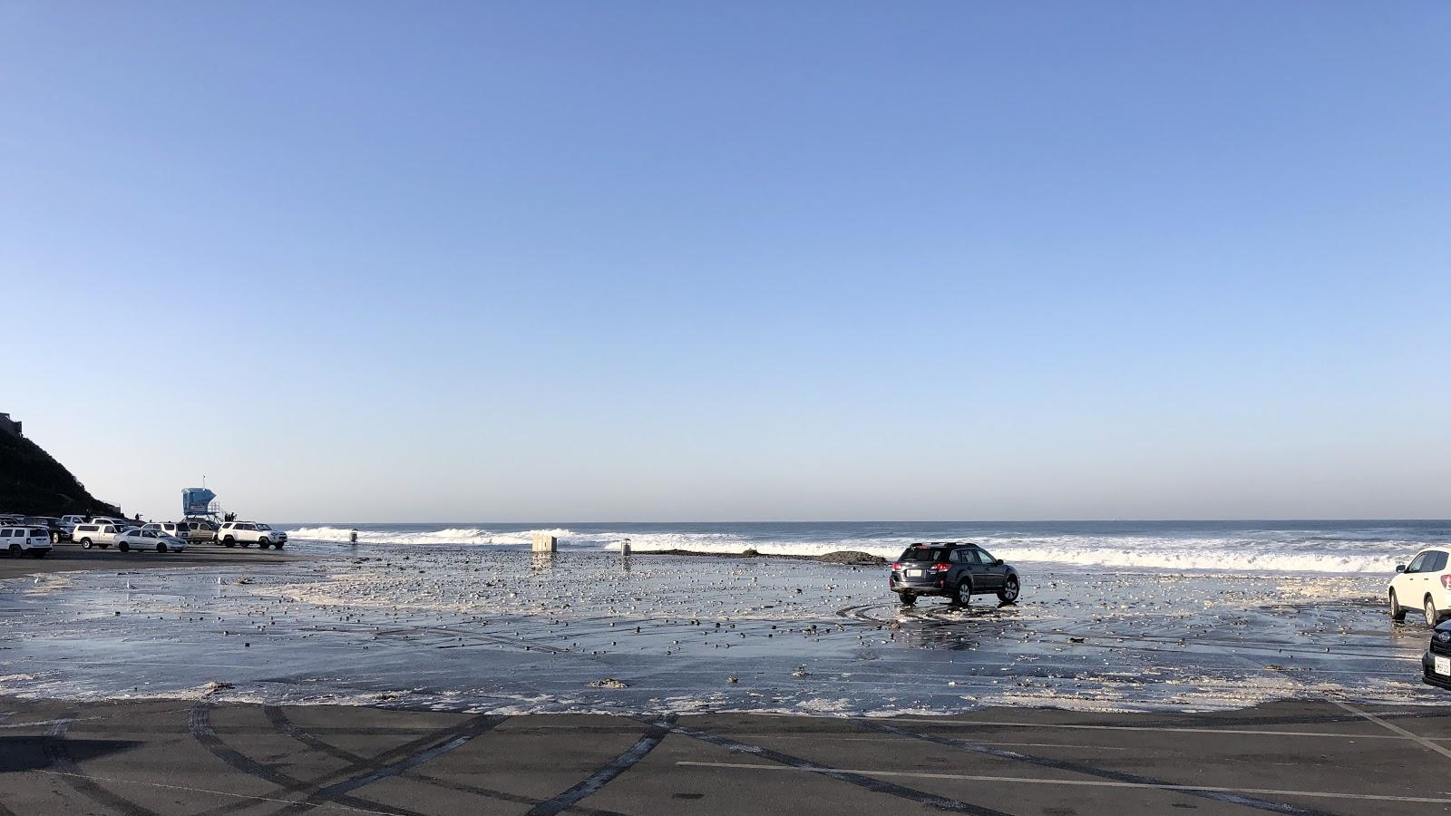
Cardiff State Beach | Nov. 2019
Notes:
Seaside State Beach Parking Lot 11/26/19 (Photo credit: Nick Sadrpour)

Slide 19
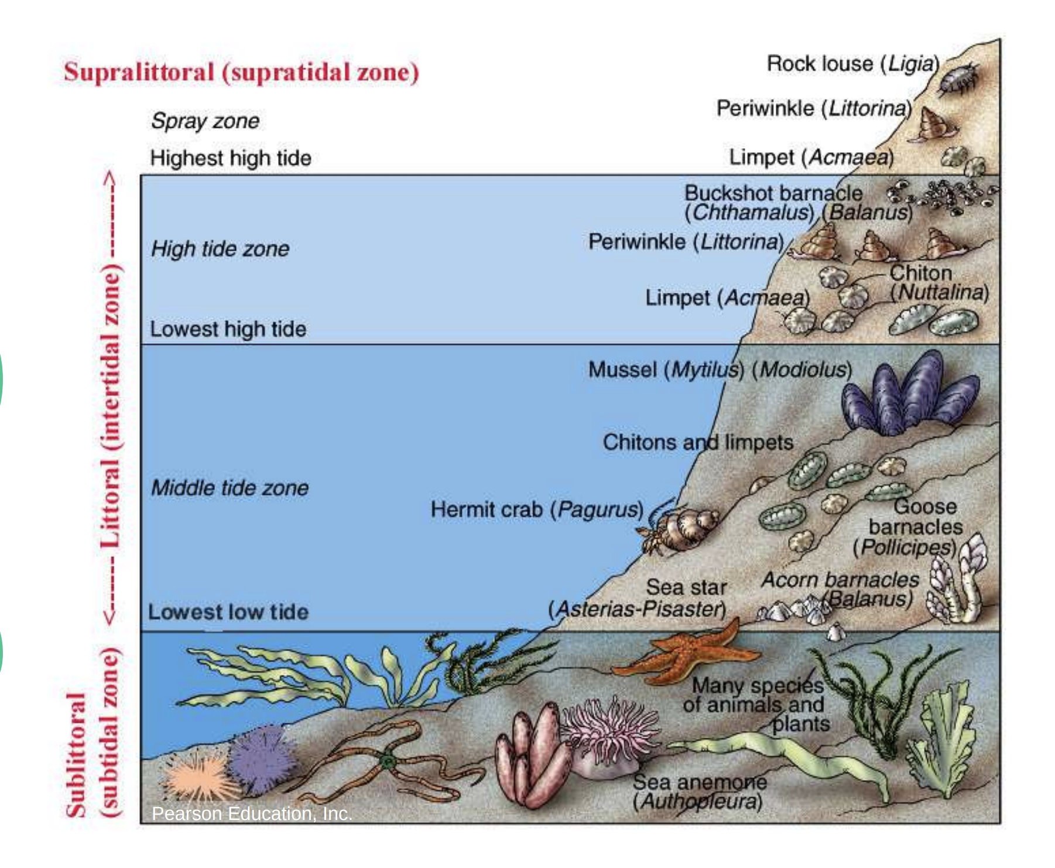
The Intertidal Zone
Notes:
The intertidal zone, the unique area between the high and low tide lines, is an unforgiving habitat.
The species that live there are subject to the harsh elements of both the land and the sea, going from completely underwater to only occasionally wet within just a few feet of space. See diagram.
Organisms that live in the intertidal zone must endure extreme changes in moisture level, temperature, salinity, and sunlight creating a robust assortment of biologically diverse organisms.
These creatures have special adaptations that allow them to endure these conditions, creating an adventure for anyone who visits this space.

Slide 20
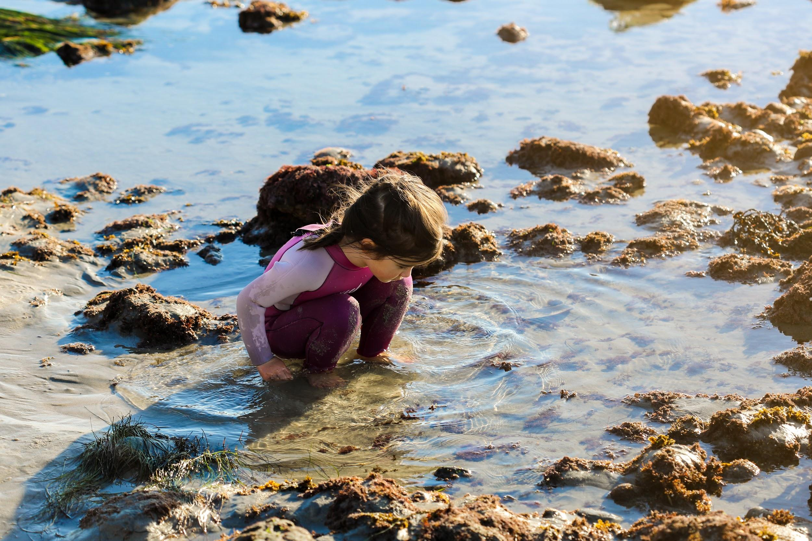
Let’s Discover Tidepools!
Notes:
Permitted/Prohibited Uses: Take of all living marine resources is prohibited except:
Recreational take by hook-and-line from shore is allowed.
no take of lobster, mention success story above and the importance of having this area protected. Calico bass, halibut ADD PHOTOS?
The recreational take by spearfishing of white seabass and pelagic finfish is allowed.
Take pursuant to the authorized activities listed below is allowed.
Pelagic finfish (CCR Title 14, Section 632(a)(3)), as defined for purposes of MPA regulations, are a subset of finfish defined as: northern anchovy (Engraulis mordax), barracudas (Sphyraena spp.), billfishes* (family Istiophoridae), dolphinfish (Coryphaena hippurus), Pacific herring (Clupea pallasii), jack mackerel (Trachurus symmetricus), Pacific mackerel (Scomber japonicus), salmon (Oncorhynchus spp.), Pacific sardine (Sardinops sagax), blue shark (Prionace glauca), salmon shark (Lamna ditropis), shortfin mako shark (Isurus oxyrinchus), thresher sharks (Alopias spp.), swordfish (Xiphias gladius), tunas (family Scombridae), including Pacific bonito (Sarda chiliensis), and yellowtail (Seriola lalandi). *Marlin is not allowed for commercial take.

Slide 21
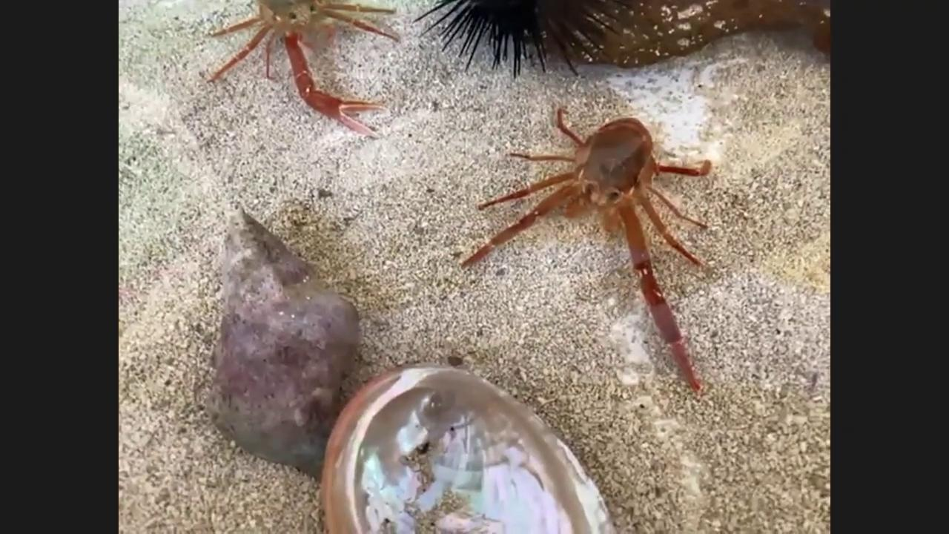

Slide 22
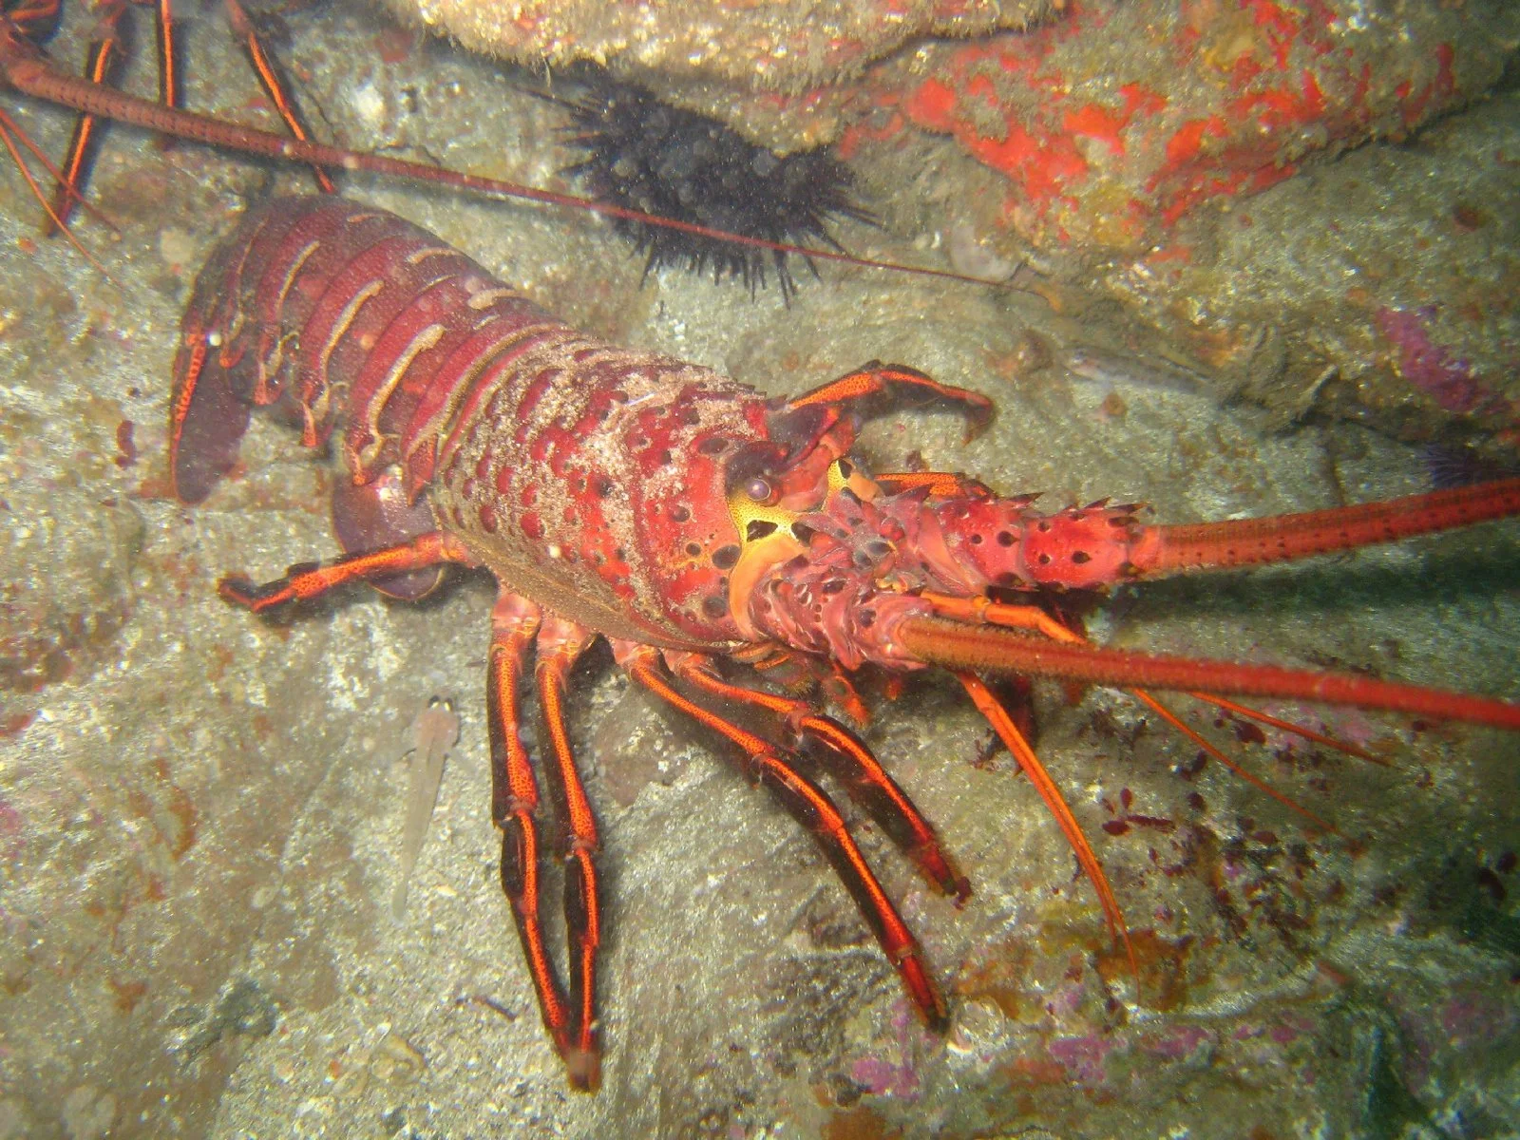
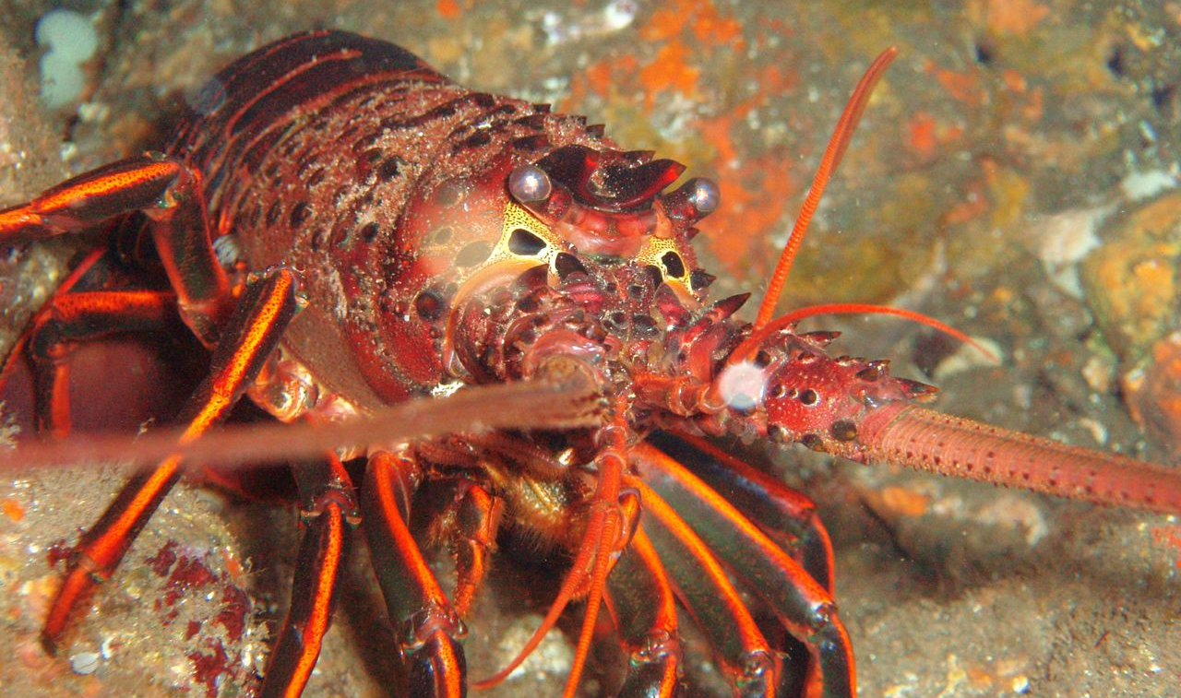
Notes:
MPAs protect not only critical habitat, but also provide refuge for animals to grow in size and number. One success story involves the spiny lobster. In the Channel Islands, where marine protected areas have been in place for 10 years, researchers found larger and more abundant lobsters. Nearby fished areas had fewer, smaller lobsters. While trophy lobsters (or extremely large, fecund lobsters) are becoming scarce throughout California, they are able to flourish and mature inside protected areas. Researchers tagged lobsters inside the protected areas, and tracked them outside in areas open to fishing. This means that underwater parks not only offer a conservation benefit to lobster, but that fishermen can also enjoy the benefits of protection by being able to catch them as they move outside the boundaries of protection. These findings also show promise for southern California’s kelp forest ecosystem, as lobster are key to the health of kelp forests.

Slide 23
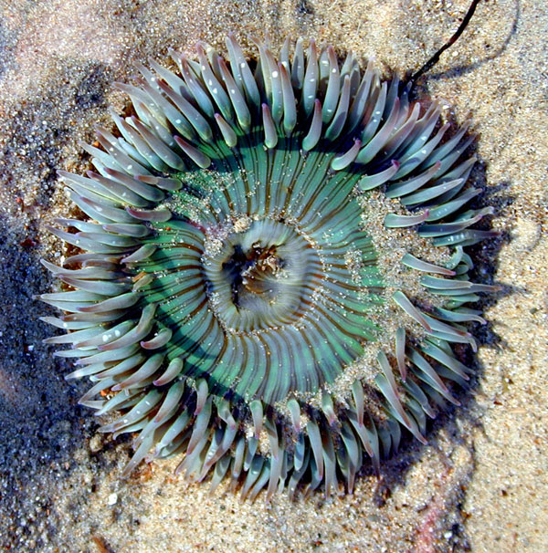
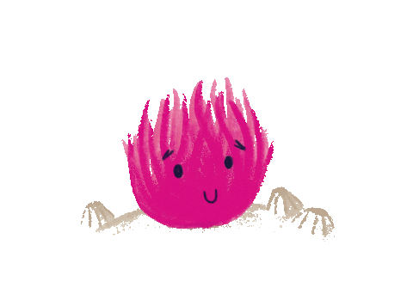
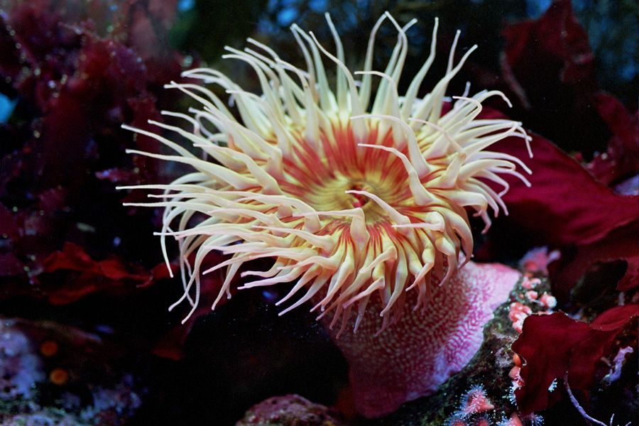
Notes:
Sea Anemone How many of you think you have seen an animal that looks like this?
This is called a sea anemone. And sea anemones are named after flowers! Because at high tide, when the water covers them, they open up their tentacles and they move them around like this and they look like a sea flower (wave hands in the air). Everybody Show me your tentacles and be an underwater sea flower with me!
But they don’t have petals like a flower, they actually have tentacles. Those tentacles have stinging cells inside, so they’re related to jellyfish and sea jellies.
Sea anemones are very slow moving, which means they rely on the water current to bring food to them. When Pieces of food float close enough to their tentacles, they grab it and bring it to the center of their bodies, which is where their mouth is. This is called filter feeding. When you touch a sea anemone it could cost them their meal so be sure you observe them with just your eyes.
Another cool thing about sea anemones is that they can survive being out of the water during low tide. They do this by tucking all their tentacles inside. They look like this! This helps them survive by holding in their water.
You will notice that the sea anemone has little pieces of shell stuck to the outside of its body, this helps reflect the sunlight almost like sunscreen!
These special features the anemone has are called Adaptations. An adaptation is a special skill or behaviour which helps an animal to survive in the habitat they live in. In fact almost all tidepool animals have unique ways to survive!

Slide 24
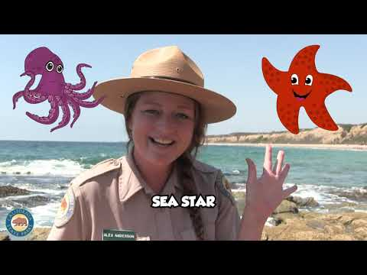
Notes:
Permitted/Prohibited Uses: Take of all living marine resources is prohibited except:
Recreational take by hook-and-line from shore is allowed.
no take of lobster, mention success story above and the importance of having this area protected. Calico bass, halibut ADD PHOTOS?
The recreational take by spearfishing of white seabass and pelagic finfish is allowed.
Take pursuant to the authorized activities listed below is allowed.
Pelagic finfish (CCR Title 14, Section 632(a)(3)), as defined for purposes of MPA regulations, are a subset of finfish defined as: northern anchovy (Engraulis mordax), barracudas (Sphyraena spp.), billfishes* (family Istiophoridae), dolphinfish (Coryphaena hippurus), Pacific herring (Clupea pallasii), jack mackerel (Trachurus symmetricus), Pacific mackerel (Scomber japonicus), salmon (Oncorhynchus spp.), Pacific sardine (Sardinops sagax), blue shark (Prionace glauca), salmon shark (Lamna ditropis), shortfin mako shark (Isurus oxyrinchus), thresher sharks (Alopias spp.), swordfish (Xiphias gladius), tunas (family Scombridae), including Pacific bonito (Sarda chiliensis), and yellowtail (Seriola lalandi). *Marlin is not allowed for commercial take.

Slide 25
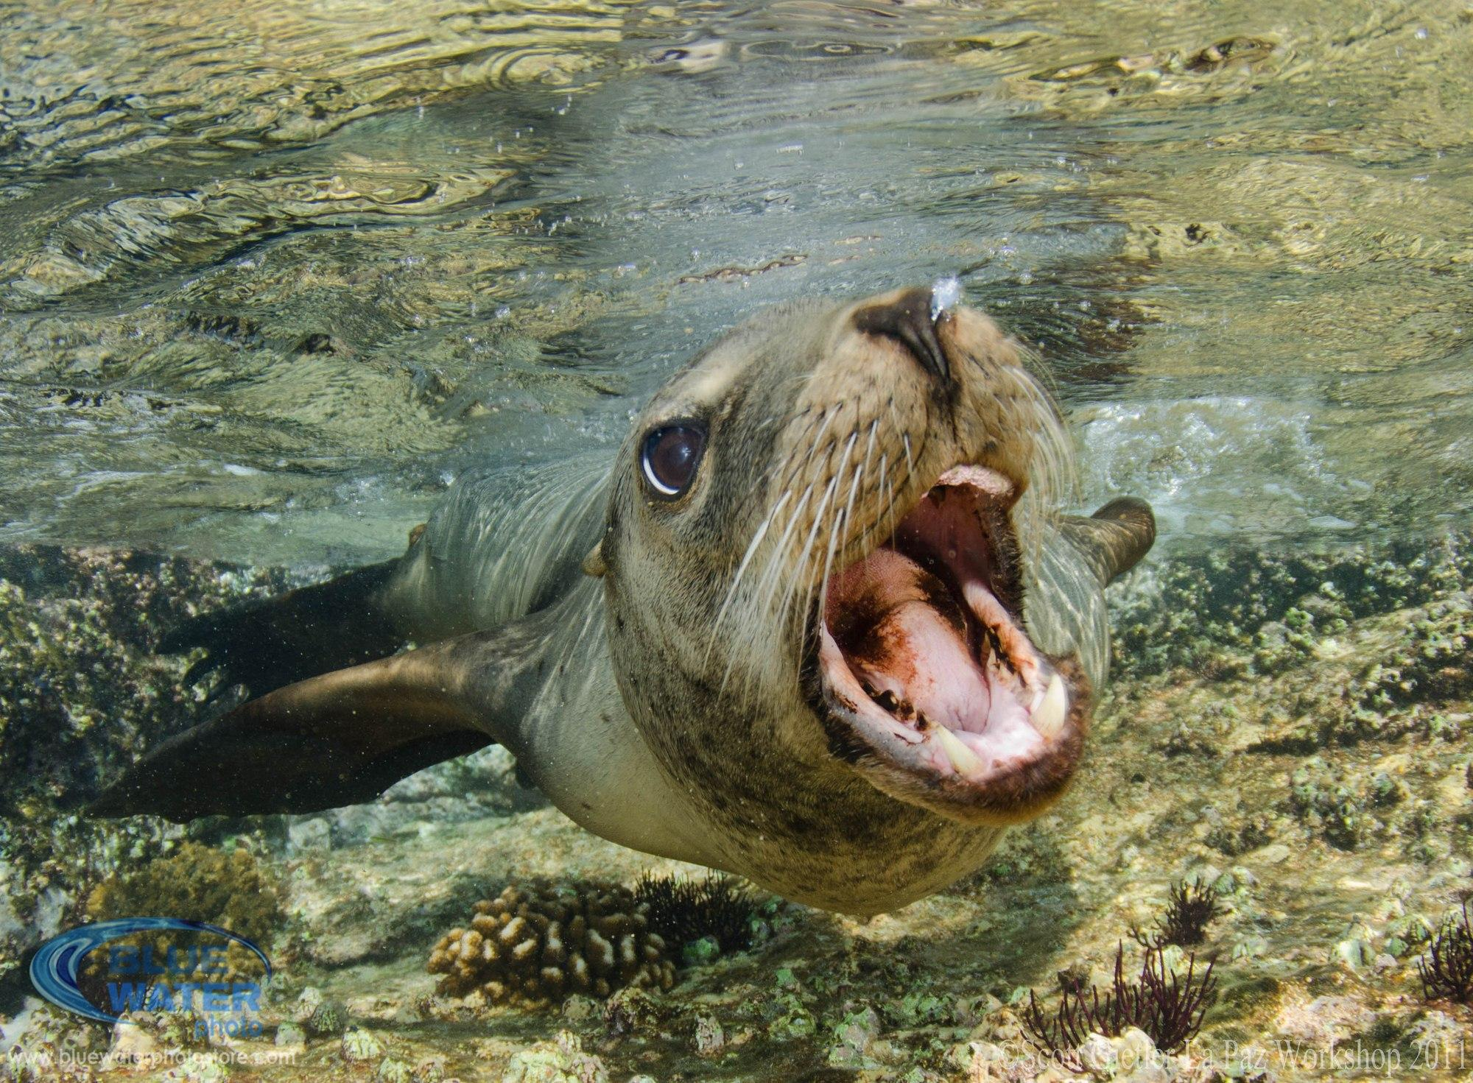
Respect the Tidepools
Pick bare spots to step
Enjoy the animals by observing them
Only take happy memories and photos of your day at the tide pools!
Notes:
Photo credit: Tanner Olthoff

Slide 26
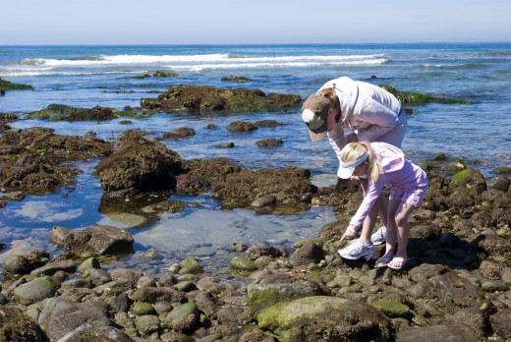
Upcoming Negative Low Tides
Friday, March 12
3:00 PM
Saturday, March 13
4:00 PM
Notes:
edit dates and times

Slide 27
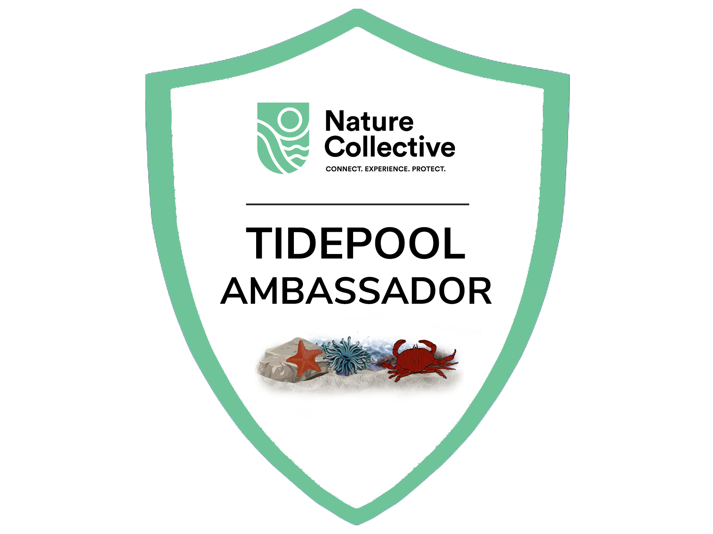

Slide 28
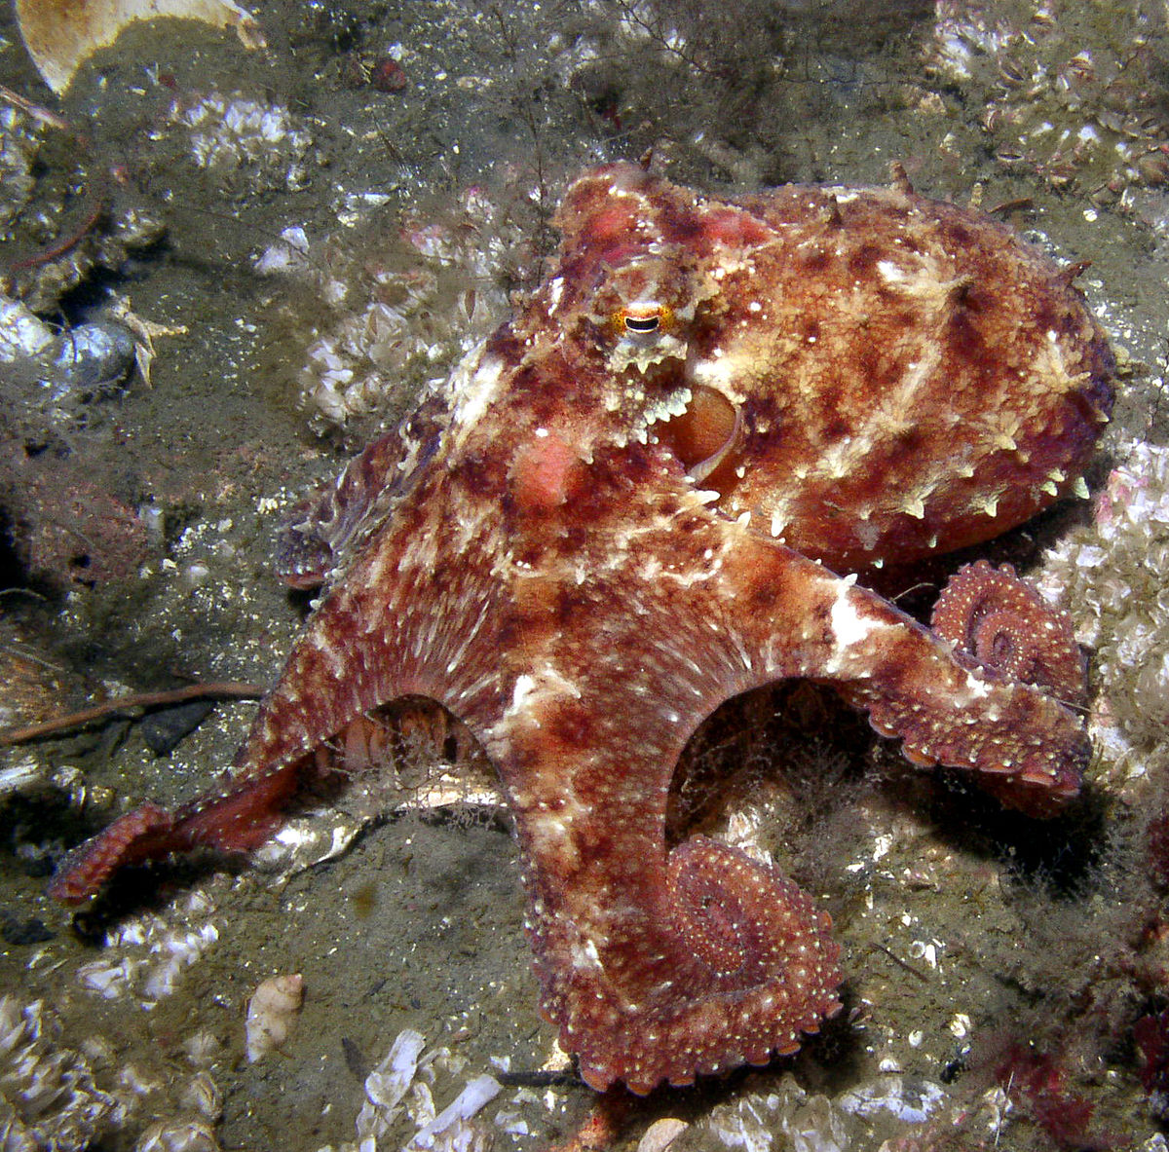
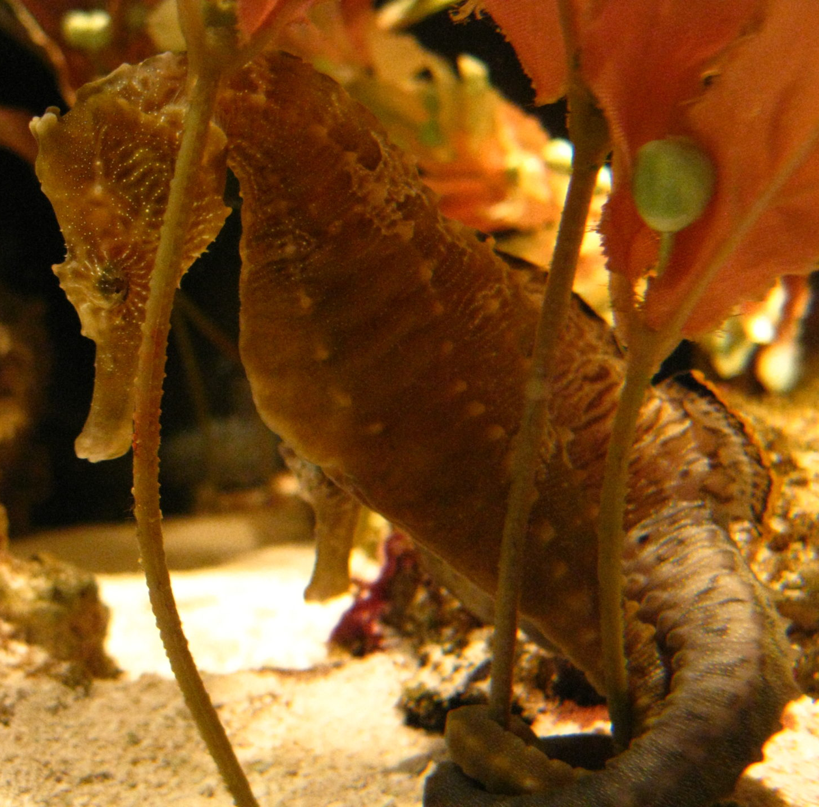
Join Us
Virtual Connections
Animal Encounters
Third Thursdays at 3:30 pm
May 20: Oh, Octopus!

