Slide 2
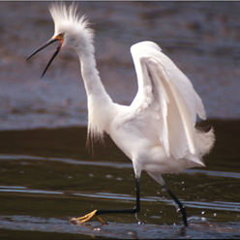
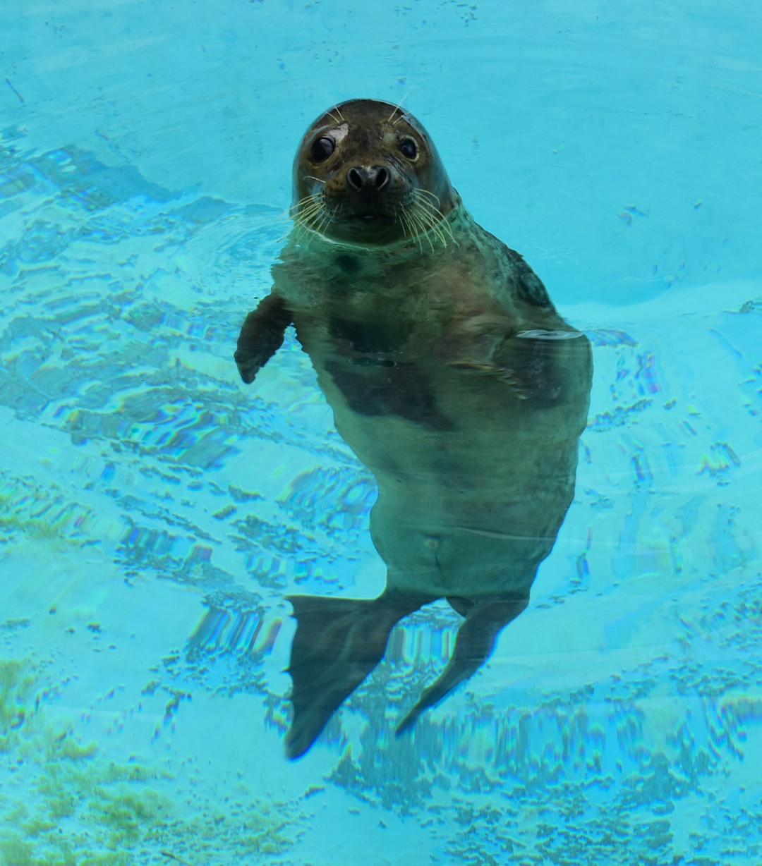
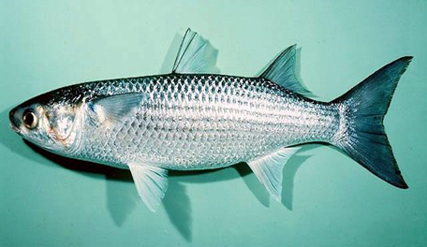
WONDERS OF WATER _________
Types of Water
Water Cycle
Watershed
Water Uses

Slide 3
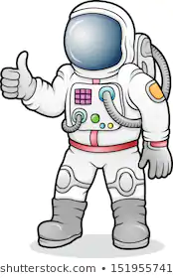
IMAGINARY ADVENTURE _________

Slide 4
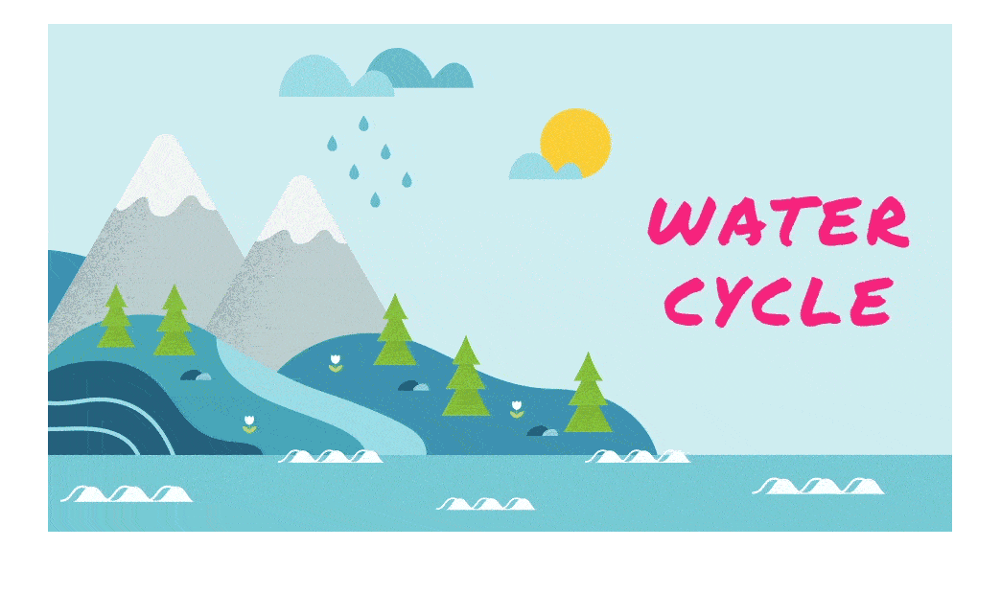
WHAT IS THE WATER CYCLE? _________
The continuous movement of water on, above and below the surface of the Earth

Slide 5
5 WATER CYCLE STAGES: _________
Transpiration
Evaporation
Condensation
Precipitation
Accumulation

Slide 6
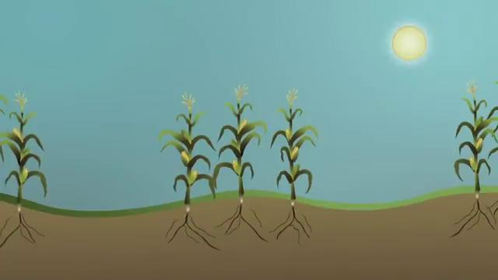
TRANSPIRATION _________

Slide 7
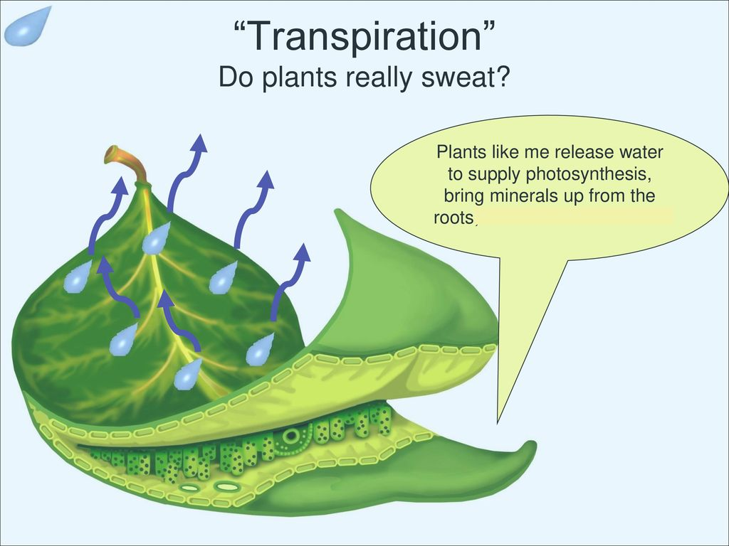
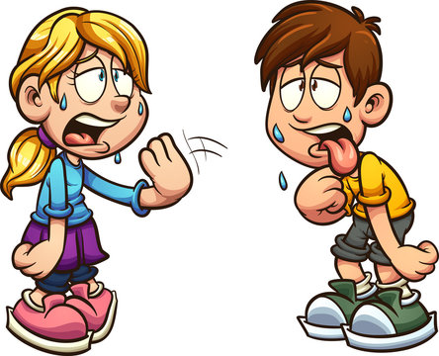
TRANSPIRATION _________

Slide 8
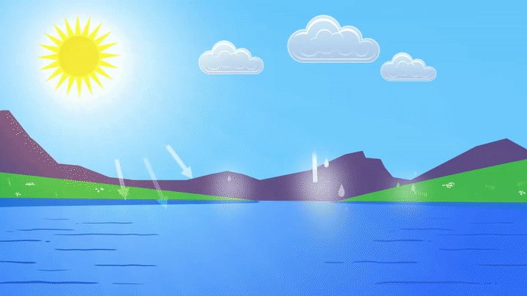
EVAPORATION _________

Slide 9
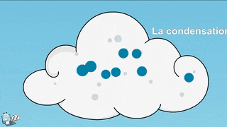
CONDENSATION _________

Slide 10
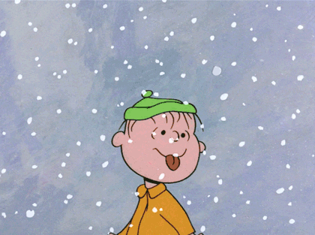
PRECIPITATION _________

Slide 11
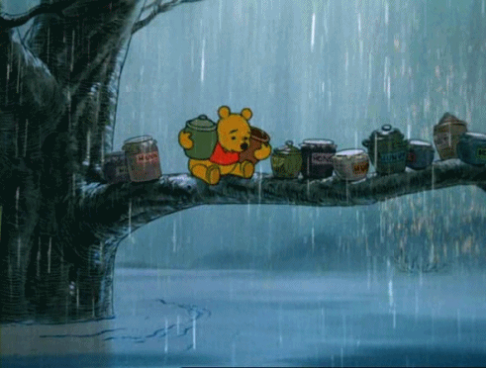
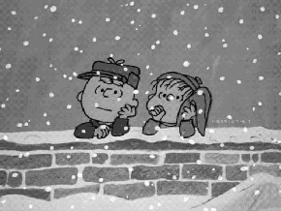
ACCUMULATION _________

Slide 12
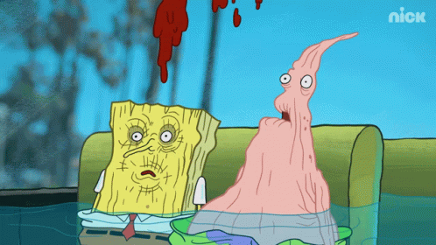
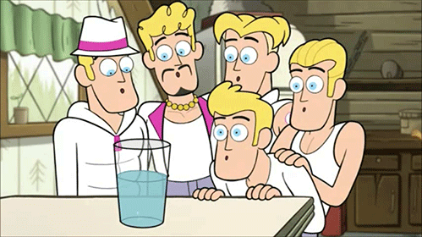
WHY IS THE WATER CYCLE IMPORTANT? _________

Slide 14
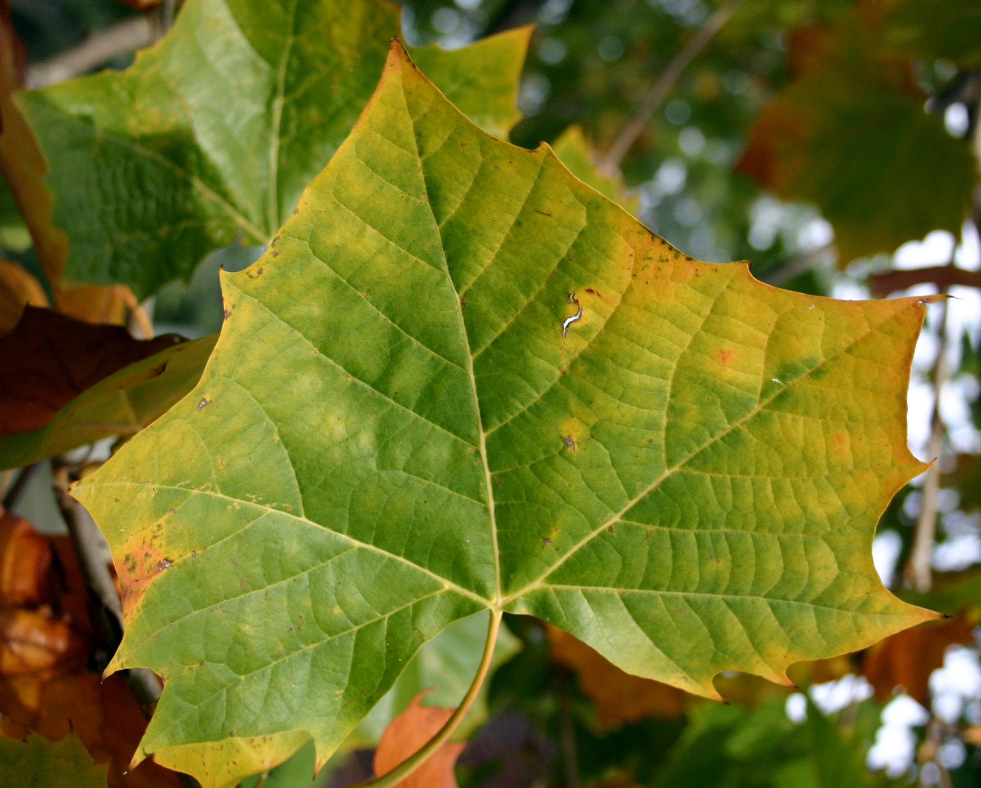
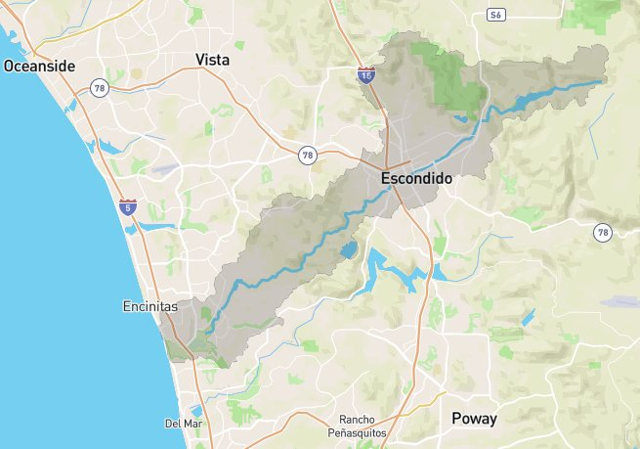
What is a Watershed?

Slide 15
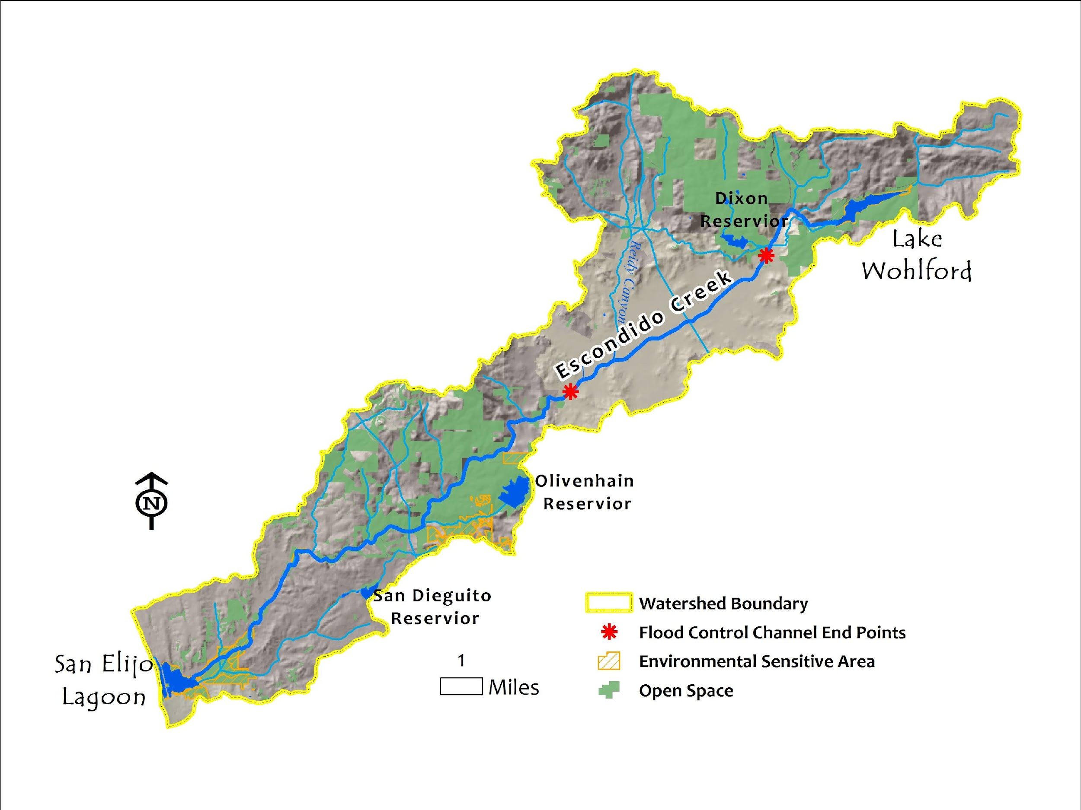
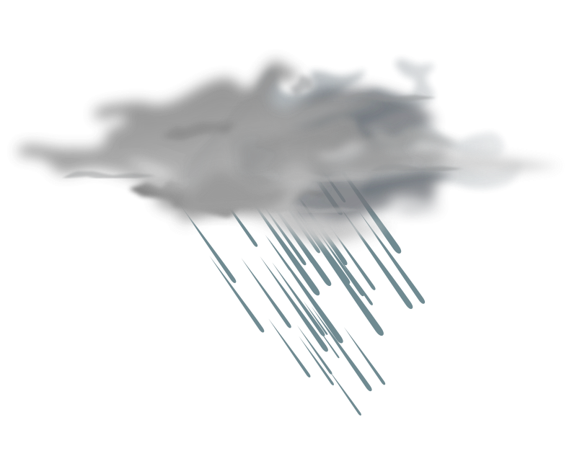
We live in the Escondido Creek Watershed

Slide 16
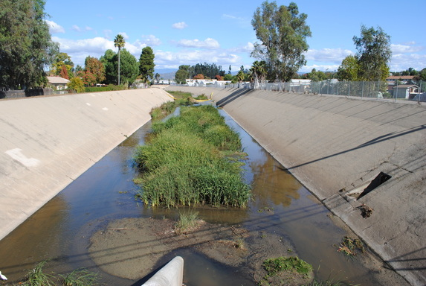
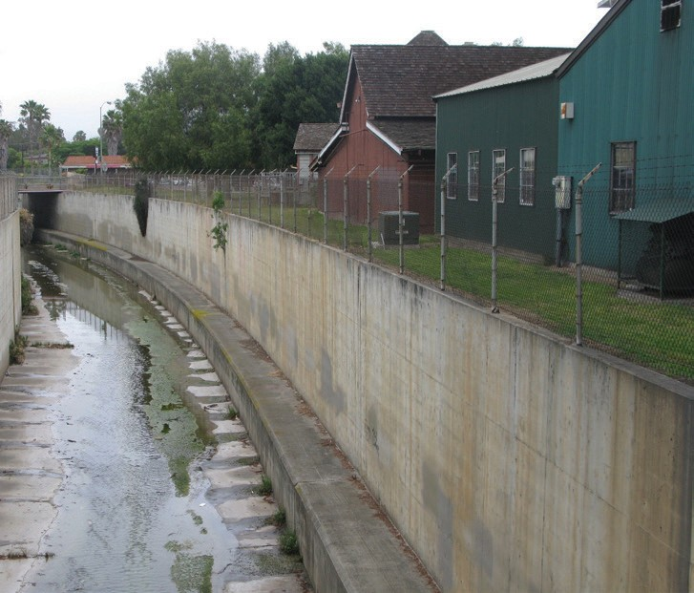
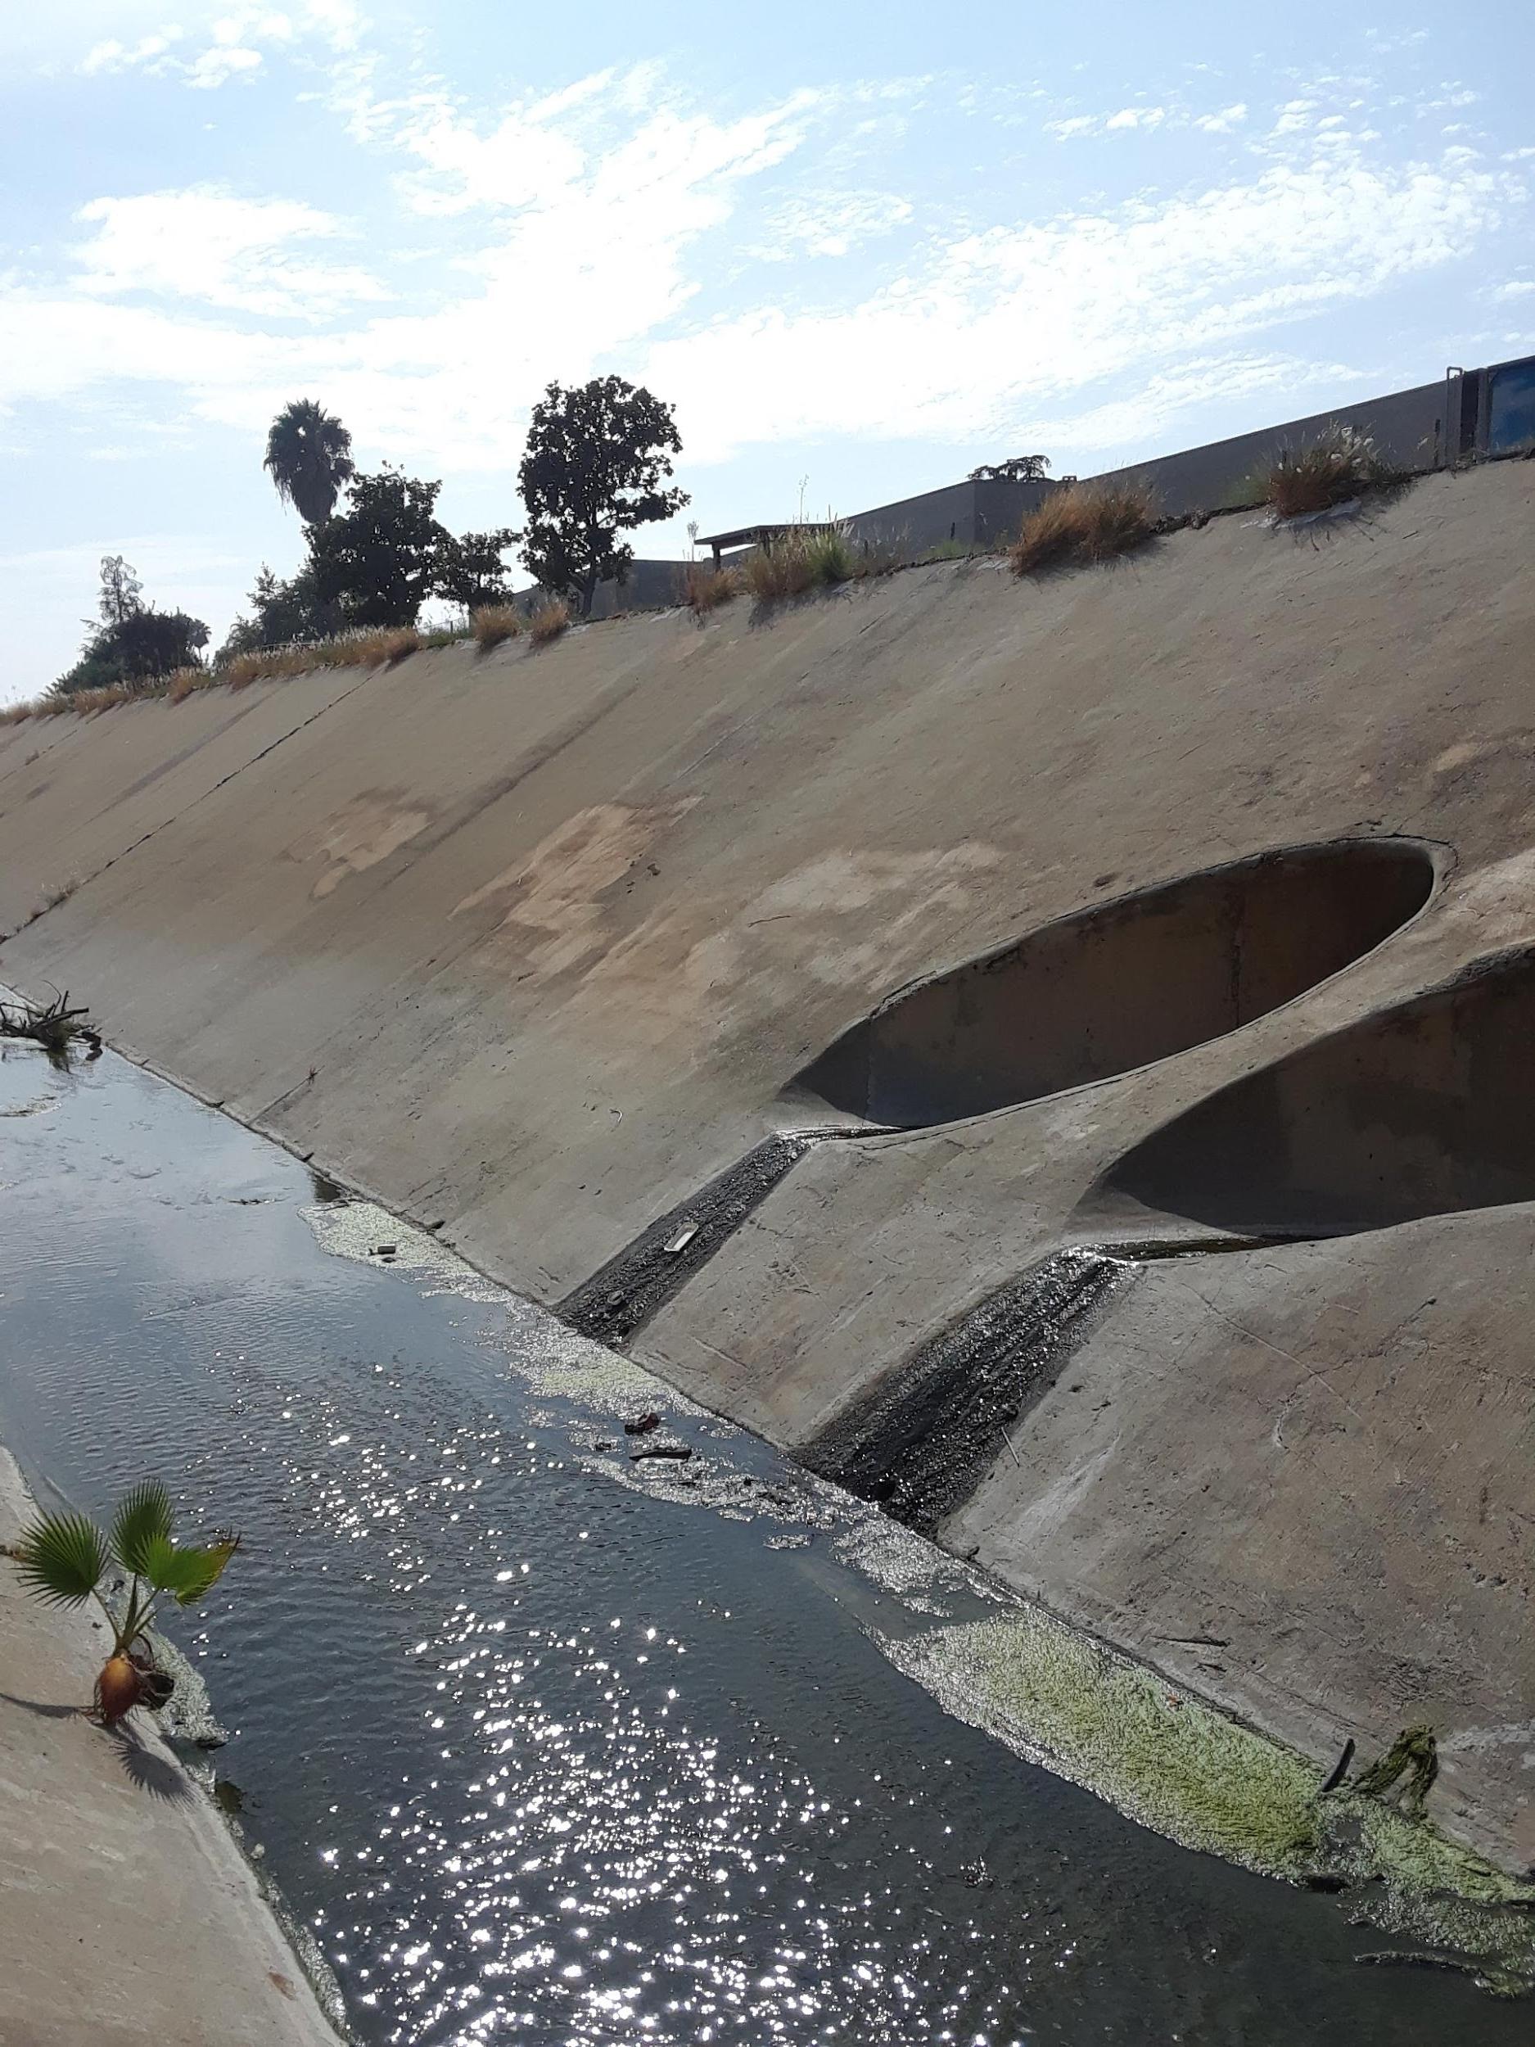
Escondido Creek downstream
City of Escondido
UPSTREAM of the creek
Escondido Creek upstream
@ Elfin Forest

Slide 17
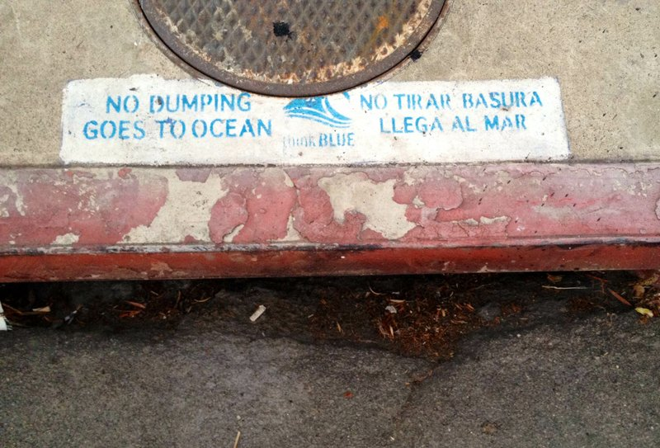
A flood channel holds water to prevent the impact of flooding.

Slide 18
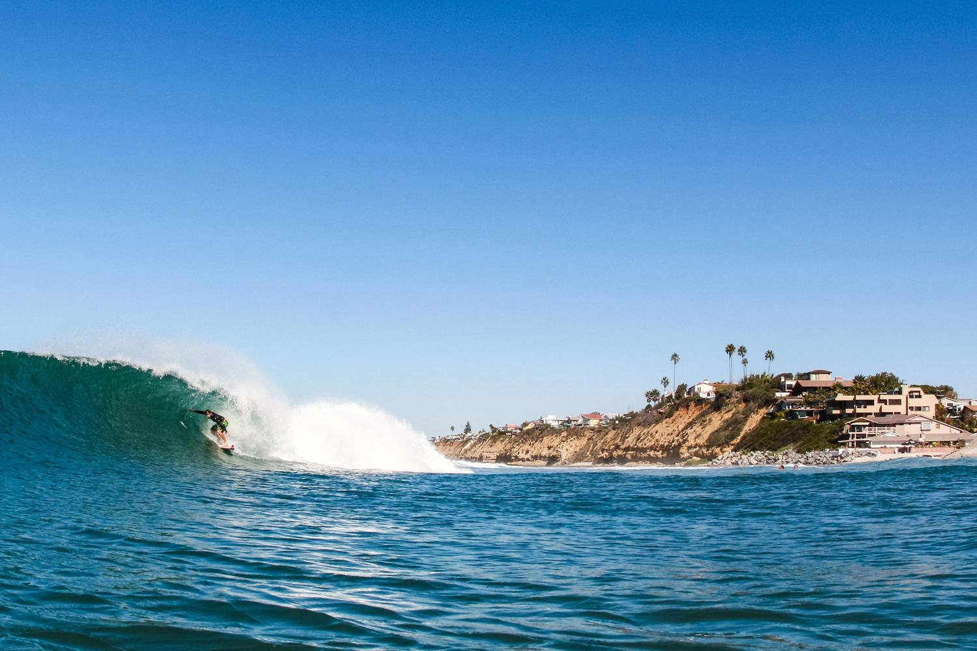
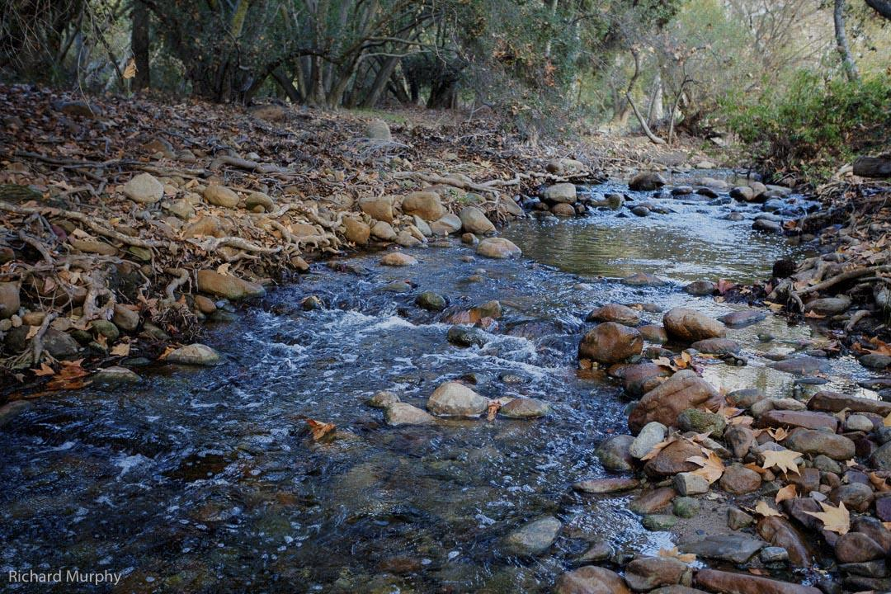
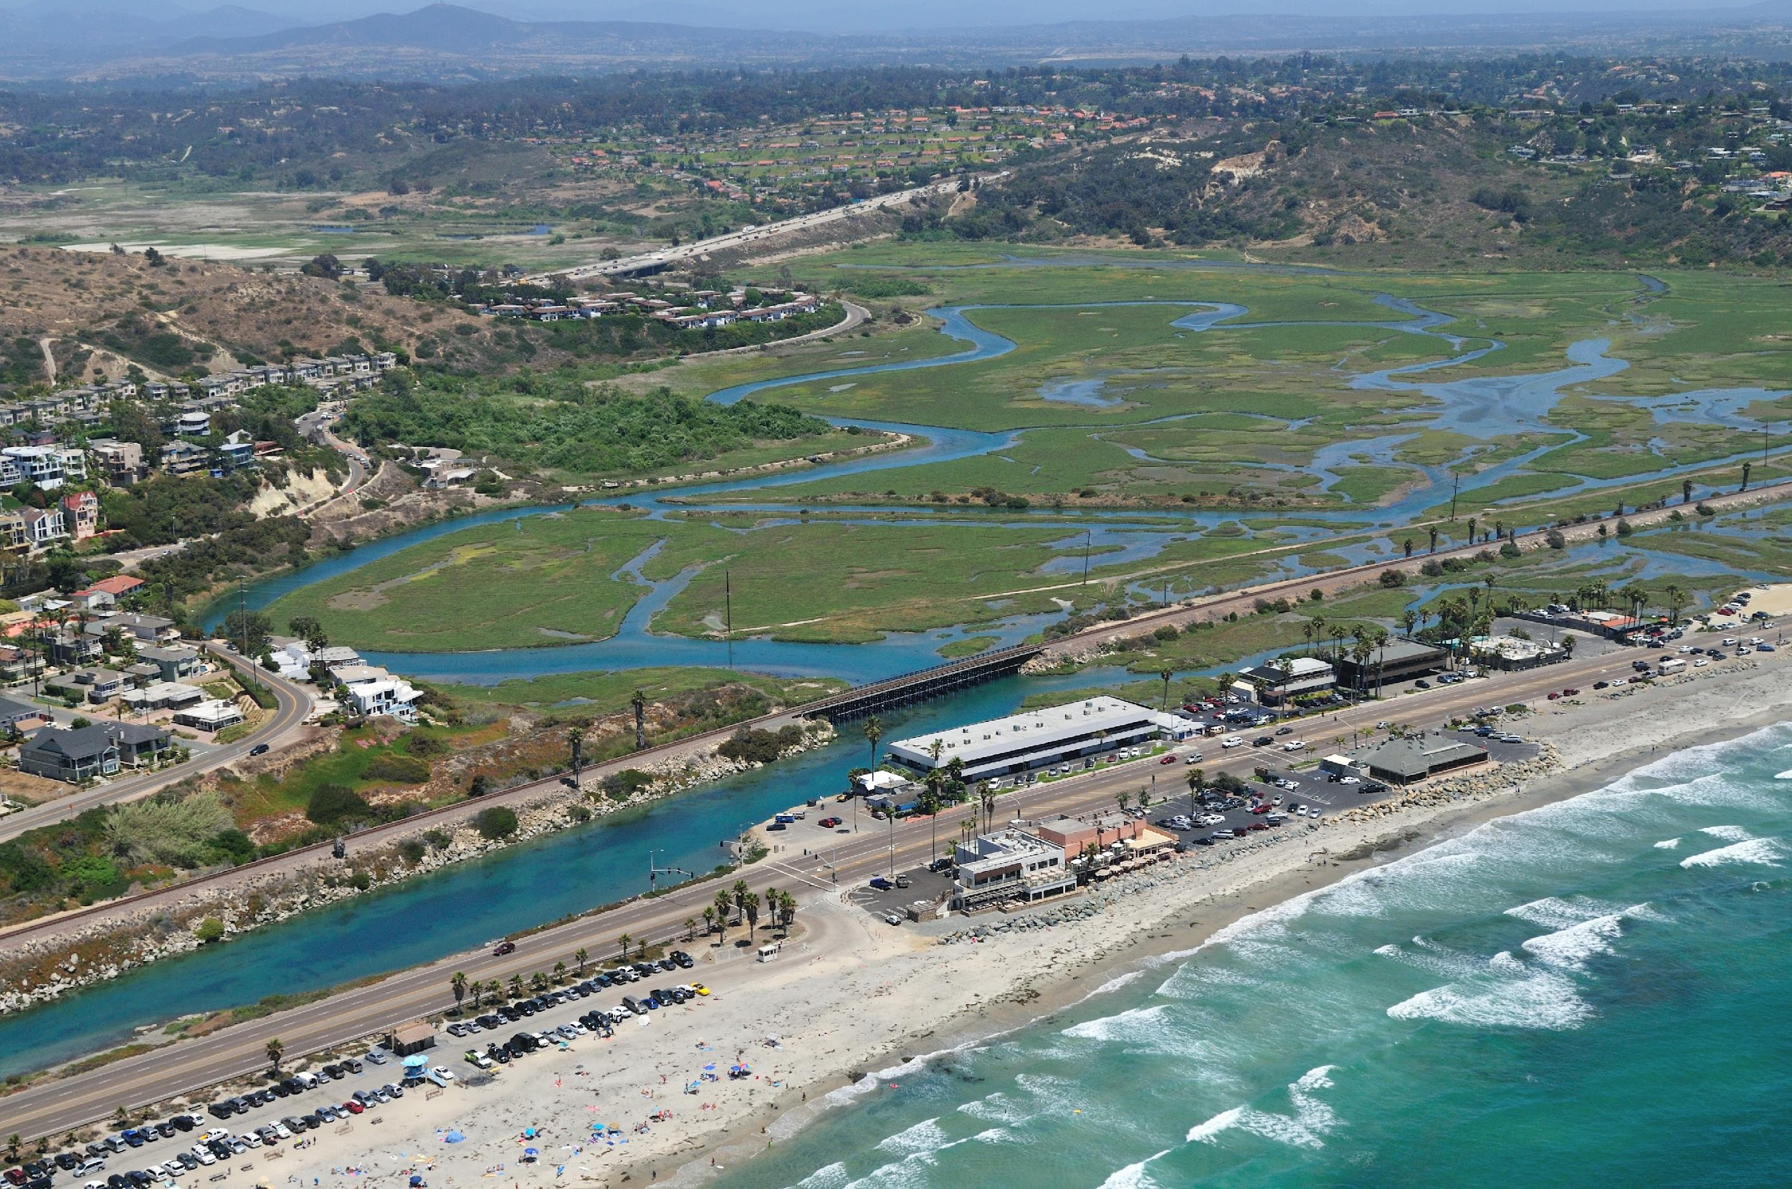
DOWNSTREAM of the creek
@ Elfin Forest
Ocean
San Elijo Lagoon
Escondido Creek downstream

Slide 19
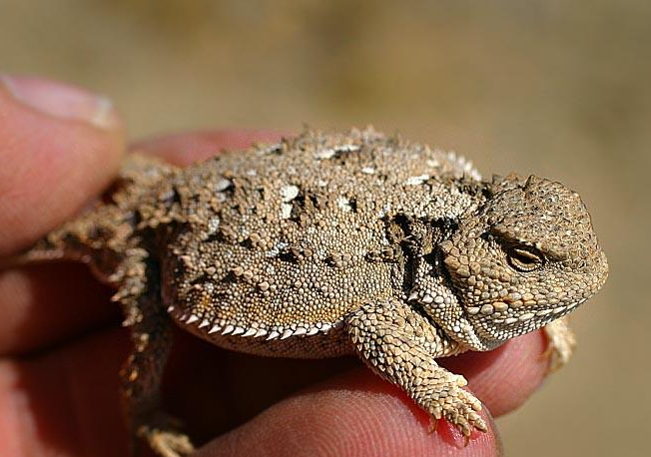
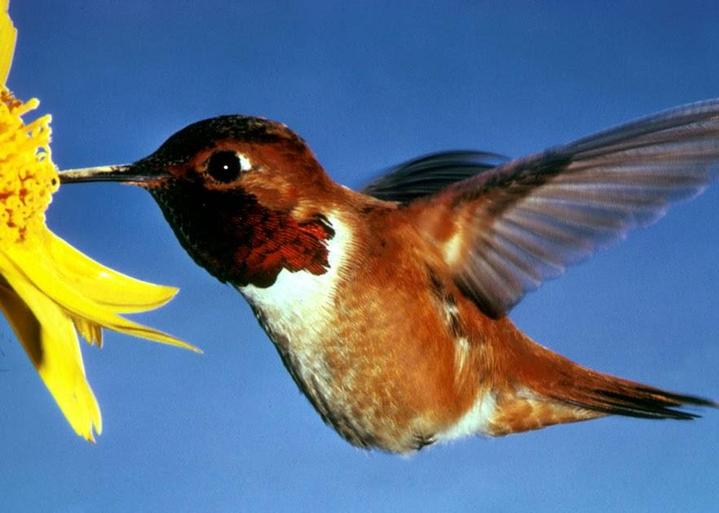
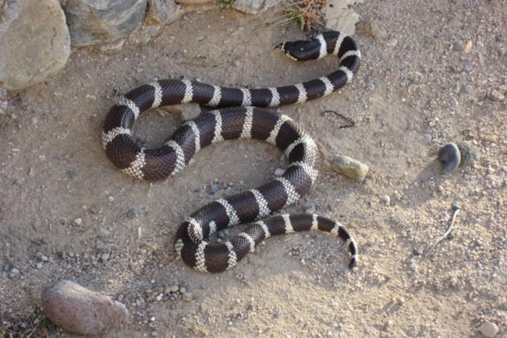
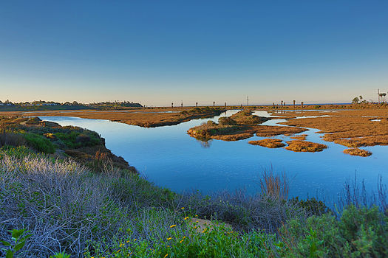
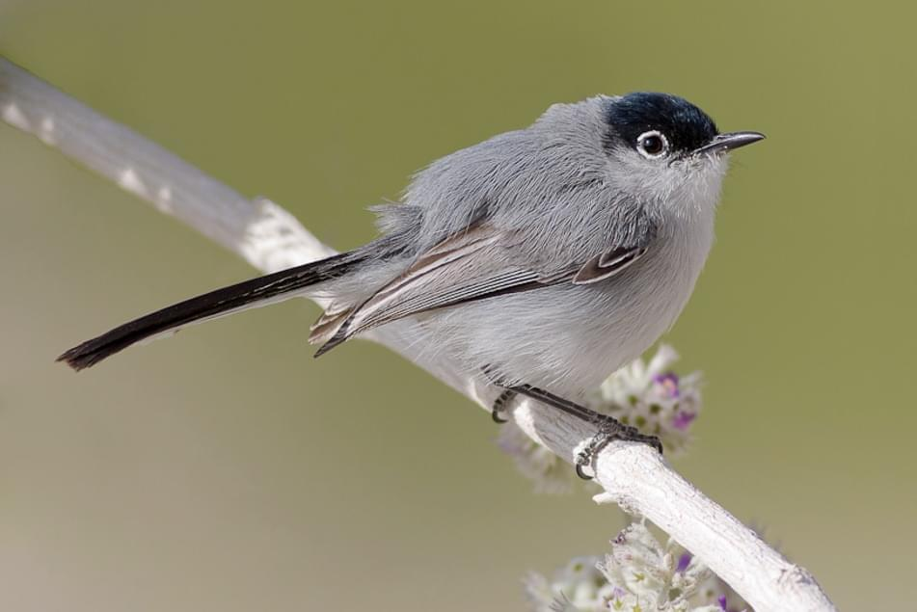
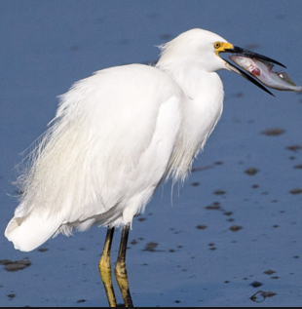
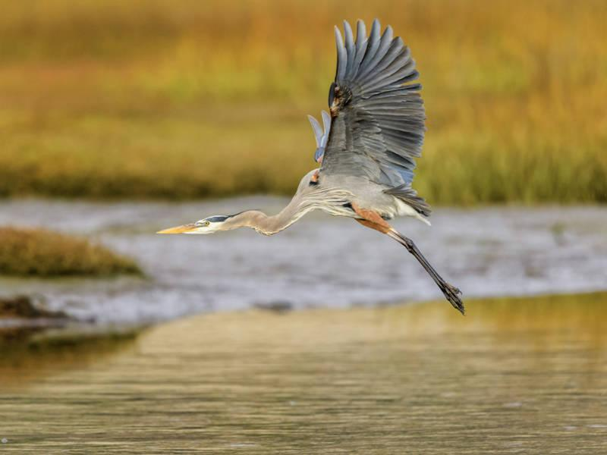
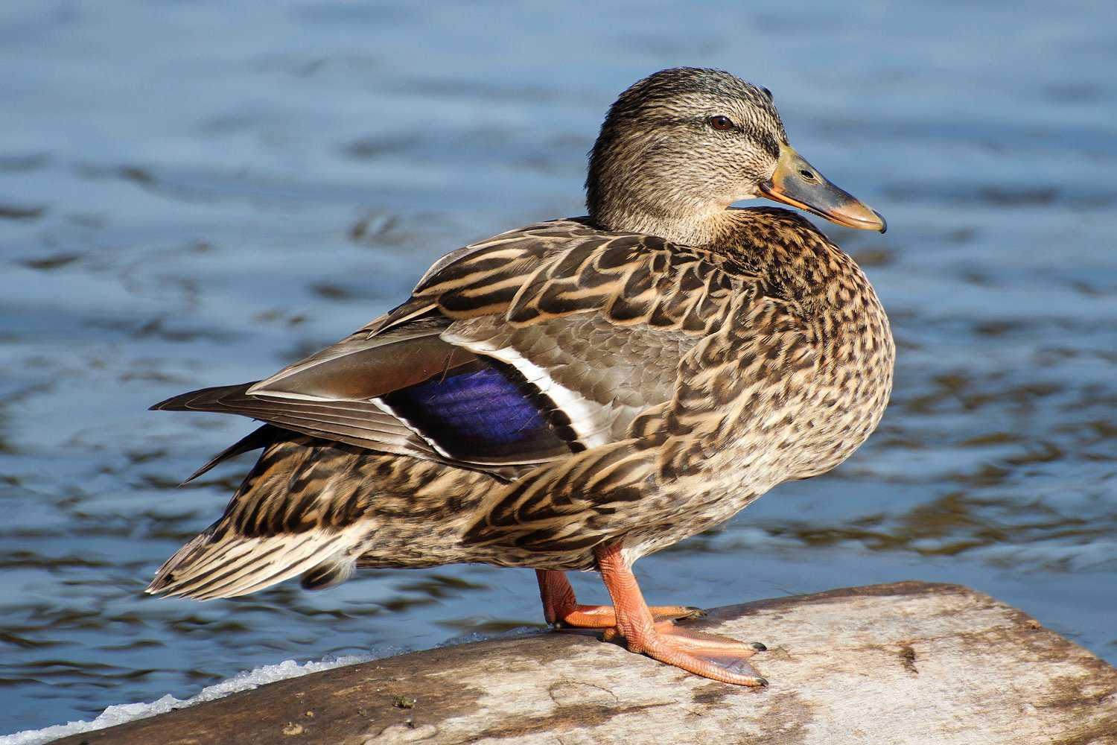
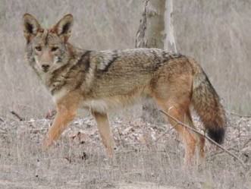
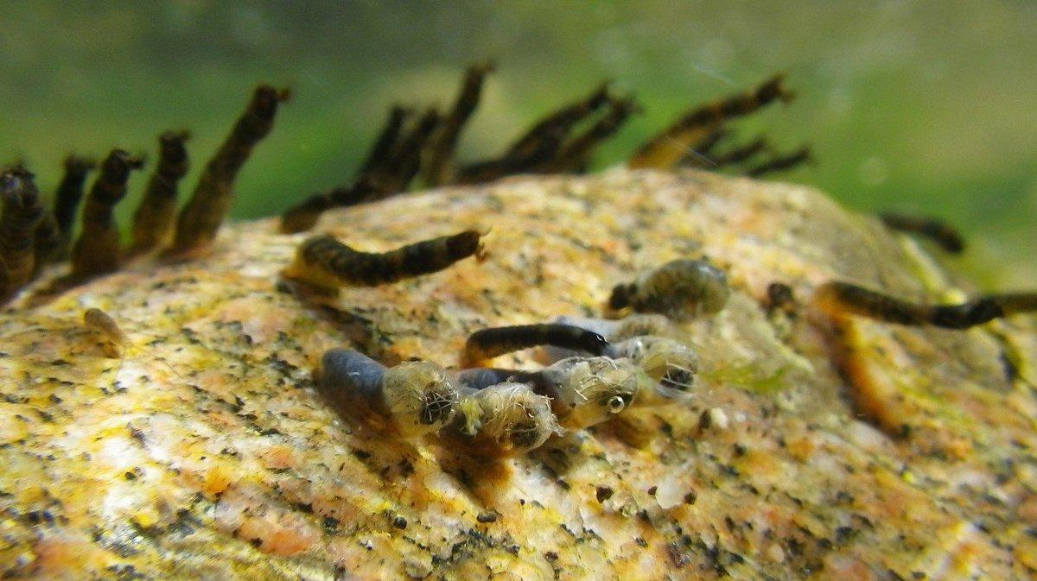
A watershed is a living ecosystem!
Notes:
let’s talk about the different ways living organisms use water

Slide 20
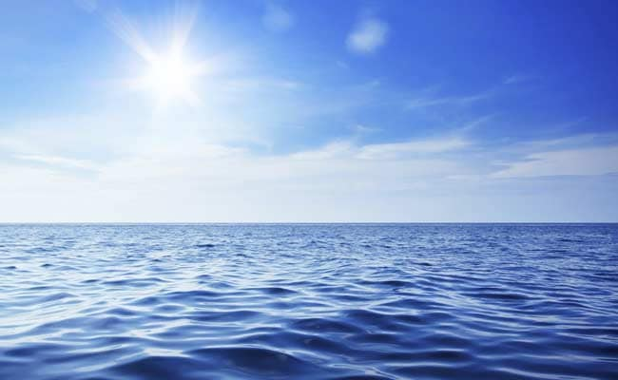
_________
What are your favorite ways to enjoy the ocean?

Slide 21
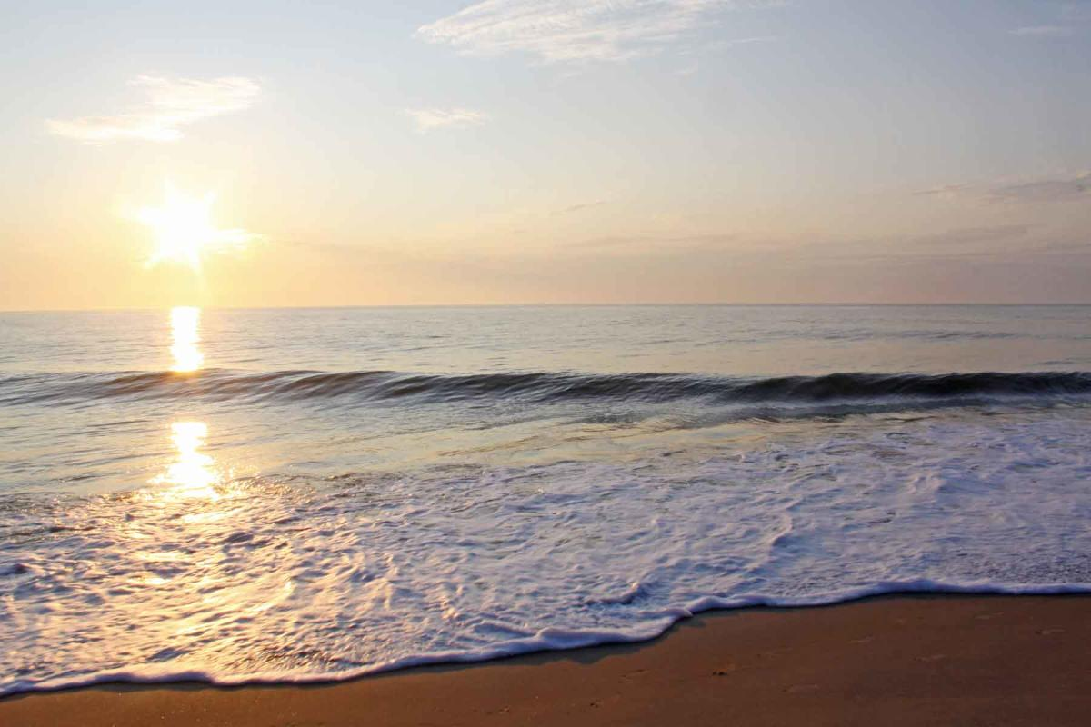
When I visit the beach I like to wonder...

Slide 22
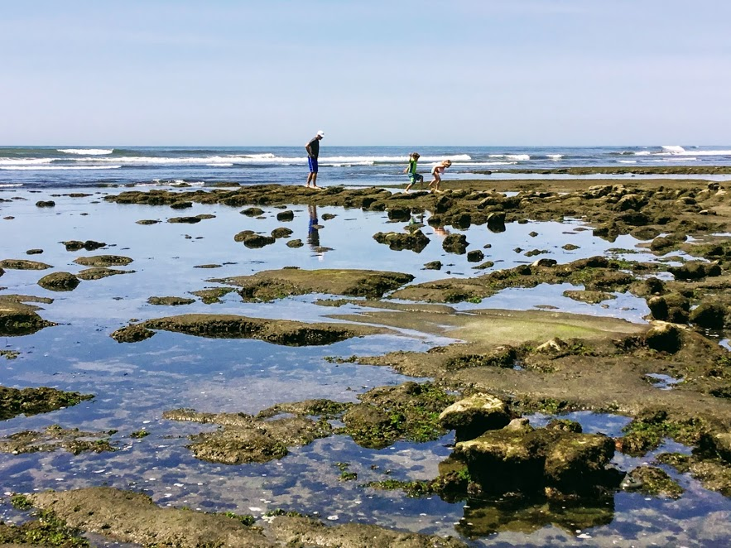
Tidepools
How animals in the Tidepools use water to survive.
How to respect the Tidepools when we visit.
Make a fun sea creature craft!

Slide 23
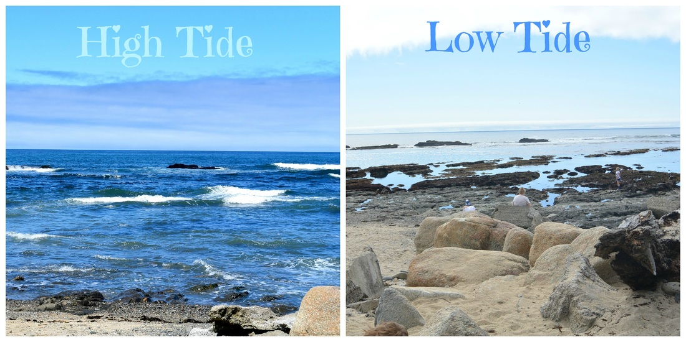

Slide 24
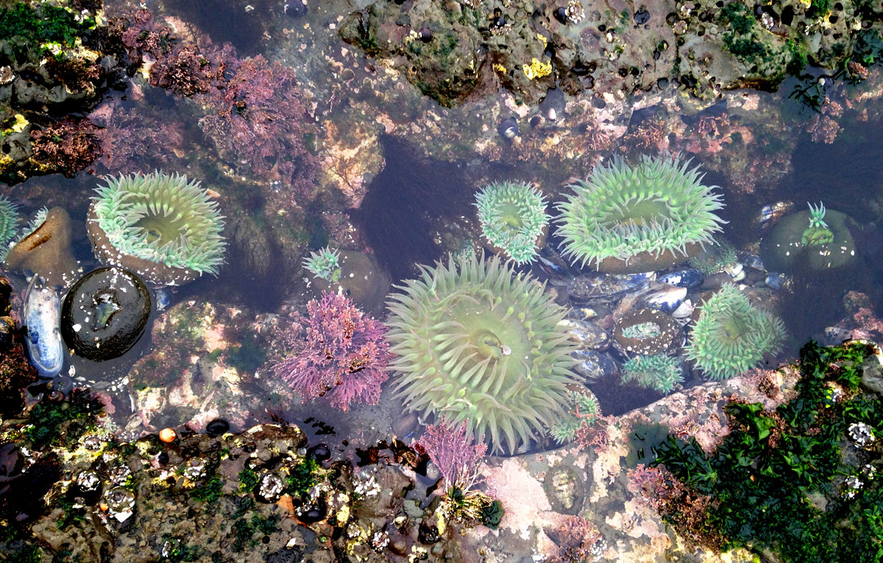
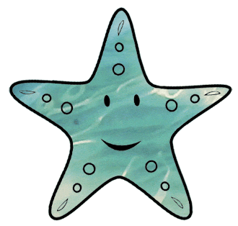
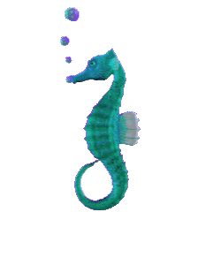
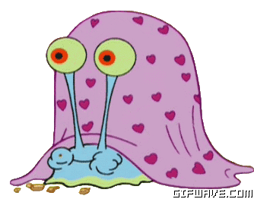

Slide 25
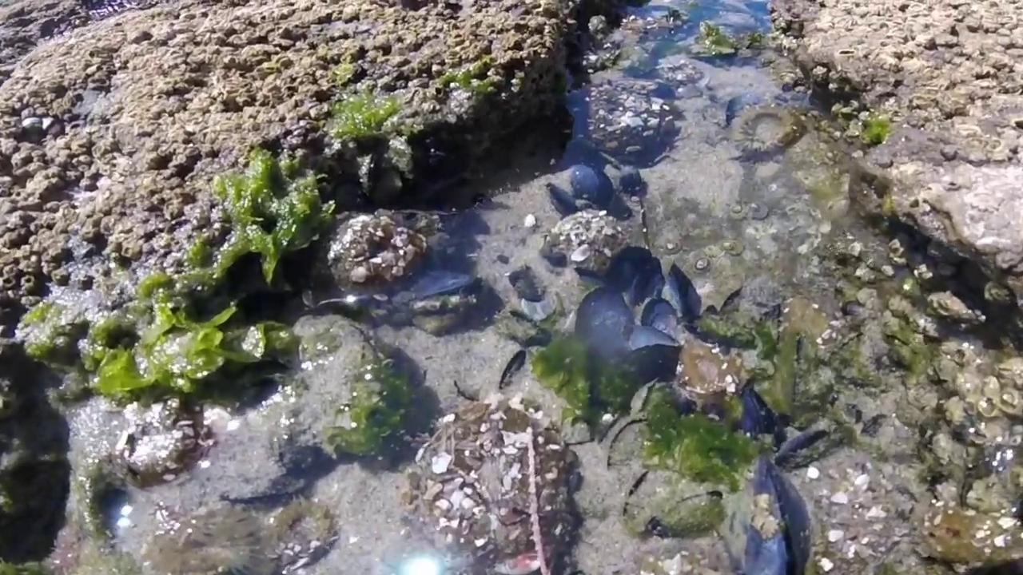

Slide 26
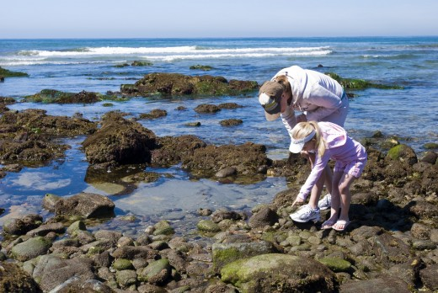
Have you ever visited the tidepools before?

Slide 27
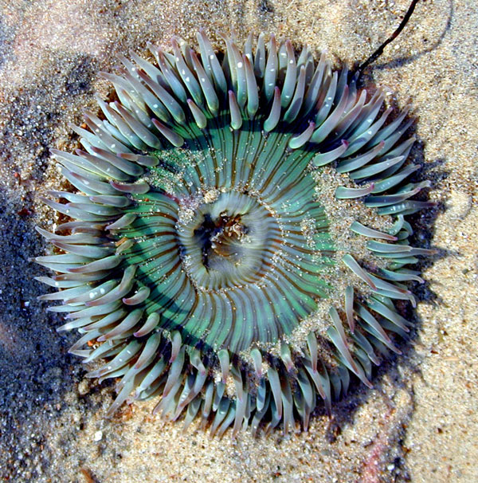
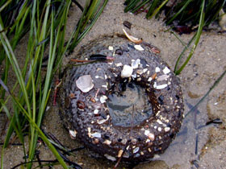
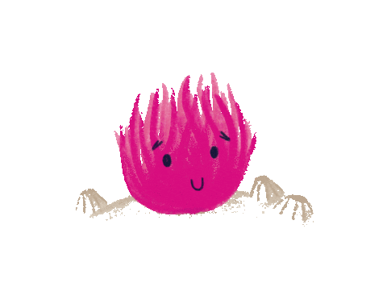
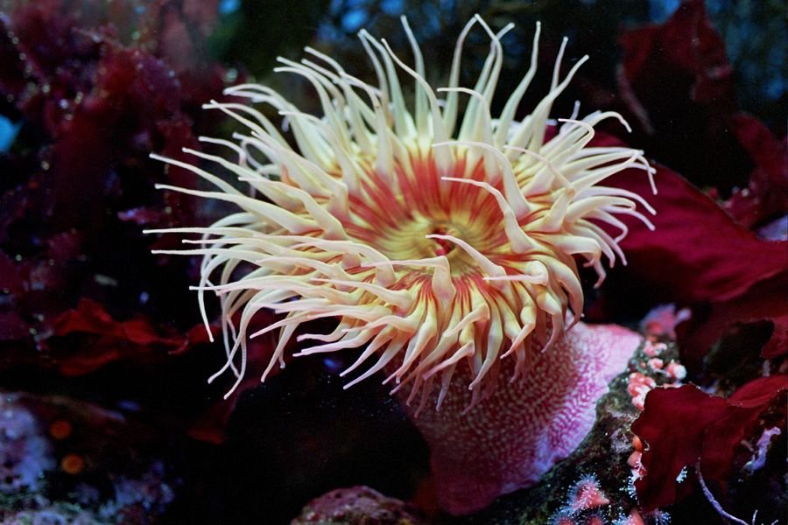
Sea Anemone

Slide 28
Let’s protect what we love!
Please Be a Respectful Tidepooler

Slide 30
Sea Anemone Craft
Materials:
-Colorful Paper
-Tape or Glue stick
-Scissors

